Slide 1
MU Physics Department ~1950

Slide 2
1954
Arthur G. Barkow

Slide 3
1954
Walter Kluck

Slide 4
1959
Friedrich Weber and Benjamin Oh

Slide 5
1959
Friedrich Weber, Gregory Kulas, Carol Squire

Slide 6
1959
Jim Sovey

Slide 7
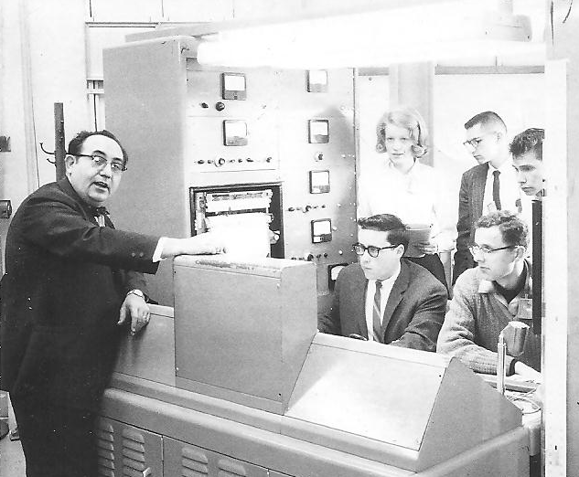

Slide 8
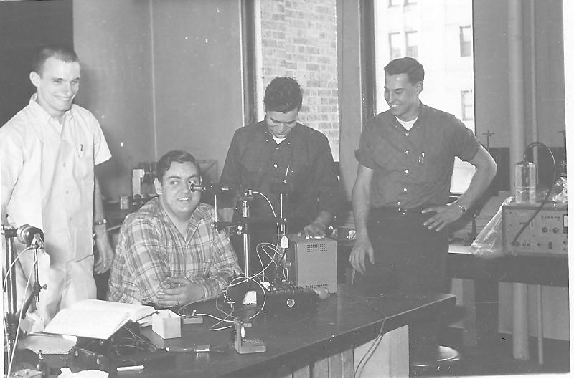
1962
Alan Toepfer, David Cutchin, Joseph Haertle, Peter Chard

Slide 9
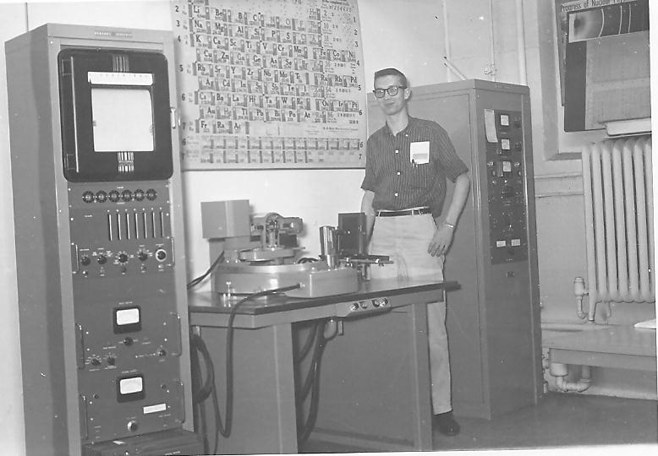
1962
Jim Stoffels

Slide 10
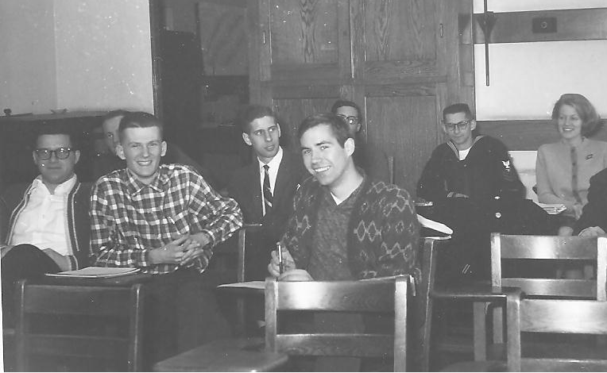
January 1965
Back Row: T. Michael O'Keefe, ?, David Haschka, SJ., Joseph Vargo, Catherine Brust, Front Row: Thomas Danninger, Robert Keller, Donald Wolkerstorfer

Slide 11
1964
Darrell Diem, James Rich, James Kolata, Peter Ryge

Slide 12
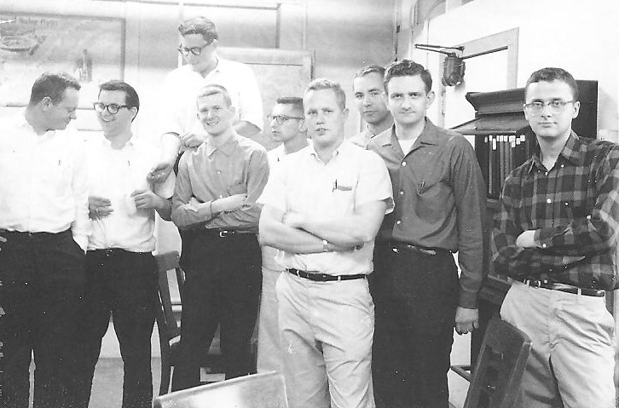
1965
Phys 121 X-Ray Lab

Slide 13
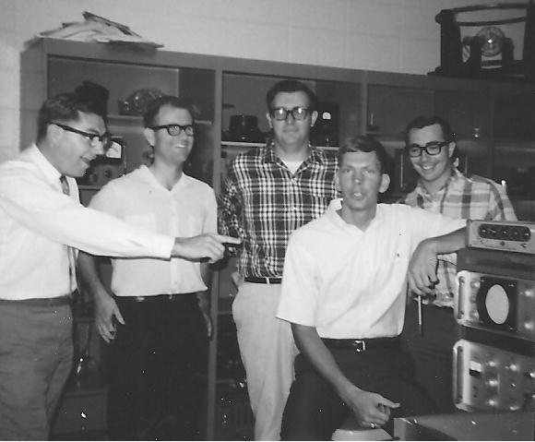
1968

Slide 14
1968

Slide 15
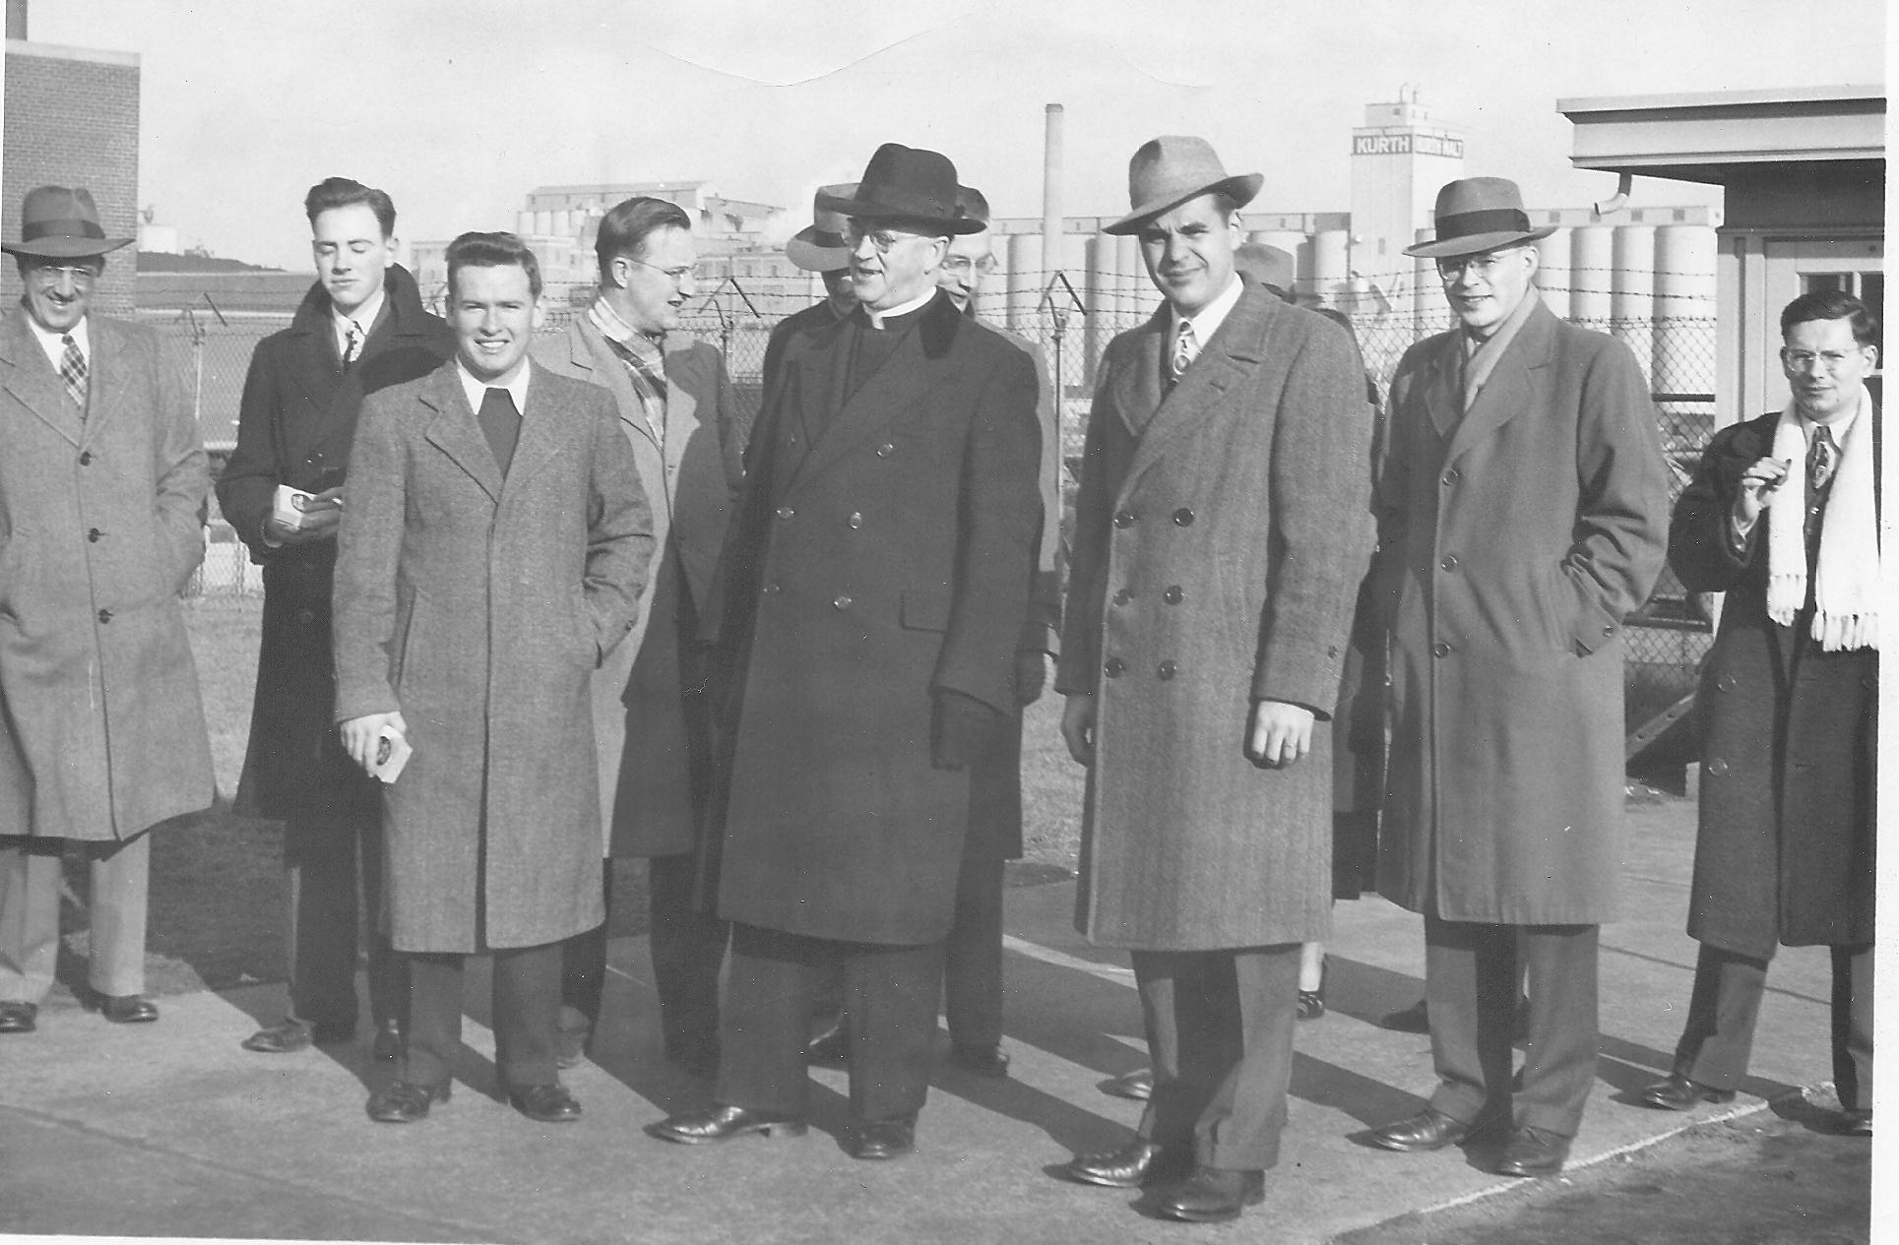
~1970

Slide 16
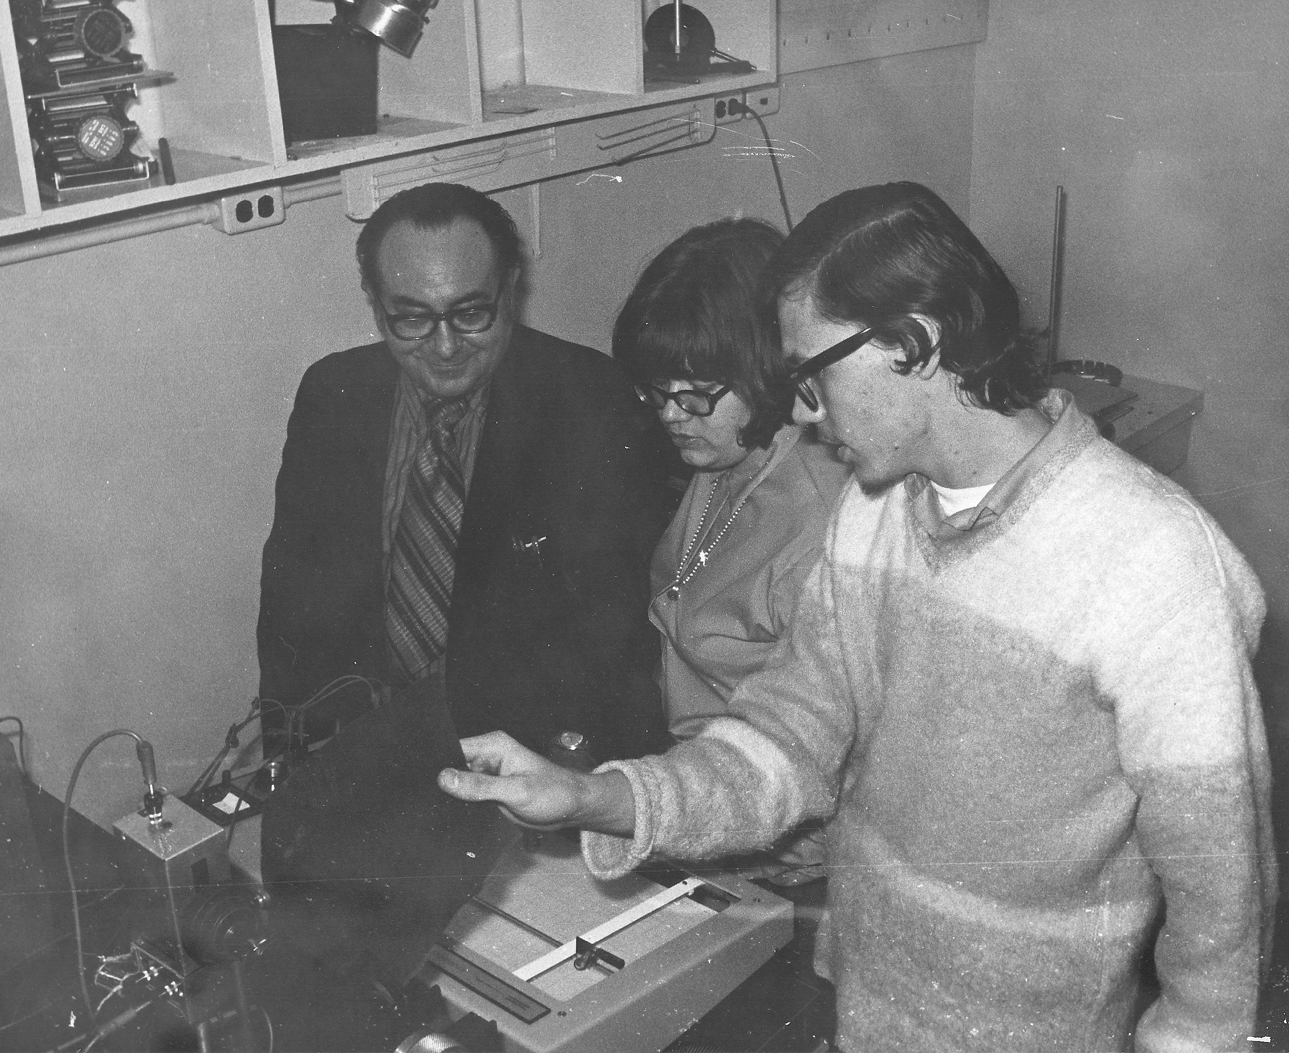
Frank Karioris, Sue Ratkowski, Chris James

Slide 17
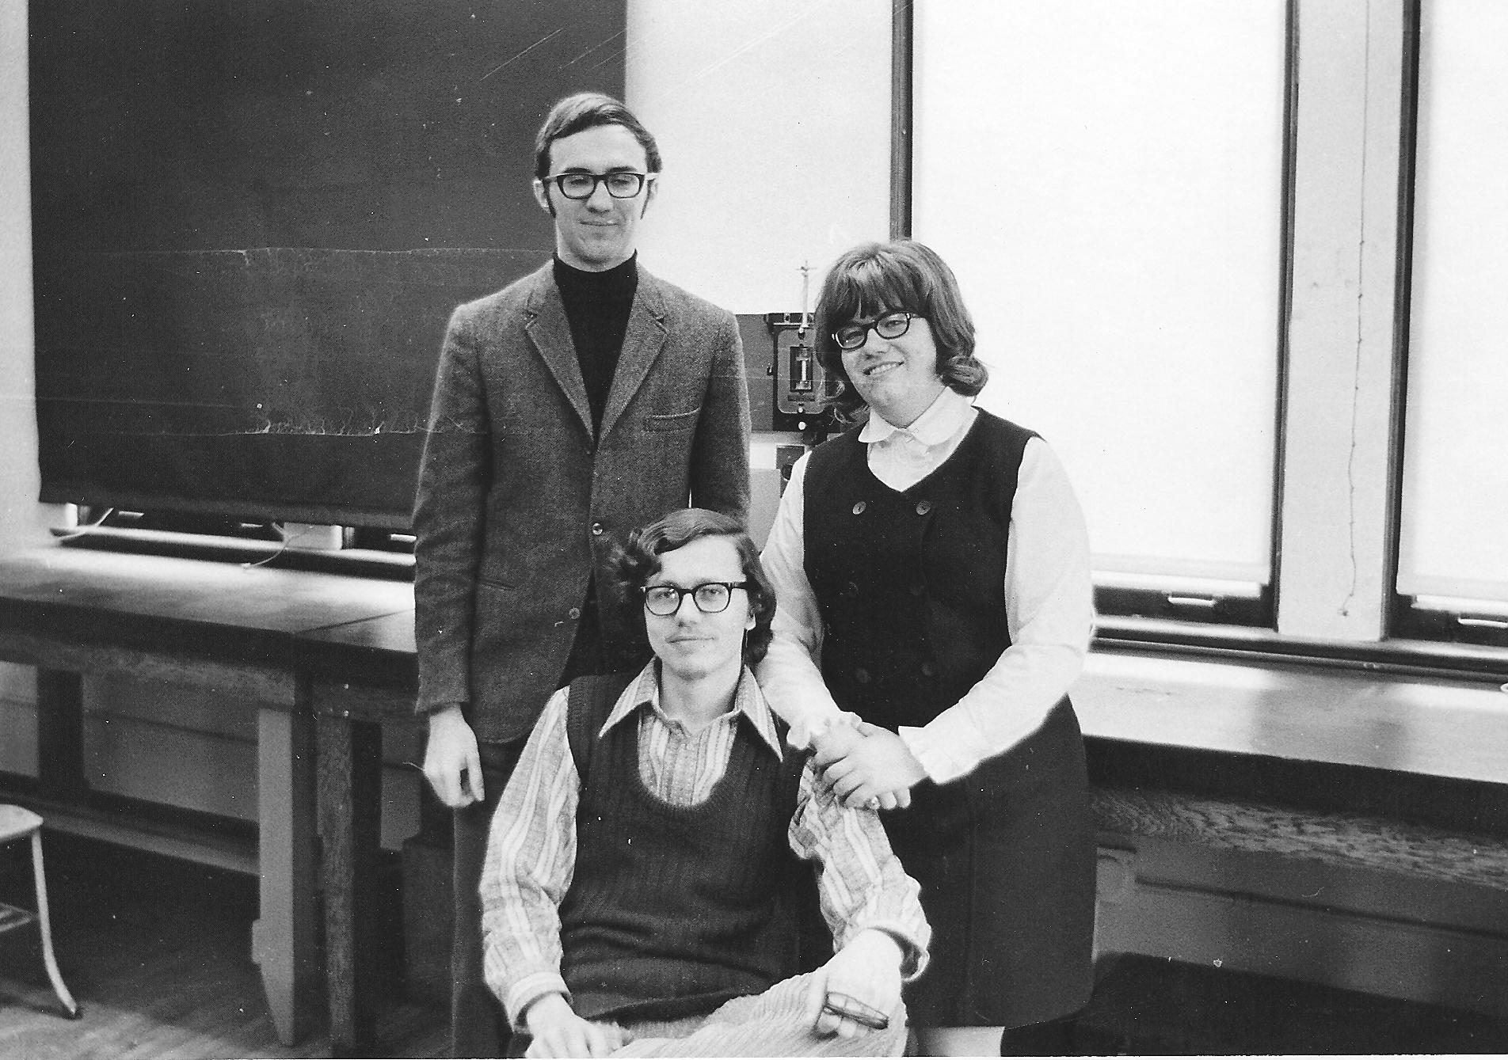
1972
James Pendzick, Chris James, Sue Ratkowski

Slide 18
1972
Sue Ratkowski, Chris James, James Pendzick

Slide 19
James Pendzick

Slide 20
Chris James

Slide 21
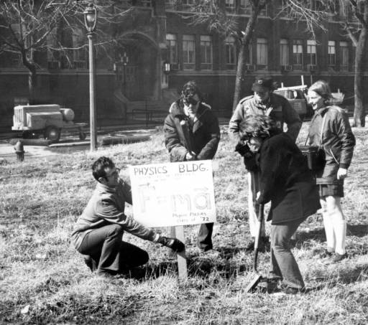
Physics Students at groundbreaking 1972

Slide 22
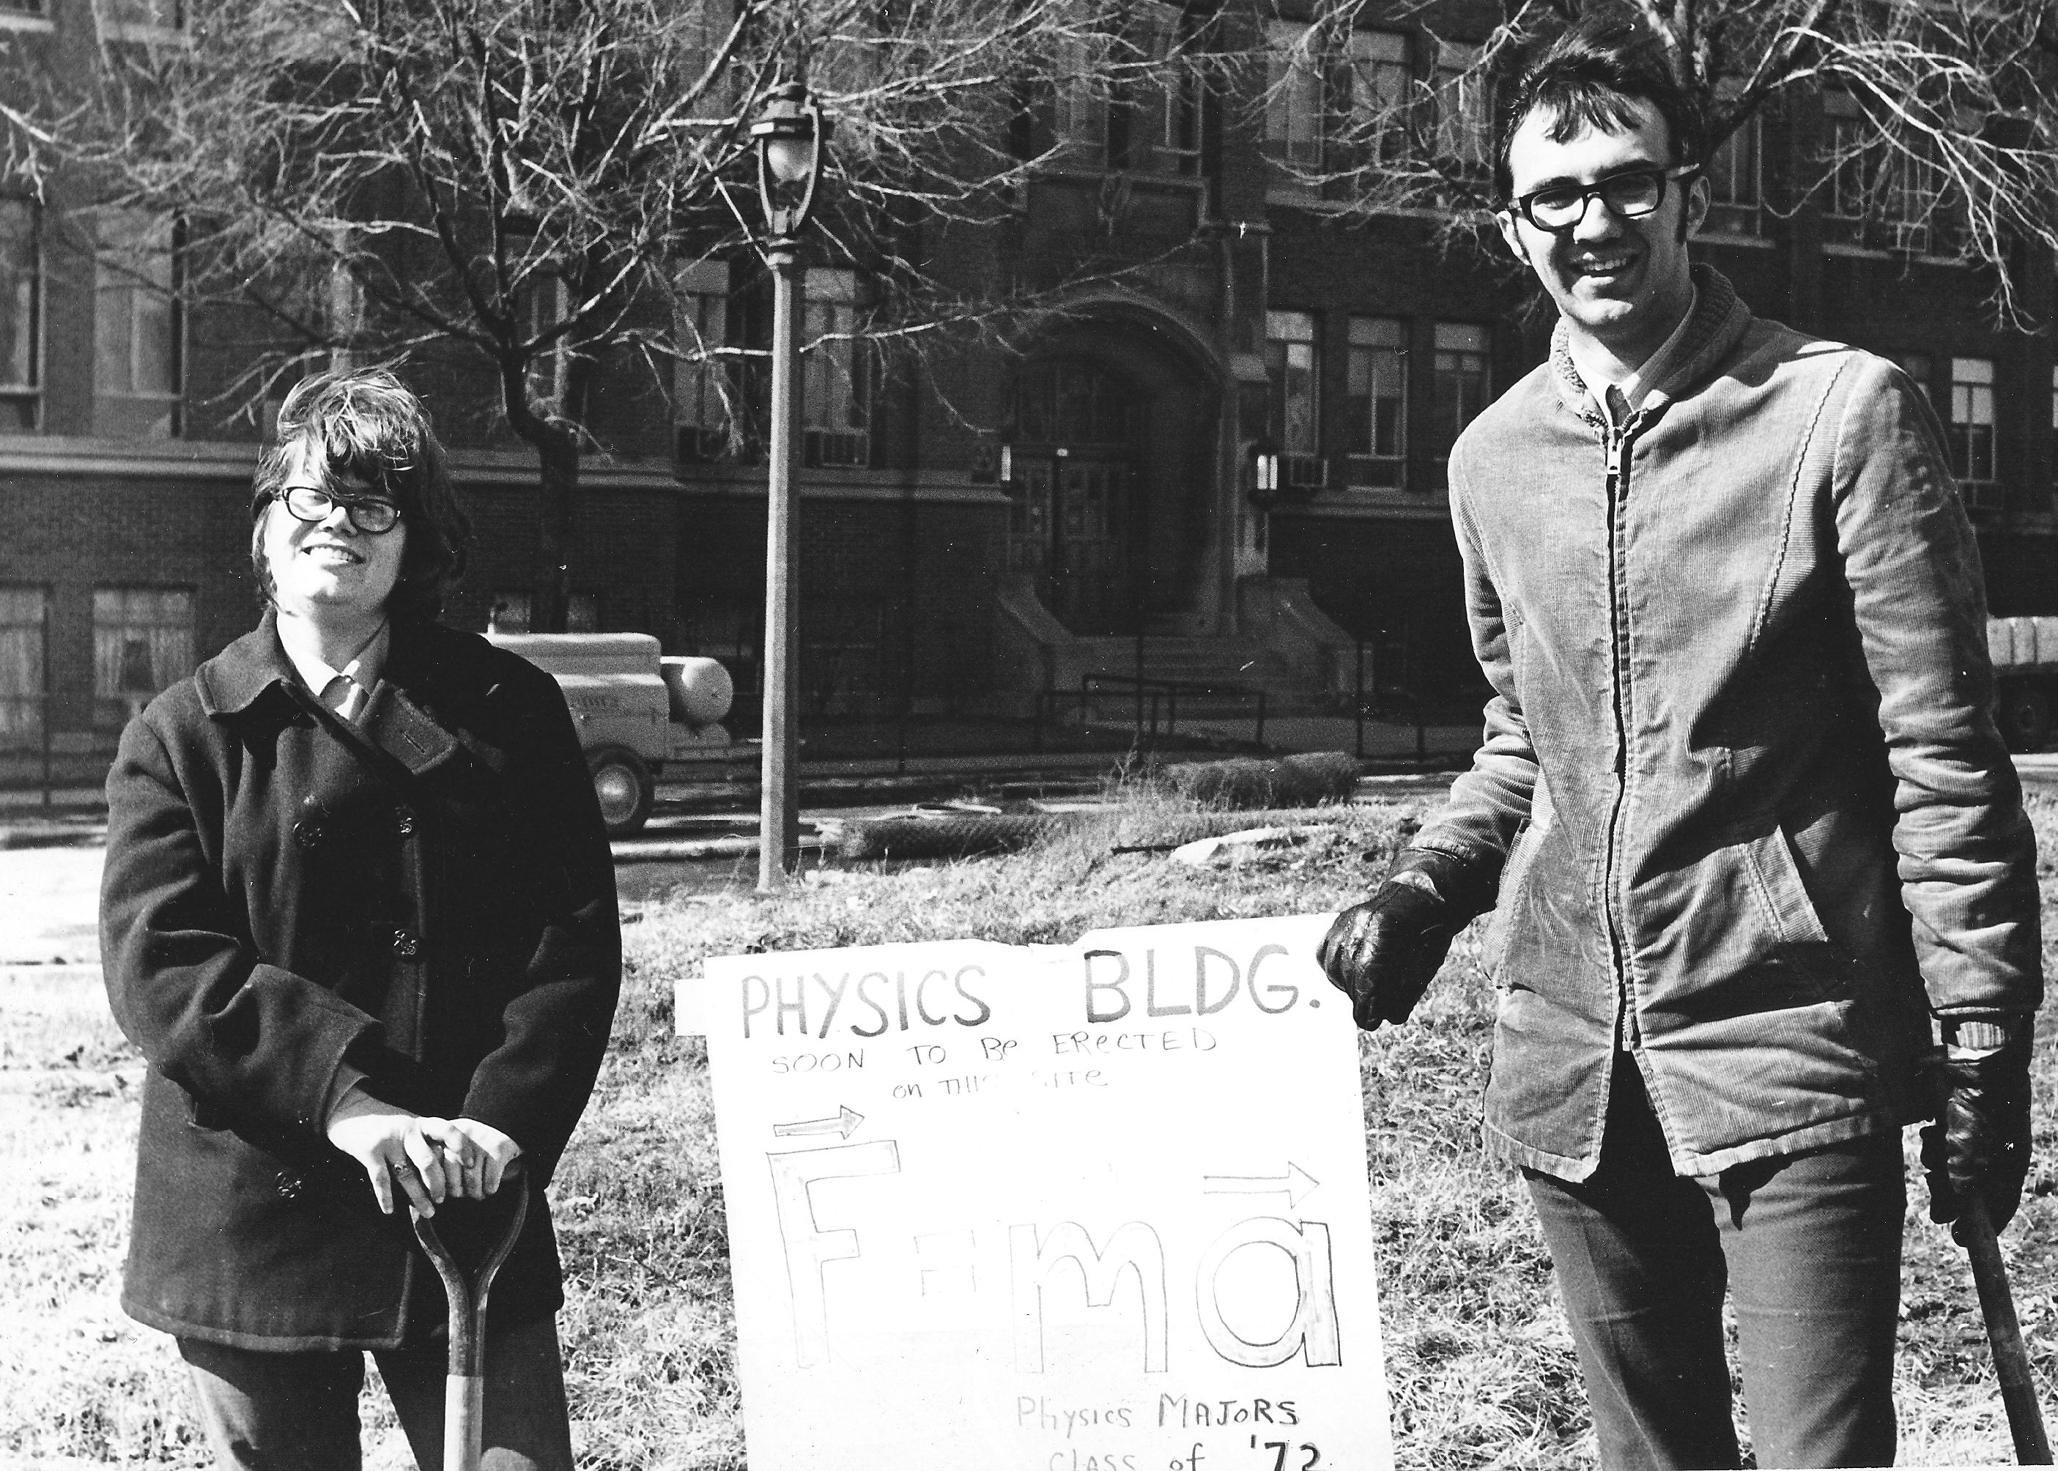
Sue Ratkowski and James Pendzick

Slide 23
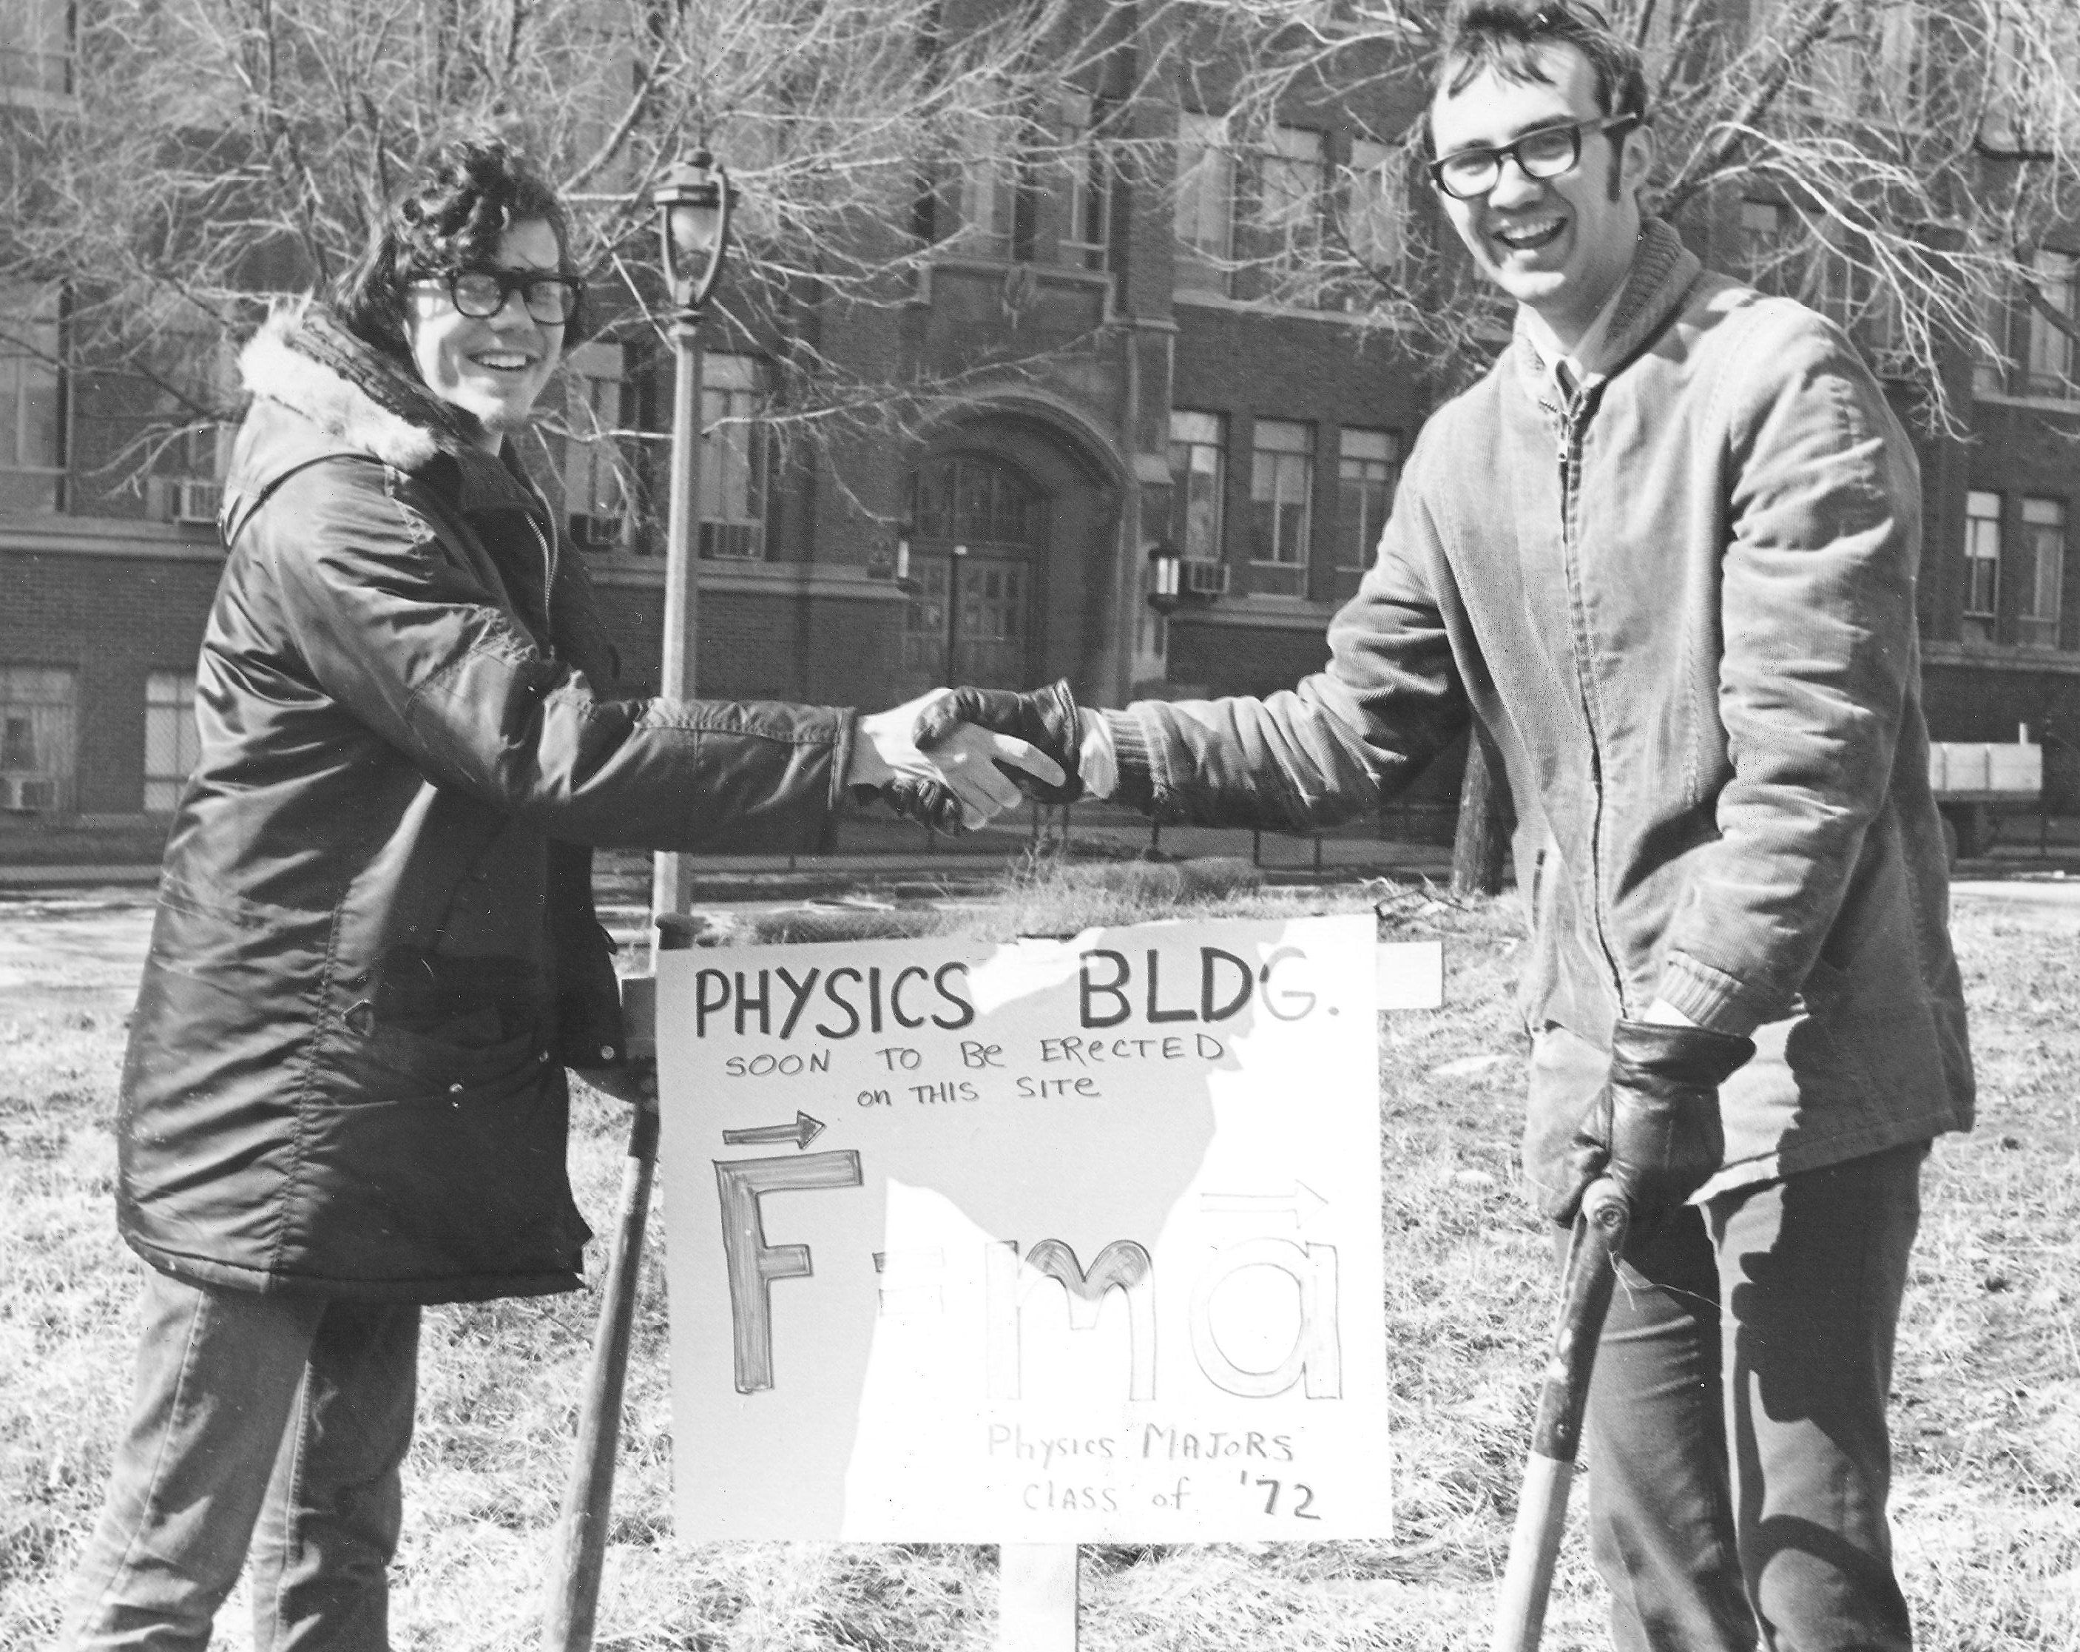
Chris James and James Pendzick

Slide 24
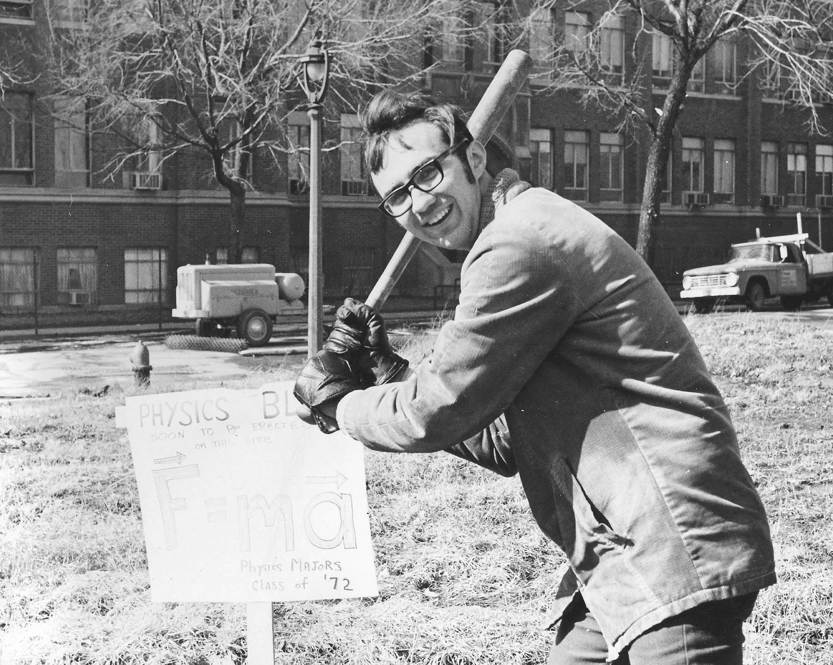
James Pendzick

Slide 25
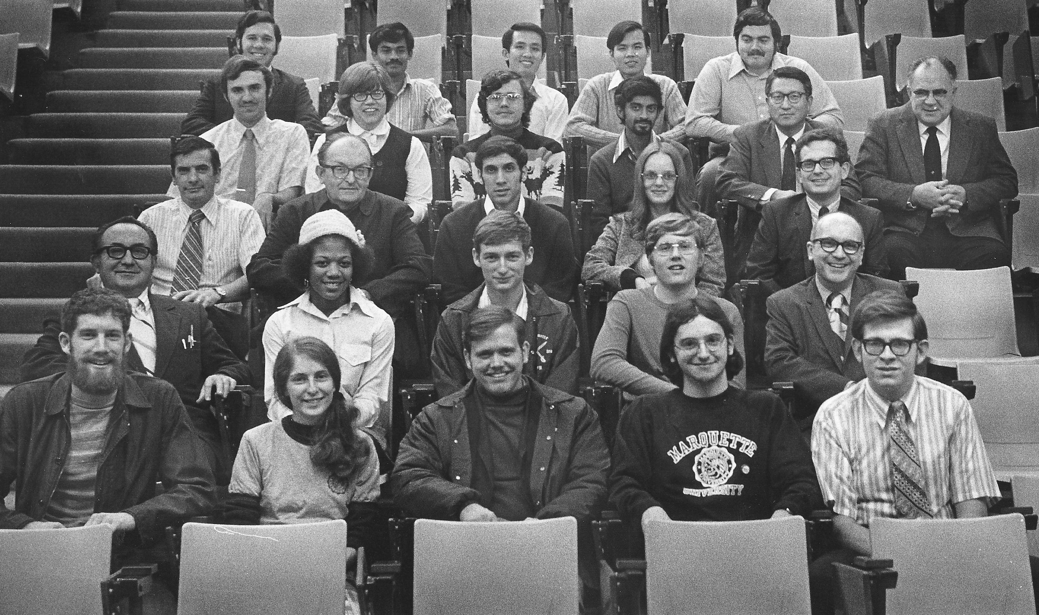
Sue Ratkowski
Gary Essmann
Physics Department
October 1972

Slide 26
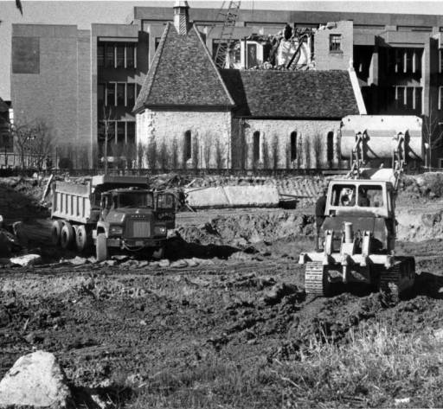
1972

Slide 27
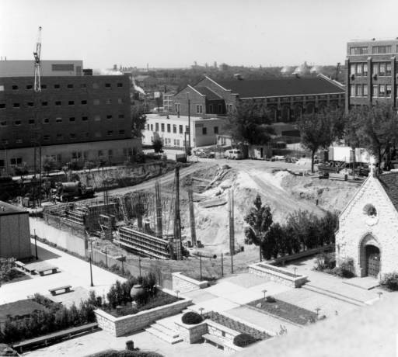

Slide 28
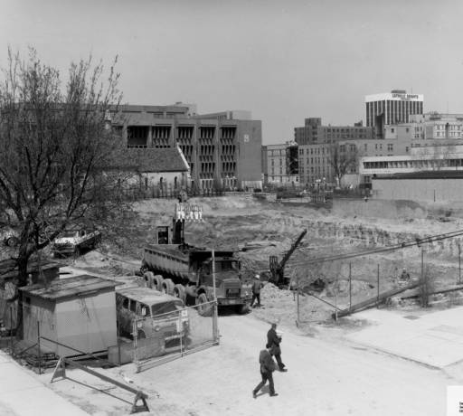

Slide 29
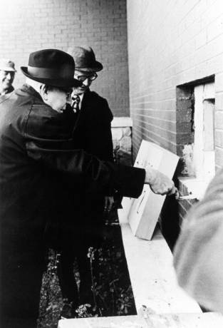
1973
Edward J. O’Donnell, S. J.
at cornerstone ceremony

Slide 30
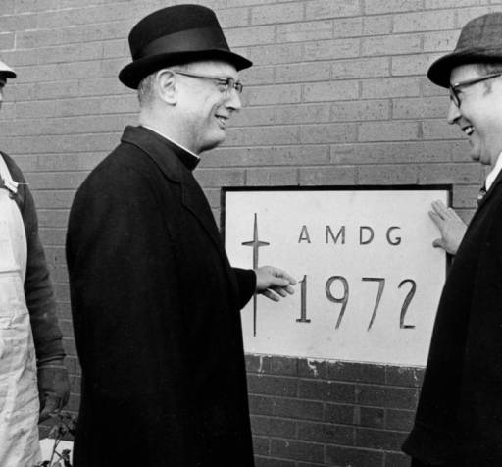
John P. Raynor, S.J., and Ralph Schulz
1972

Slide 31
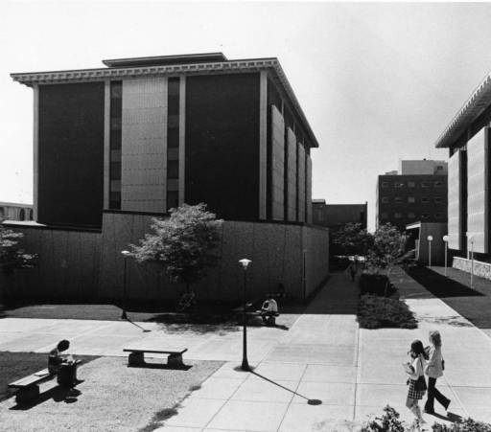

Slide 32
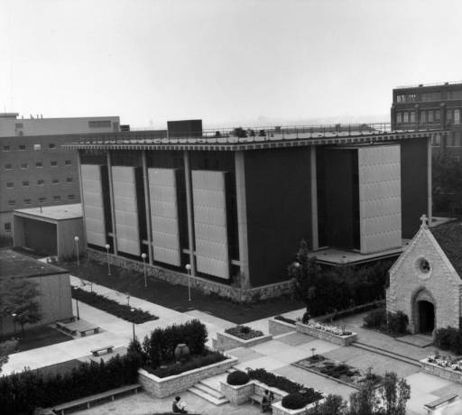
1973

Slide 33
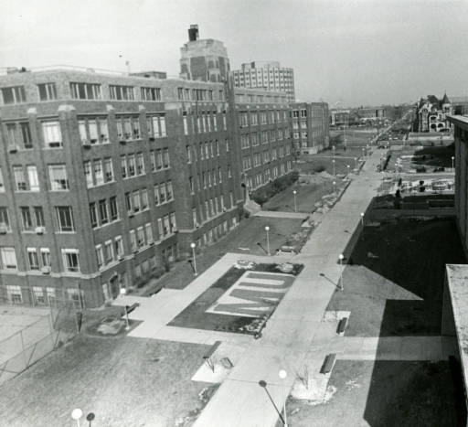

Slide 34
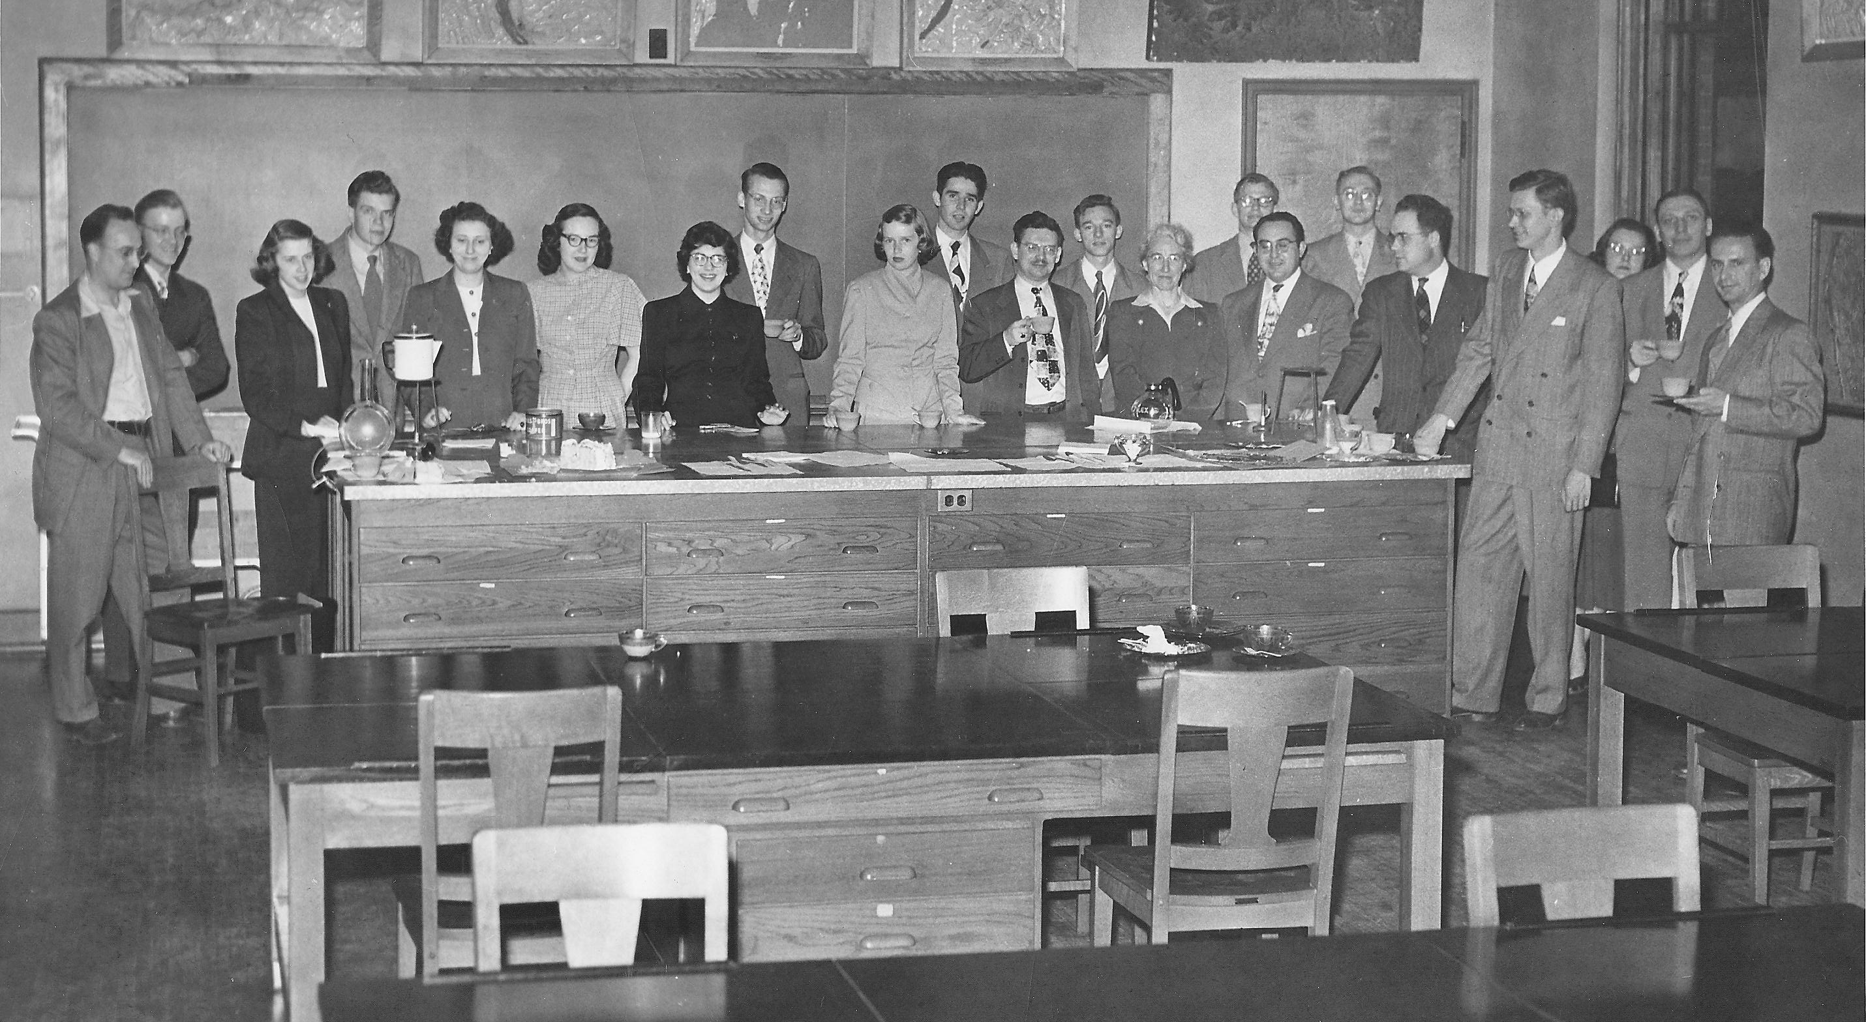
MU Physics Department ~1970

Slide 35
Robert Hugo, Budd Brown,
Sue Ratkowski
1973

Slide 36
Robert Hugo, Frank Karioris, Budd Brown
1973

Slide 37
Andy Kluka, George Ridgeway
1973

Slide 38
Debra Schwacher
Stephen Jarvis
1973

Slide 39
Frank Karioris, Budd Brown, Robert Hugo,
1973

Slide 40
Mark Kimball, Ramsey Clark
1973

Slide 41
Clarine Magedanz, Thomas Keuch 1975

Slide 42
Debra Schwacher 1975

Slide 43
George Ridgeway, Stephen Jarvis 1975

Slide 44
George Lochbraum, Mark Kimball, Clarine Magedanz, Theodore Leeson, Ramsey Clark
1975

Slide 45
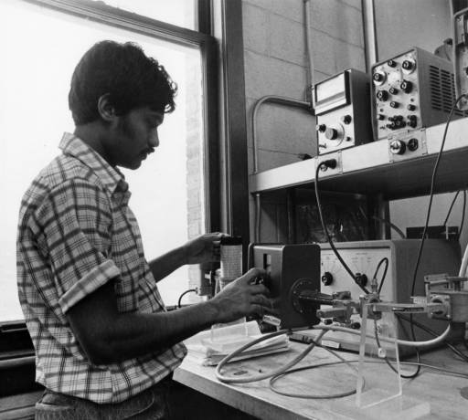
1975

Slide 46
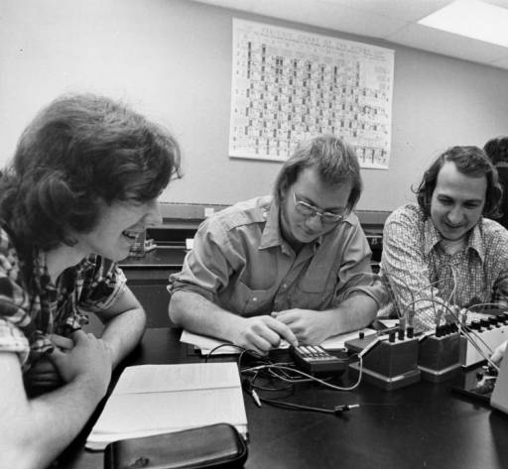
1975

Slide 47
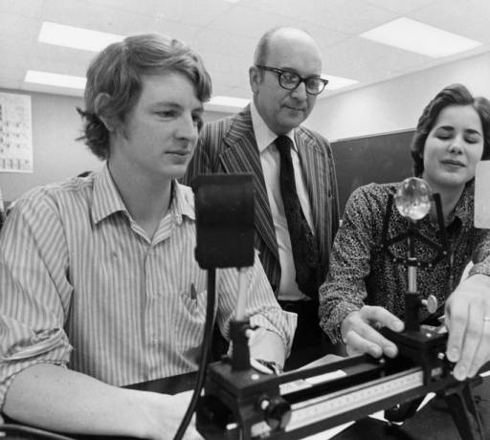
1975

Slide 48
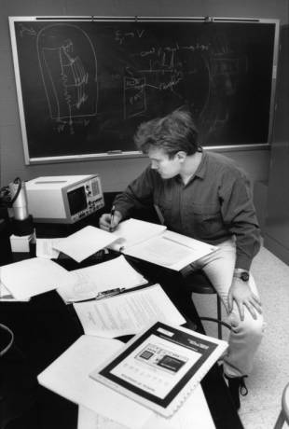

Slide 49
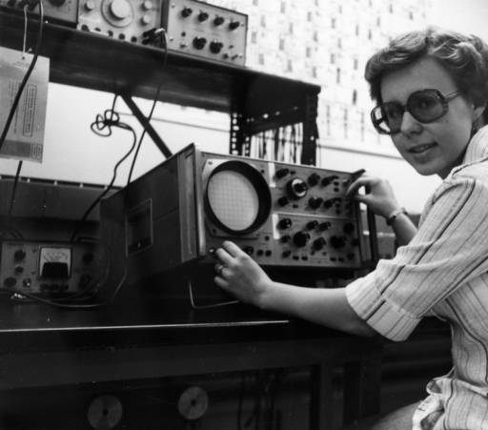
1976

Slide 50
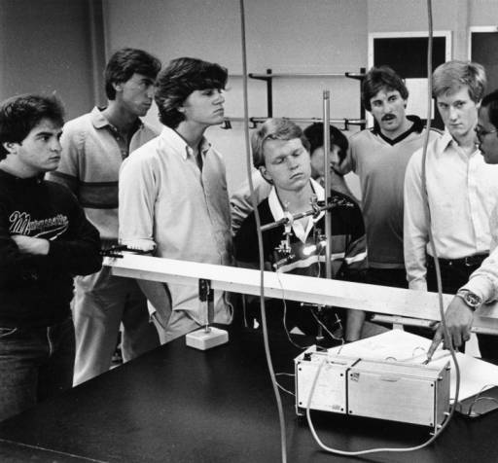
1984

Slide 51
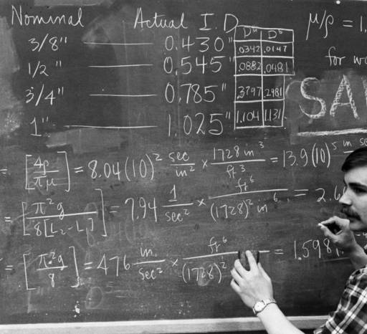

Slide 52
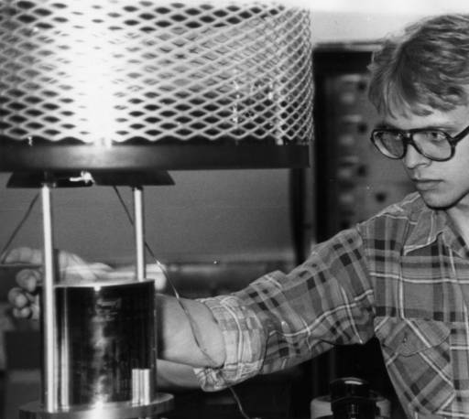

Slide 53
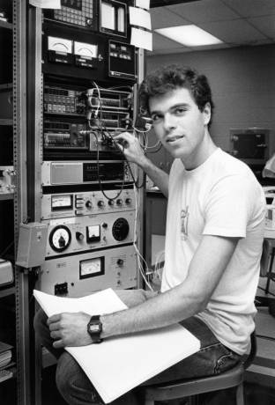

Slide 54
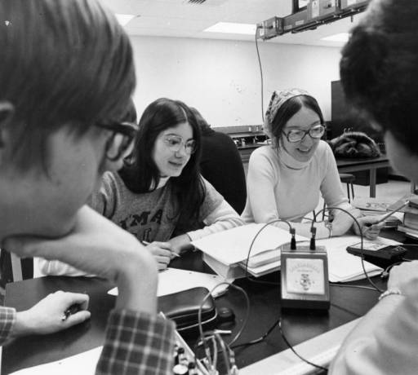

Slide 55
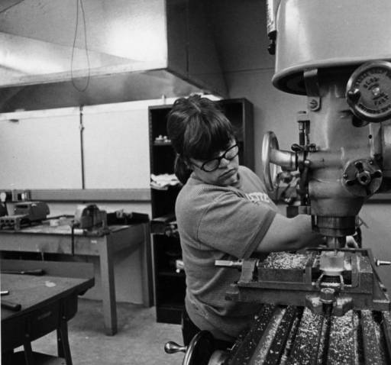

Slide 56
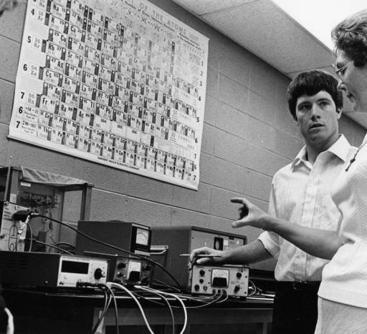

Slide 57
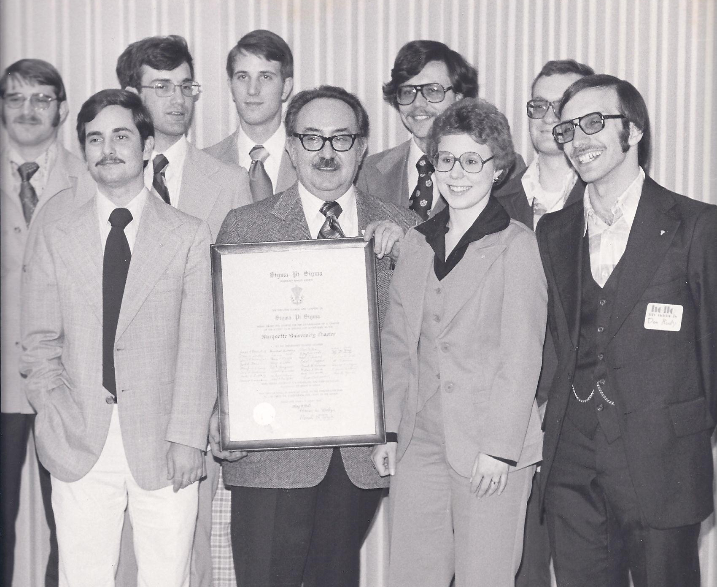
Paul Lett
SPS Chapter
April 7, 1978
Back Row: Keith Trischan, Michael Cherney, Paul Lett, Chris James, Cliff Kelley
Front Row: Norm LaFond, Frank G. Karioris, Andrea Spruck, Donald Rudy

Slide 58
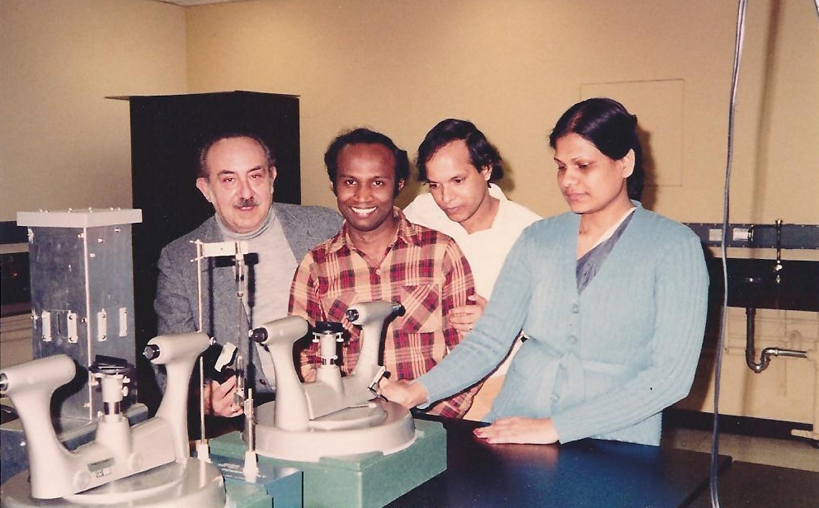
1982
Frank Karioris, Wasantha Wijesundera, A. Bari Siddique, Ummey Khalida Begum

Slide 59
1983
Ken Mendelson, Father Burch, S. J., Wadda al-Hinai, Frank Karioris, Kuuck Lee

Slide 60
Lecture Demonstrations - November 1984
Richard Dittman and Glenn Schmieg

Slide 61
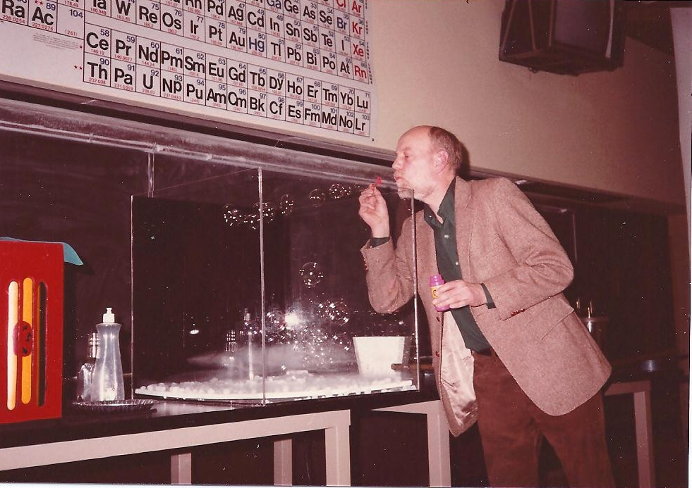
Lecture Demonstrations - November 1984
Richard Dittman

Slide 62
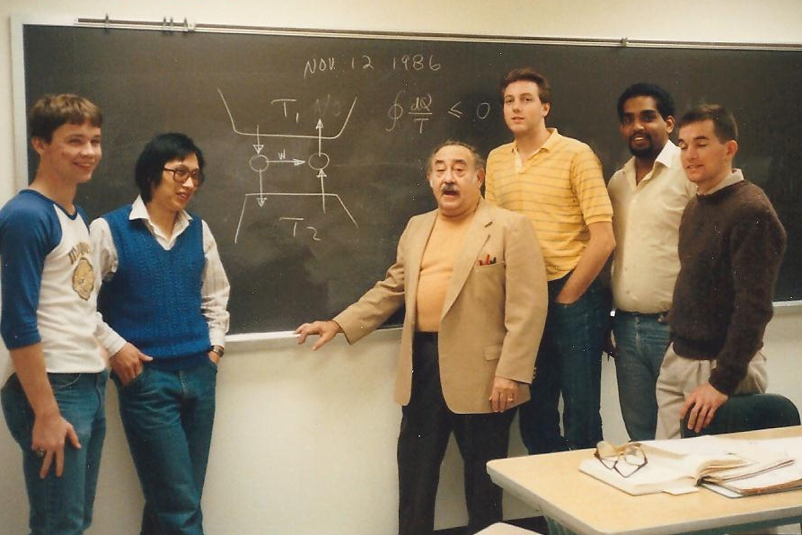
Phys 162 1986-87

Slide 63
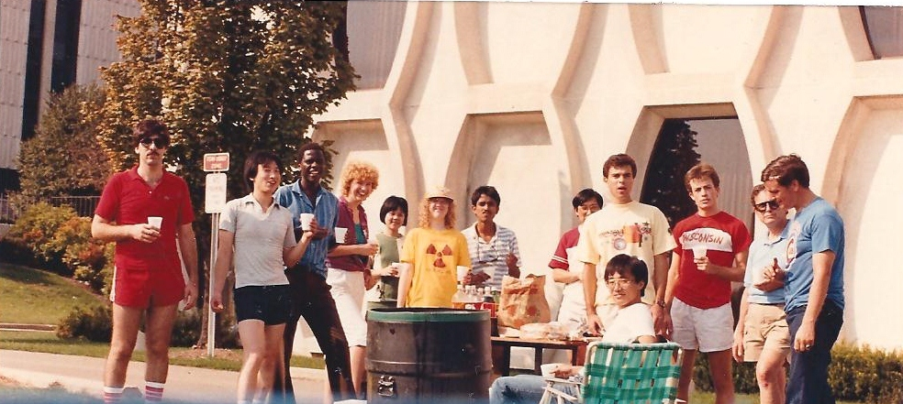
Physics Department Picnic 1987-8

Slide 64
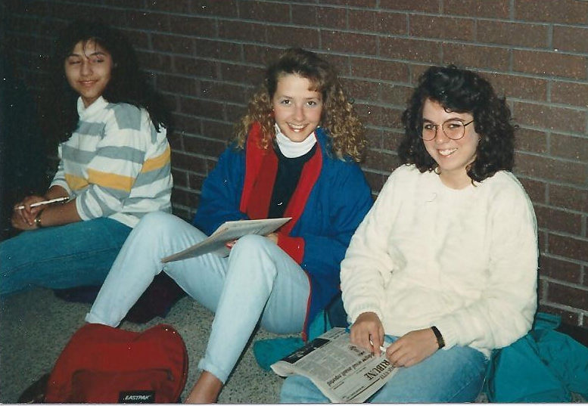

Slide 65
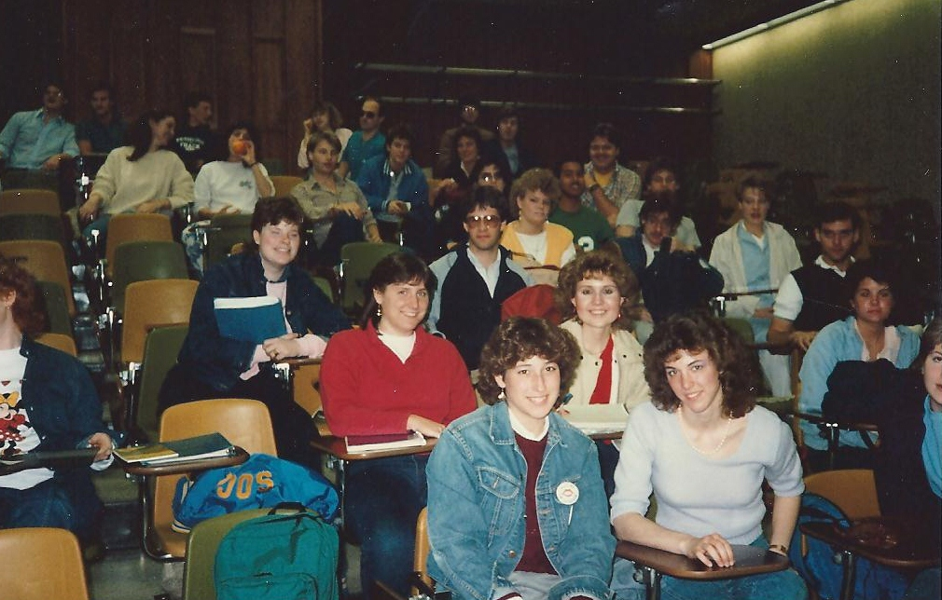
1989

Slide 66
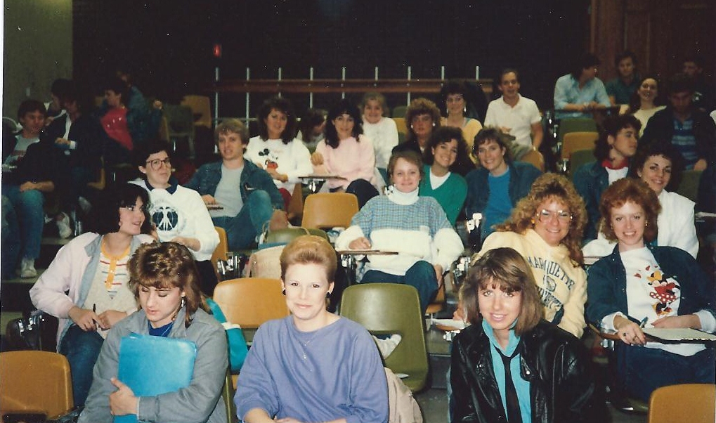
1989

Slide 67
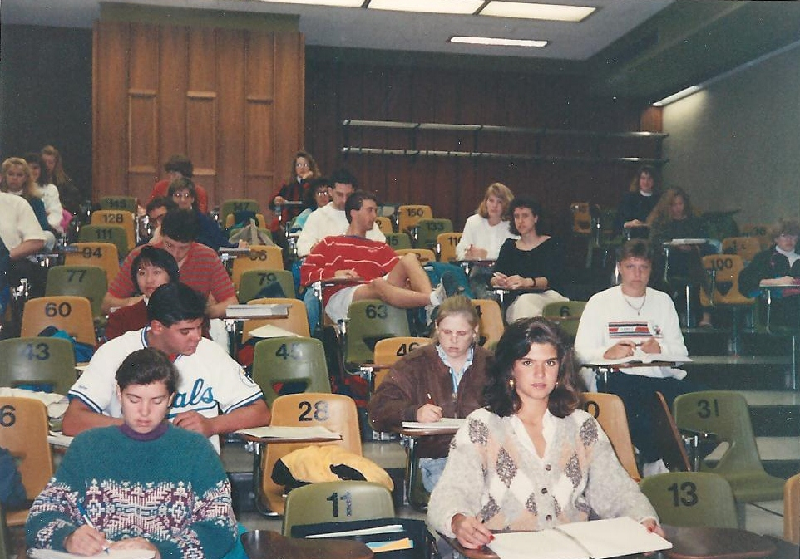
1989

Slide 68
Electronics Lab
~1985

Slide 69
Physics Department Picnic
1987

Slide 70
Sister Feldott
1987

Slide 71
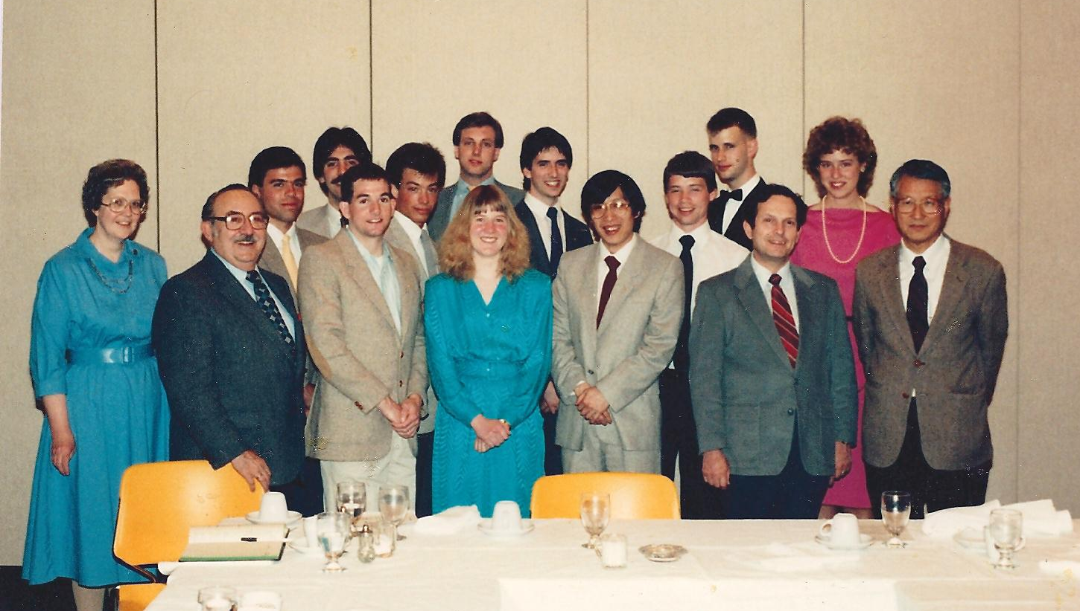
Peter Bandettini
Jim DeRoso
Bob Crowley
Jane Burrows
Sister Feldott
Ki Lee
Frank Karioris
Anne Schaefer
Ken Mendelson
SPS Reception 1987

Slide 72
Smio Tani
Frank Pedrotti
Roy Day
Peter Santi
Joe Collins
SPS Reception
1990

Slide 73
SPS Reception
1991

Slide 74
November 1992
Weilin Gong and Kaustav Banerjee

Slide 75
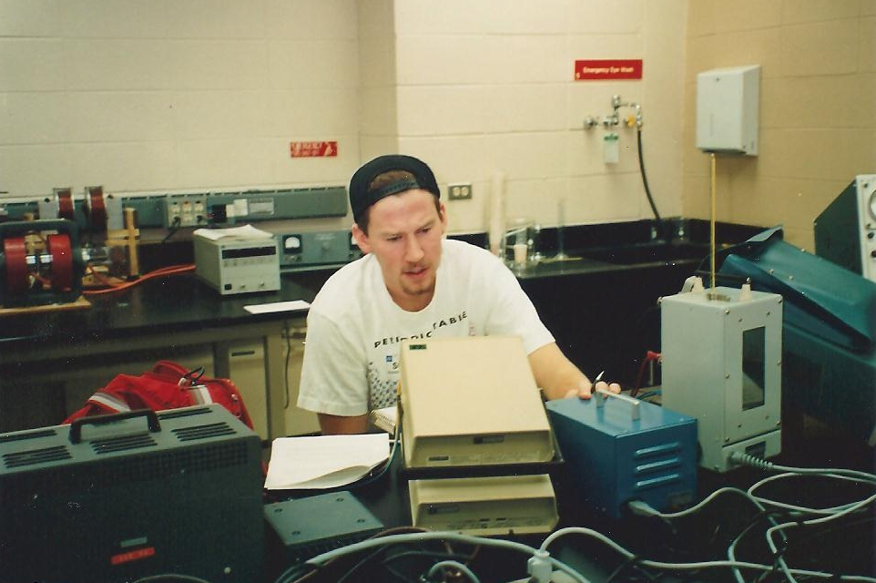
Advanced Lab Fall 1992
David Huffman

Slide 76
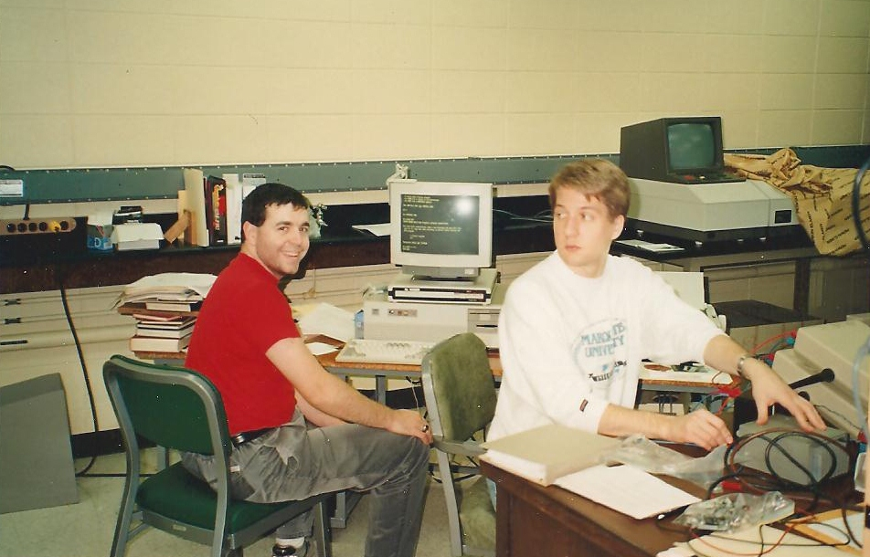
November 1992
Jonathan Filter and James Phillips

Slide 77
1991-2
Joleen Kugi and John Karkheck

Slide 78
Graduation 1991-2
Joleen Kugi and Joe Collins

Slide 79
Graduation 1991-2
Joe Collins and John Karkeck

Slide 80
Graduation 1991-2

Slide 81
Graduation 1991-2

Slide 82
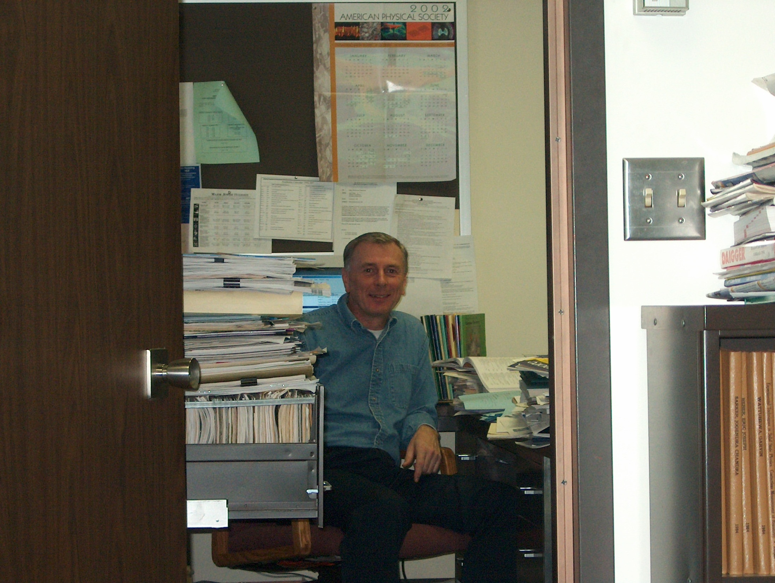
2002

Slide 83
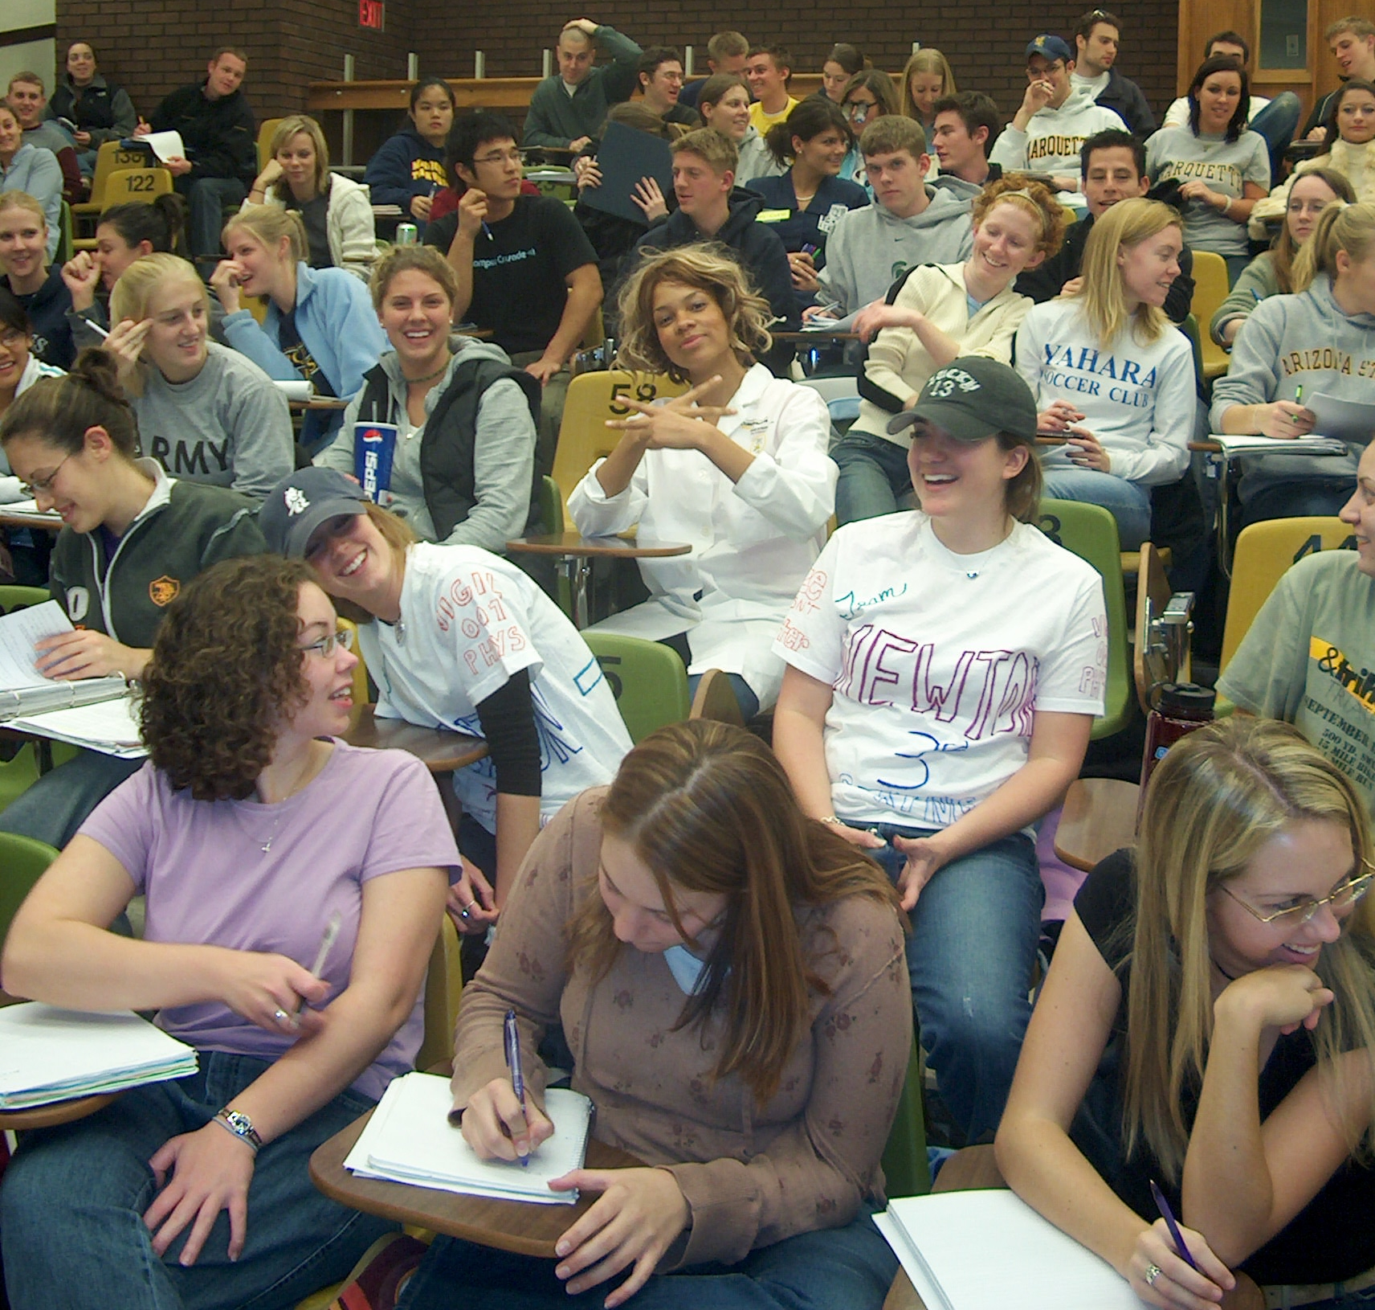
2002

Slide 84
2002

Slide 85
2002

Slide 86
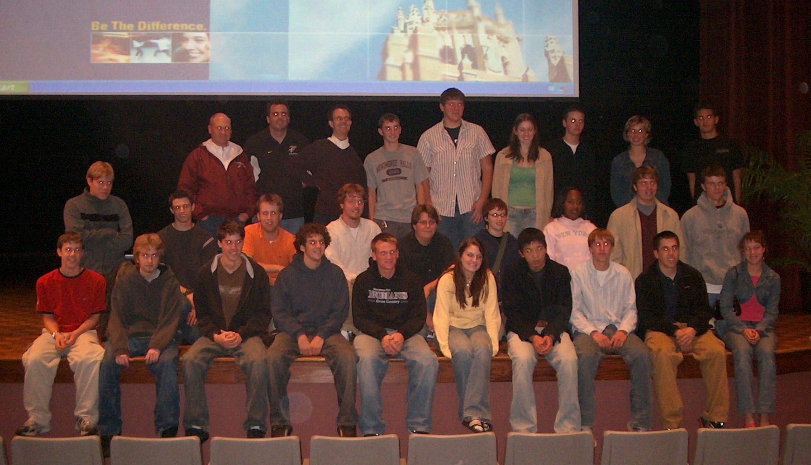

Slide 93
2002

Slide 99
Physics Department 2002

Slide 100
Awards Banquet 2003

Slide 101
Awards Banquet 2003

Slide 102
Summer Cookout
2008

Slide 104
Summer Cookout
2008

Slide 105
Summer Cookout
2008

Slide 106
2011

Slide 107
2011

Slide 108
2011

Slide 109
2011

Slide 110
2011

Slide 111
2011

Slide 112
2011

Slide 113
2011

Slide 114
2011

Slide 115
Women in Physics 2012

Slide 116
Physics Department 2012

Slide 117
Physics Club 2012

Slide 118
SPS Congress 2012
Orlando, FL

Slide 119
Wei Wu, Abigail Searfoss, Kyle Kimminau

Slide 120
SPS Congress 2012
Mike Nichols, Abigail Searfoss, Speaker Dr. Jocelyn Bell Burnell, Kyle Kimminau, Justin Provance

Slide 121
Poster presentations at SPS Congress by
Mike Nichols, Kyle Kimminau, and Nick Lopez-Canelas

Slide 122
January 2013
Holiday Party

Slide 123
January 2013
Holiday Party

Slide 124
January 2013
Holiday Party

Slide 125
January 2013
Holiday Party

Slide 126
January 2013
Holiday Party

Slide 127
Andrew Kunz received the 2013 Excellence in Faculty Advising Award!

Slide 128
Women in Physics celebrating Earth Day with a local Daisy Troop

Slide 129
Making birdhouses!

Slide 131
Physics Club at the Chicago Museum of Science and Industry!

Slide 133
The End!

