Slide 1
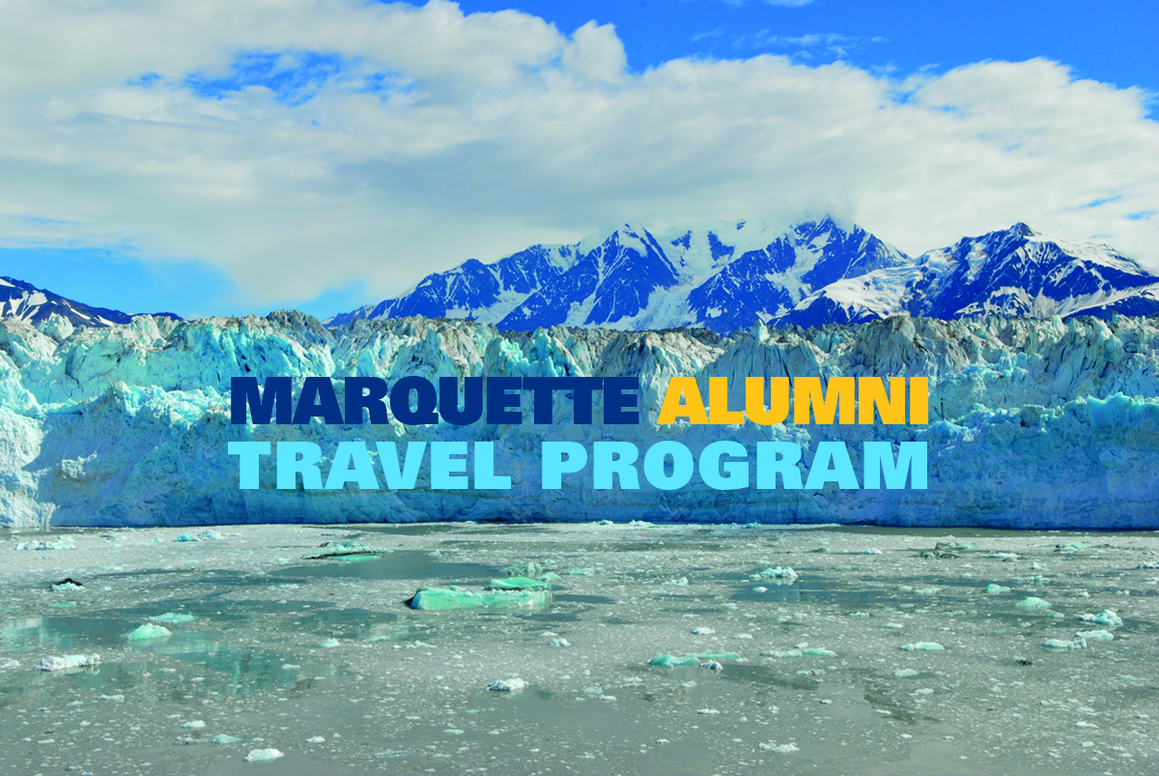
Marquette Travel Program

Slide 2
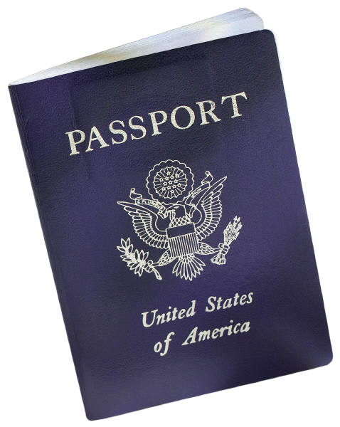
Opportunity to travel with fellow Marquette alumni
Over 40 annual trips to choose from both nationally and internationally
Land trips and river/sea cruises
Marquette alumni travelers receive a special Marquette luggage strap

Slide 3
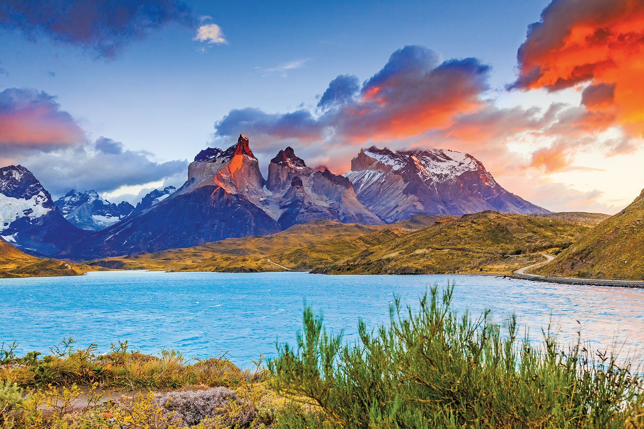
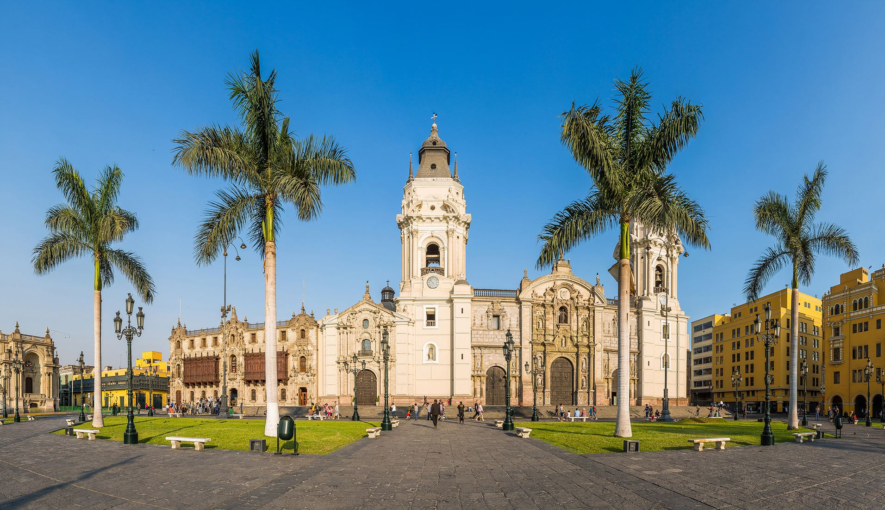
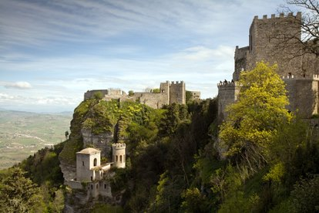
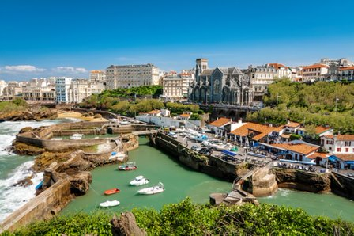
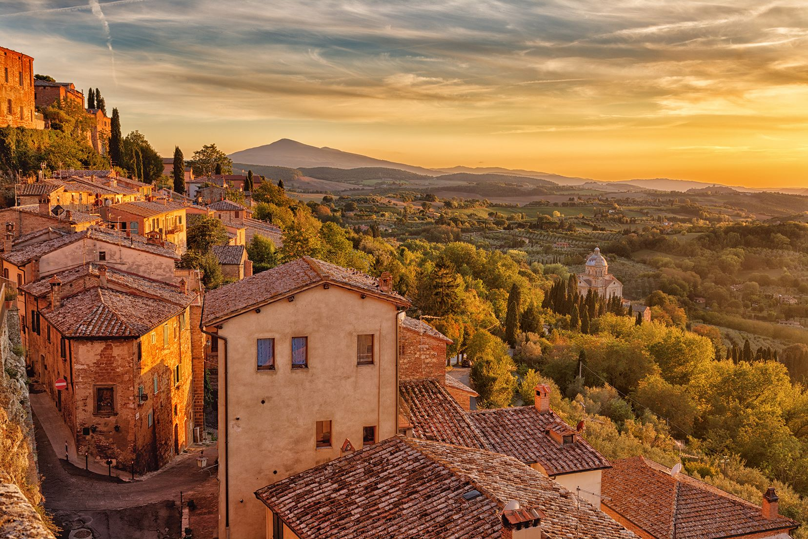
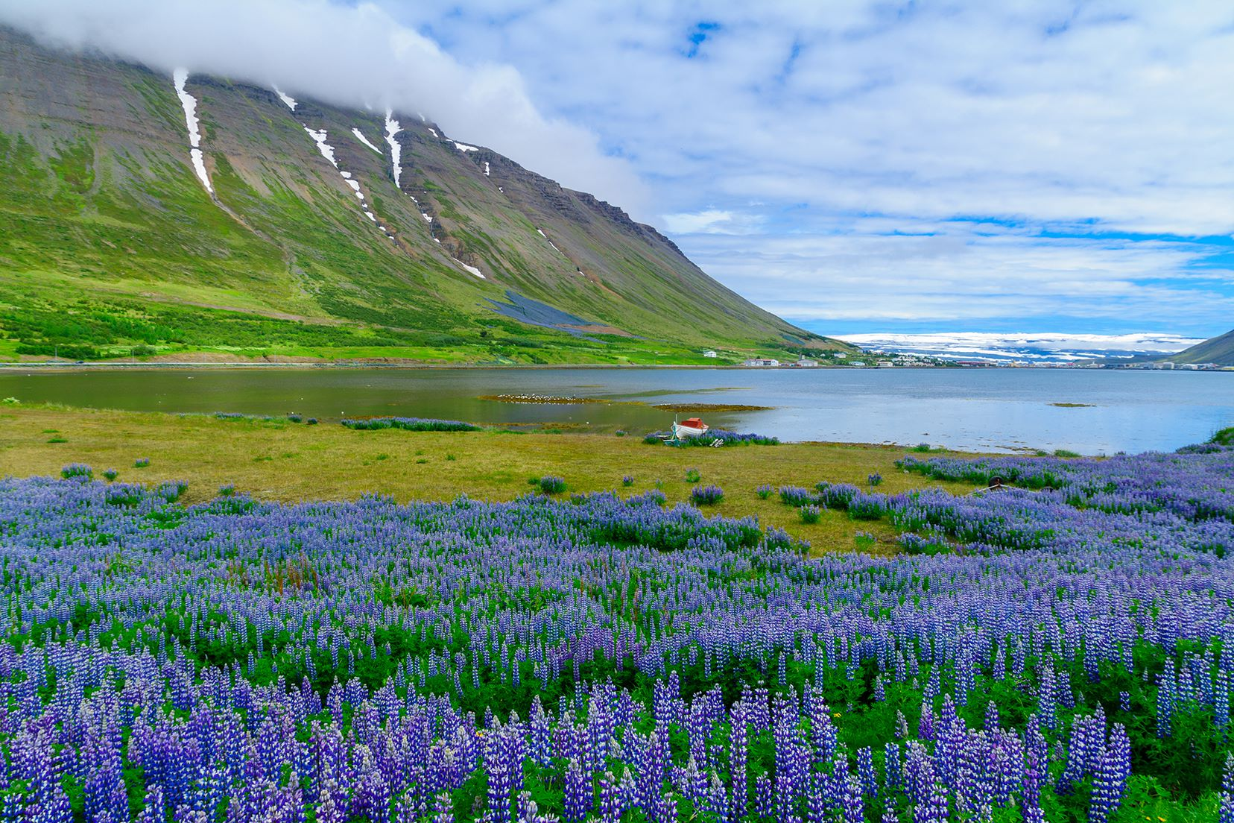
Wonders of Peru, featuring an Amazon Cruise
Sketches of Sicily
Basque Country: Spain & France
CHILEAN WONDERS
Hill Towns of Italy
Iceland Cruise: The Land of Fire and Ice

Slide 4
ICELAND CRUISE

Slide 5
Basque Country: Spain & France
HILL TOWNS OF ITALY
Iceland Cruise: The Land of Fire and Ice

Slide 6
WONDERS OF PERU
Sketches of Sicily
Basque Country: Spain & France
Chilean Wonders: Lake District & Patagonia
Hill Towns of Italy
Iceland Cruise: The Land of Fire and Ice

Slide 7
MARKETING
Information at Reunions
National Alumni Newsletter
Social Media
Emails to past travelers and alumni over the age of 50
Brochure mailings
MUAA Website

Slide 8
QUESTIONS
What trips would you like to see offered through the Alumni Travel Program?
What audience should be targeted for marketing these trips?
How can we market this opportunity further?

