Slide 1
Welcome, MUAA National Board of Directors

Slide 2
Call to Order
Bill Krueger, Eng ’87
President, MUAA National Board of Directors

Slide 3
Invocation
Rev. Fred Zagone, S.J.
University Chaplain
Marquette University

Slide 4
Ice Breaker Activity
Please share your most memorable job or volunteer experience while attending Marquette.
Notes:
Bill to kick-off.

Slide 5
MUAA National Board Meeting October 7, 2021

Slide 6
Arts & Sciences and Education

Slide 7
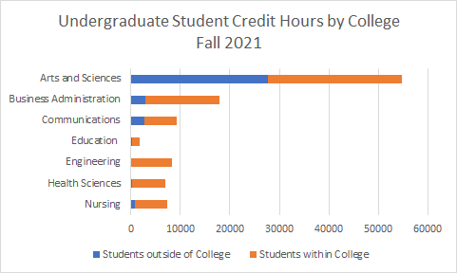
A&S—The Heart of Marquette

Slide 8
College of A&S Programs
40+ Majors and Minors Offered
Most Popular Majors
Psychology
Criminology and Law Studies
Political Science
Biological Sciences
Most Popular Graduate Programs
Masters: Computing, Criminology and Law Studies
PhD: Biological Sciences, Chemistry, Computer Science, Religious Studies
New Majors Fall 2021
Environmental Science
Middle East and North African Studies (MENA)
Statistical Science

Slide 9
College of Education Programs
Undergraduate: Teacher Education
Graduate: Counseling, Counseling Psychology, Educational Policy and Leadership
Grad Program Highlights:
Catholic School Leaders Program
Online Master of Science in Clinical Mental Health Counseling

Slide 10
Diversity and Inclusion
A&S 1st yr students 39%; faculty 20% diverse
Education 1st yr students 38%; faculty 23% diverse
ENGL 1001 Redesign
Latina/os Well-Being Research Initiative
BLEST Hub (Black and Latino/a Ecosystem and Support Transition)
Solidarity and Ally Circles
HSI (Hispanic-Serving Institution)
Urban Scholars Program

Slide 11
Student Success Initiative
Key priority areas
Increasing retention rates; initial focus on year 1-2 and year 2-3
Identifying barriers to graduation and reducing time to graduation
Creating a coordinated network of student support services
Engaging in research and assessment for continual improvement
Timeline
Fall 2021: pilot implemented “First Nine Weeks”
5 years to fully implement

Slide 12
New Initiatives in A&S
High-Impact Student Experiences
Arthur Vining Davis Foundation – Internships
Professional Formation Initiative
Undergraduate Research (MU4Gold)
Civic Dialogues Program
For students and the community
Productive conversations around challenging issues

Slide 13
Research & Development

Slide 14
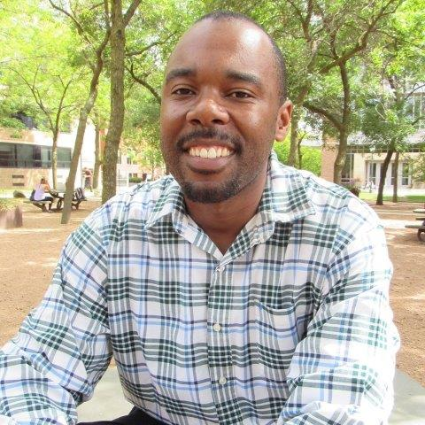
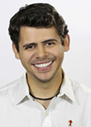
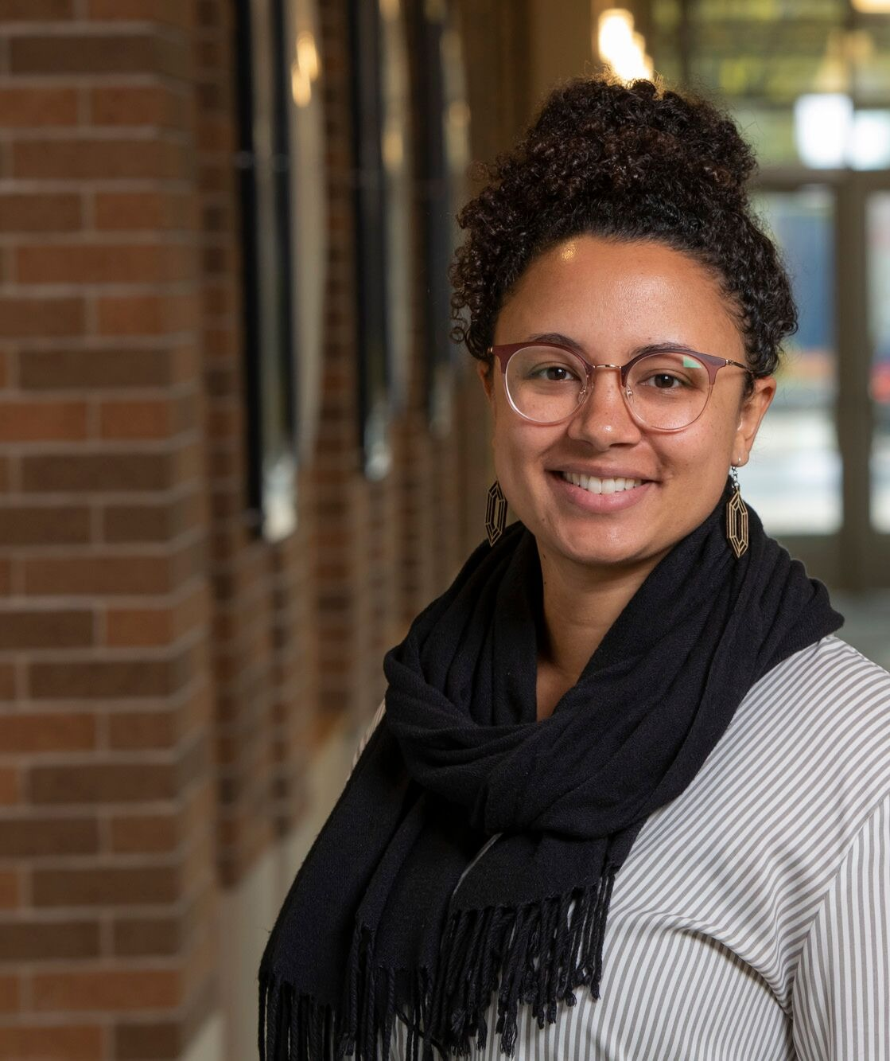
Humanities Research Highlights
Dr. Cedric Burrows (ENGL)
Honored with 2021 National Council of Teachers of English David H. Russell Distinguished Research Award
Rhetorical Crossover: The Black Presence in White Culture
Dr. Alexandre Martins (THEO)
Hubert Mader Visiting Professorship in Bioethics, AY2021-22 (SLU)
Dr. Desiree Valentine (PHIL)
2021 Woodrow Wilson Career Enhancement Fellowship Junior Faculty Award
Notes:
The NCTE awards recognize the profession's leaders for their commitment and dedication to advancing literacy, the field of education or their organization.

Slide 15
Science Research Highlights
Summer Research Experiences for Undergrads (REU) program
33 undergraduate MU participants
Dr. Anita Manogaran (Biology): $945,000 National Science Foundation grant
how cells respond to and manage misfolded and aggregating proteins
Drs. Nate Lemoine and Stefan Schnitzer (Biology):
Elected as Ecological Society of America Fellows
Dr. Tim Tharp (Physics):
Research from Dr. Tharp's group, the ALPHA collaboration, is featured on the cover of Nature (April 2021)
Dr. Michael McCarthy (Sociology):
Berggruen Institute Fellowship, U of Southern California

Slide 16
Time to Rise Campaign Priorities: A&S
Endowed professorships and Chairs
Faculty research and community partnerships
Academic Centers (Les Aspin, Peacemaking, Advancement of Humanities)
Data Science and Computer Science
Excellence Fund for High-Impact Student Experiences
Research, internships, study away
Professional formation, student success support
Career development
Notes:
Jody & Alan please check this slide – feel free to revise/edit/add

Slide 17
Time To Rise Campaign Priorities: Education
Endowed professorships and Chairs
Harman Literacy and Learning Center
Dwayne Wade Summer Reading Program
Support Catholic school leaders pursuing advanced degrees
Support Student Affairs and Higher Ed (SAHE) assistantships
Excellence Fund for High-Impact Student Experiences
access to advanced mental health training for diverse students
increasing capacity for mental health providers (Master’s students)
assistance with costs beyond tuition, including housing and books
research, internships, study away
Notes:
Jody & Alan please check this slide – feel free to revise/edit/add

Slide 18
Thank You

Slide 19
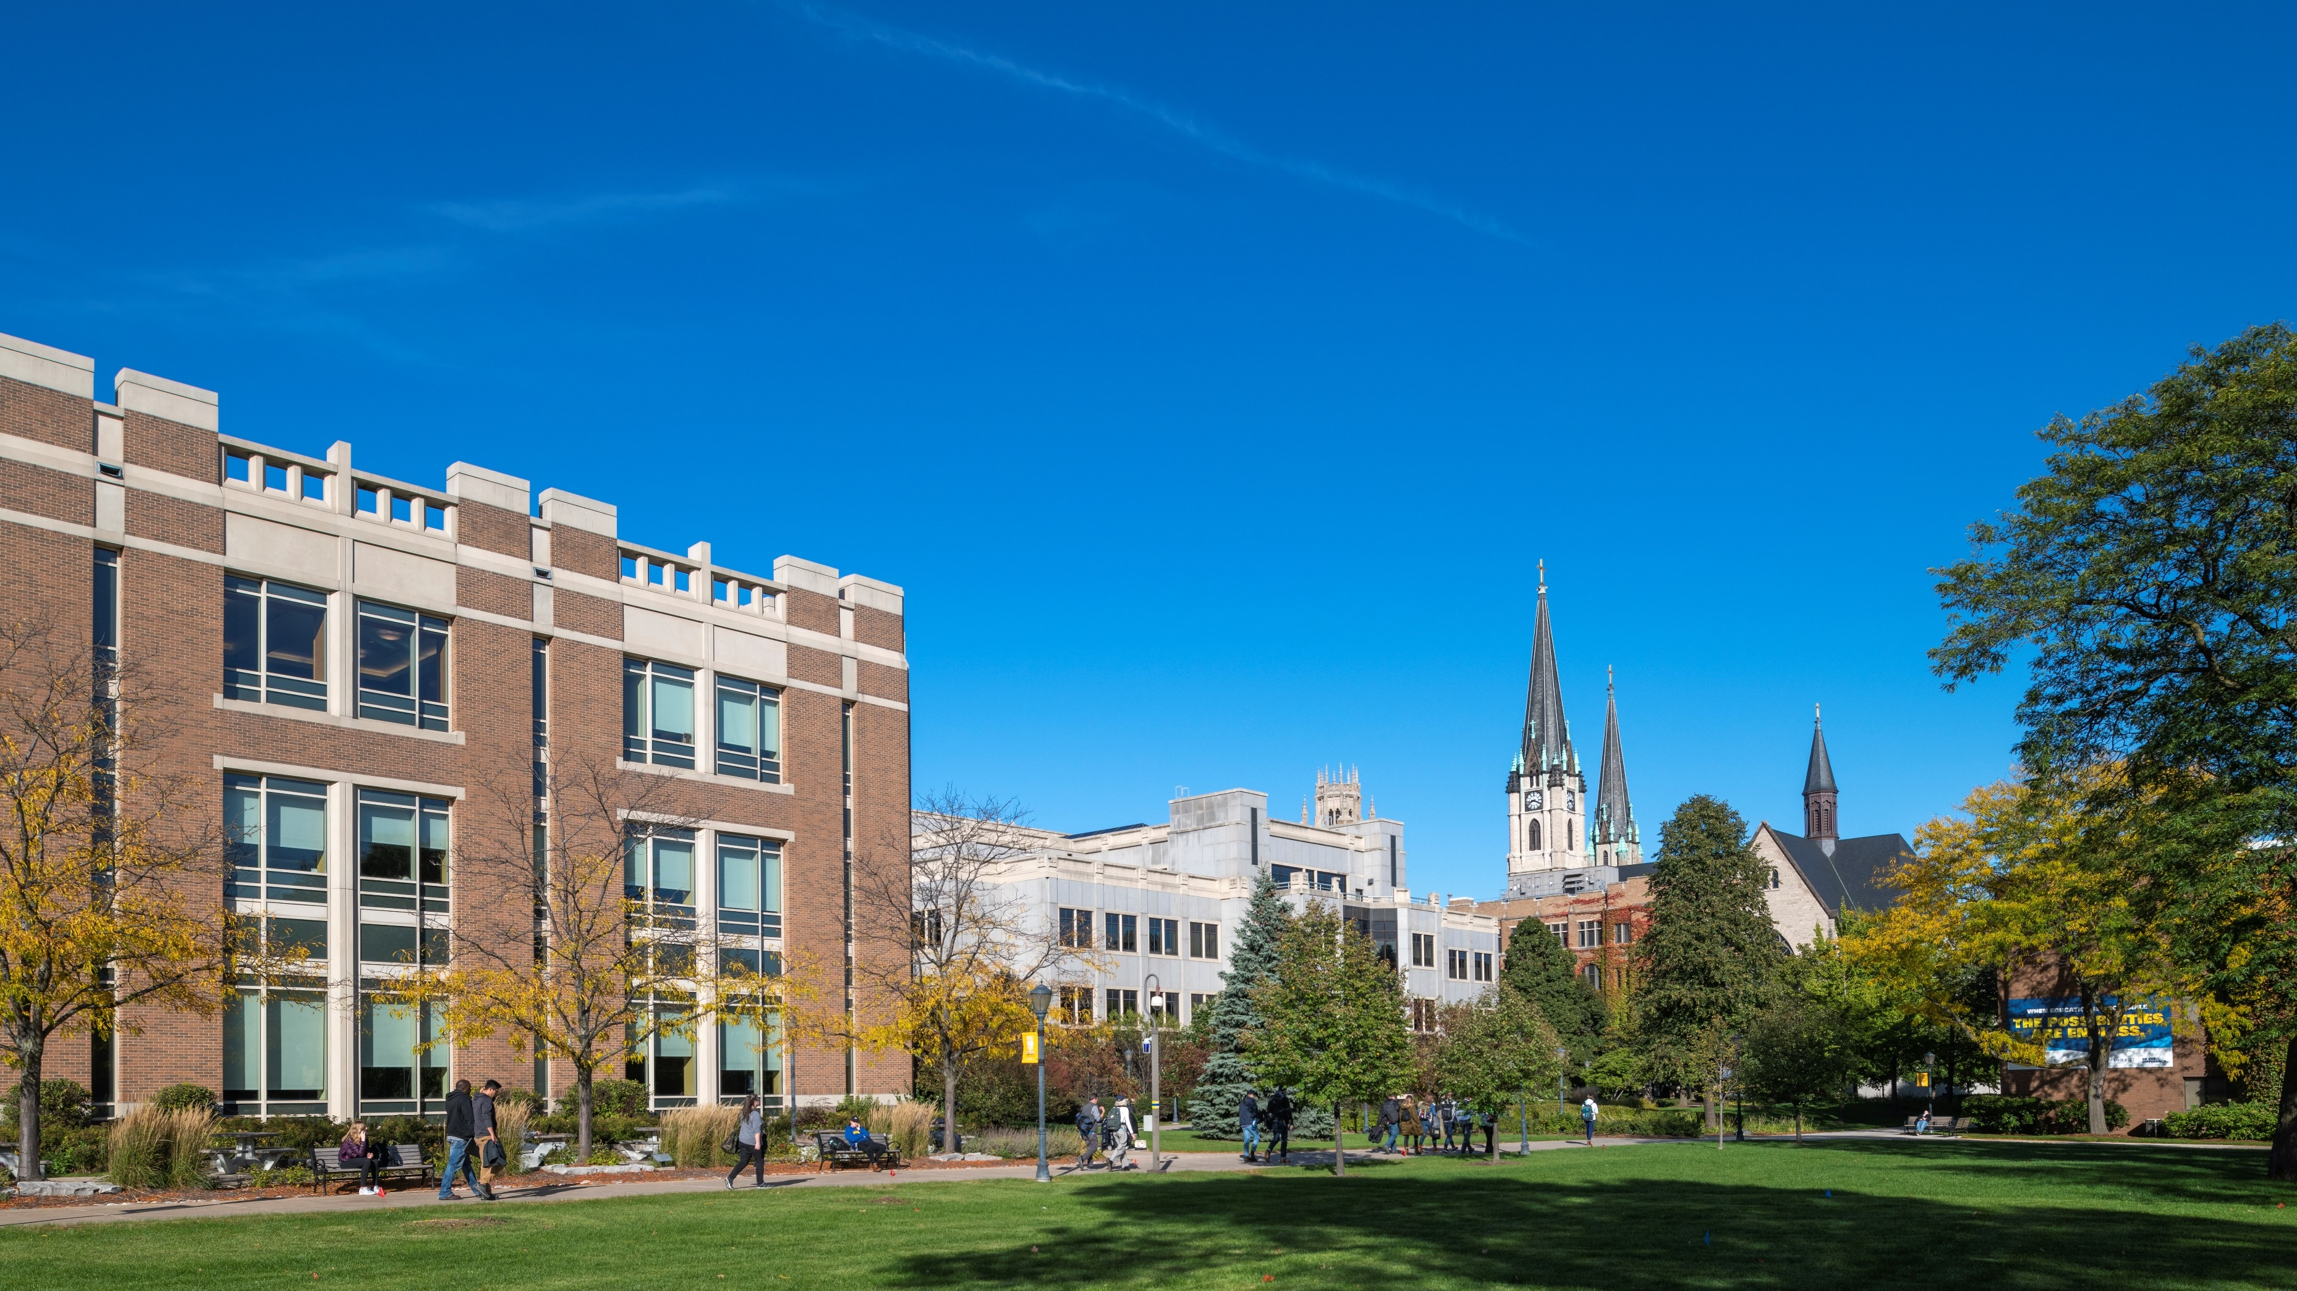
BRAND REFRESH
THOMAS PIONEK
Assistant Vice President of Marketing
University Relations
JENNIFER RUSSELL
Sr. Director of Marketing Projects
University Relations

Slide 20
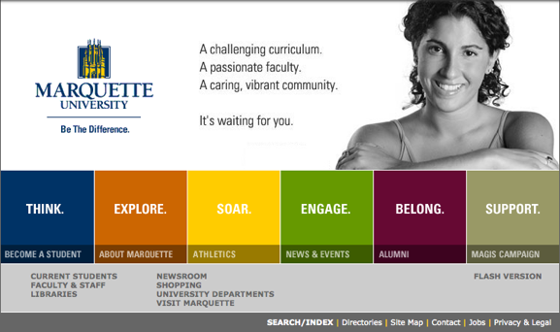
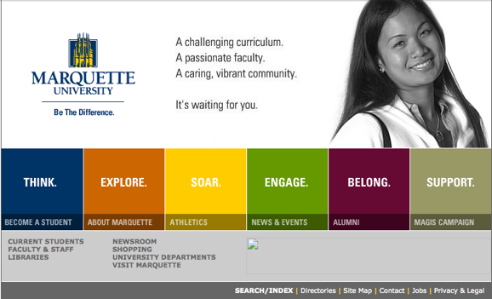
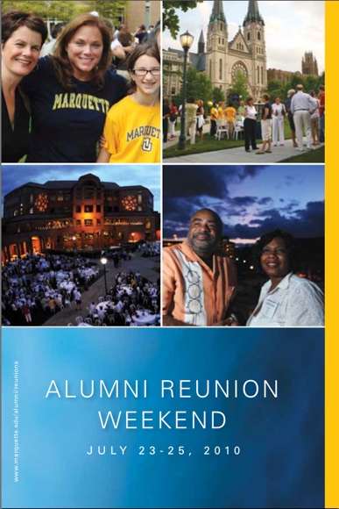
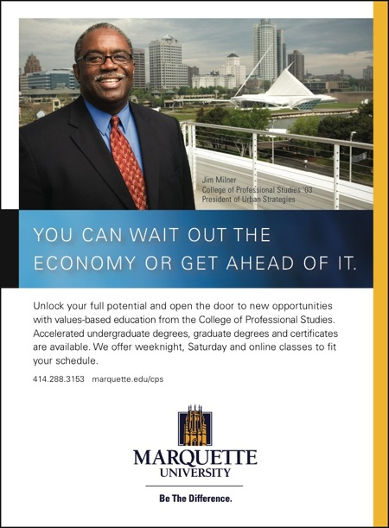
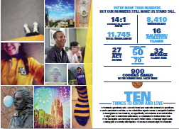
Brand platform history
2004
2009
2014
2019
Notes:
2003-2004 - Marquette worked with agency to create brand identity
Design and rollout 2003-2006
Brand iteration 2006-2008
2008-2009- Creative platform refresh (Internal)
Smaller scale design and rollout 2010-2011
Brand iteration 2012-2013
2013-2014 - Creative platform redesign with agency
Design and rollout 2014-2017
Brand iteration 2017 to present
2019- Internal team platform iteration to include more dynamic visual elements, chevron and illustration.
Temporary to extend current platform use
Same time, started efforts on brand refresh with an agency, was put on hold with COVID

Slide 21
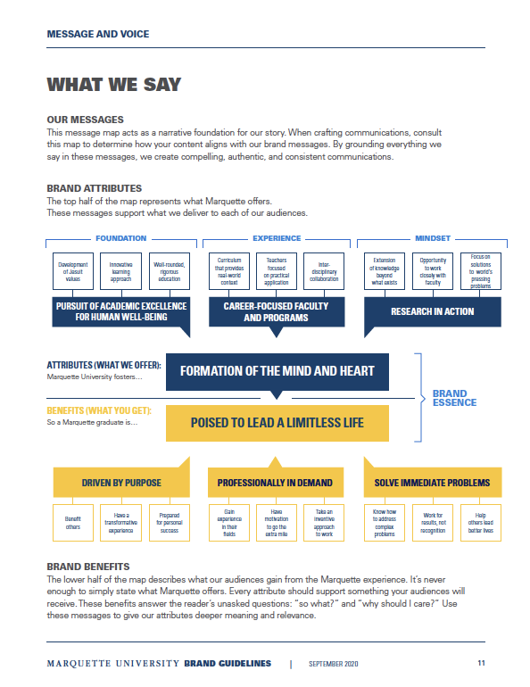
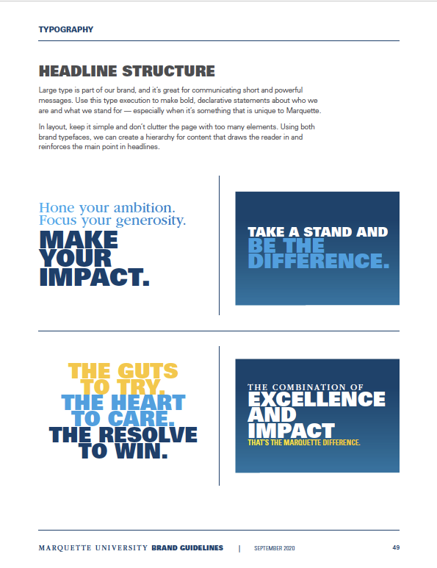
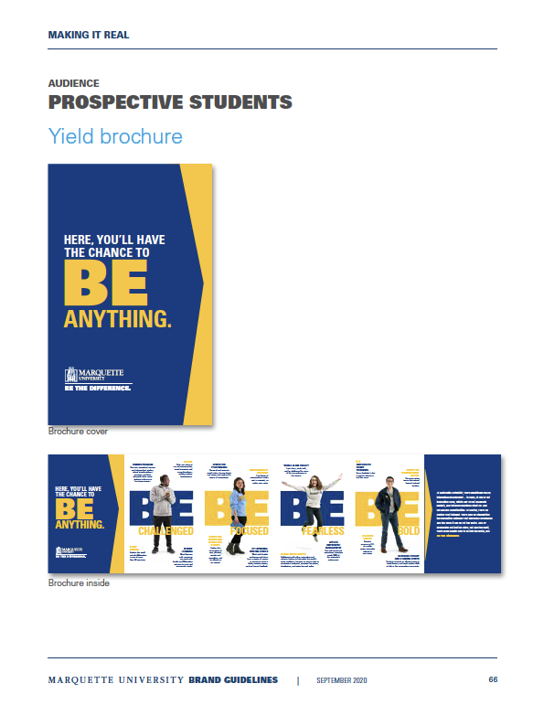
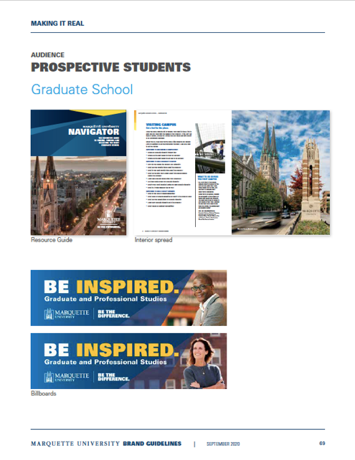
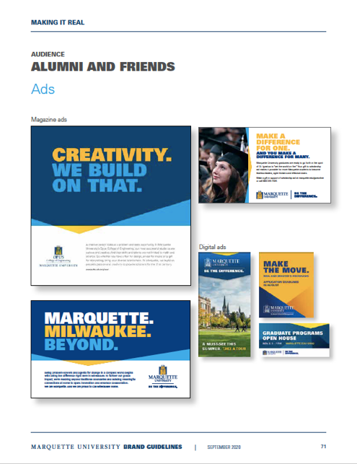
Why a brand refresh
CREATIVE PLATFORM
Refresh visual language to remain distinct
Strengthen marketing to graduate students and online learners
Expand consistency among external partners implementing the brand
Deepen branding in social media and digital video
Refine ability to strategically accommodate new programs / initiatives.
Notes:
WHY
Strategic reasons
Need to lean into brand to show value of Marquette education
Increased competition within our primary areas of brand strength
Operational reasons
The visual language of the brand platform is becoming dated, last brand refresh was in 2014
University has increased marketing graduate students and online learners
There are more external partners implementing the brand (online program managers for nursing, graduate programs, and online programs)
Social media and digital video are a larger part of marketing mix since 2014
Need to accommodate pace of new programs / initiatives developed by university.
WHAT
1) Updated creative platform that will define usage of:
Brand message and voice
Typography
Colors
Photography
Visual elements
Social media elements
Video elements
Illustration
2) Concepts for application of the creative platform to:
Social media
Video
Advertising, print and digital
Digital
3) Concepts for undergraduate and graduate marketing collateral.

Slide 22
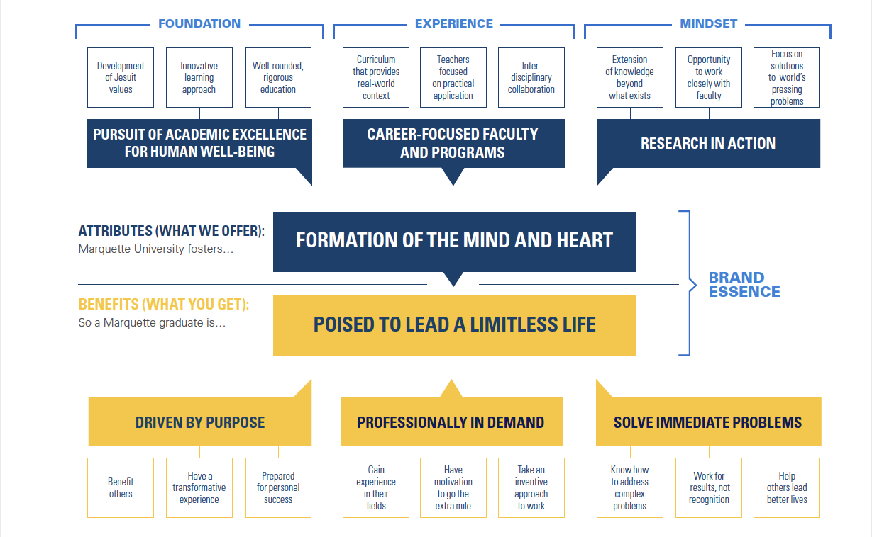
Brand message map
OUR MESSAGES
Narrative foundation for our story.
Used to create we create compelling, authentic, and consistent communications.
BRAND ATTRIBUTES
Top half of the message map
Represents what Marquette offers
BRAND BENEFITS
Lower half of the message map
Represents what our audiences gain from the Marquette experience.
Notes:
OUR MESSAGES
Narrative foundation for our story.
Used to create we create compelling, authentic, and consistent communications.
BRAND ATTRIBUTES
The top half of the map represents what Marquette offers. These messages support what we deliver to each of our audiences.
BRAND BENEFITS
The lower half of the map describes what our audiences gain from the Marquette experience. these messages to give our attributes deeper meaning and relevance.

Slide 23
Notes:
[Divide 20 MUAA members into four small groups of five)
[Ask two groups to look at the top half of the message map – the ATTRIBUTES
and do three things:
Pick three boxes the resonate most with you
Pick three boxes that are unique to Marquette
Pick any box that you think you think needs to be changed for some reason, and identify why?
Ask two groups to look at the bottom half of the message map – the BENEFITS
Pick three boxes the resonate most with you as an alum of the university
Pick three boxes that you think matter most to today’s prospective students
Pick any box that you think needs to be changed for some reason, and identify why?
Come back and report out to the larger group.

Slide 24
Breakouts
Group 1: Clare (lead), Bill, Swati, Marissa and April
Group 2: Nick (lead), Mary Lou, Javier and Pat
Group 3: Aleisha (lead), Cathy, Paul and Lee Ann
Group 4: Ron (lead), Ivan, Marilynn and Monica

Slide 25
ATTRIBUTES: GROUPS 1&3
Pick any three boxes that resonate most with you as an alum
Pick any three boxes that are unique to Marquette
Should any box need to change? If so, why?
Notes:
[Ask two groups to look at the top half of the message map – the ATTRIBUTES:
Pick three boxes that resonate most with you
Pick three boxes that are unique to Marquette
Should any box need to change? If so, why?

Slide 26
BENEFITS: GROUPS 2
Pick any three boxes that resonate most with you as an alum
Pick any three boxes that matter most to today’s students
Should any box need to change? If so, why?
Notes:
Ask two groups to look at the bottom half of the message map – the BENEFITS
Pick three boxes the resonate most with you as an alum of the university
Pick three boxes that you think matter most to today’s prospective students
Pick any box that you think needs to be changed for some reason, and identify why?

Slide 27
Report-outs
Attributes:
Group 1:
Group 3:
Benefits:
Group 2:

Slide 28
COMMITTEE REPORTS

Slide 29
Governance Committee Meeting
October 2021​
Standing committee to oversee the recruitment process of all directors, propose amendments to by-laws as appropriate and make recommendations for board activities and initiatives. Agenda:
Strategic Plan: Ideas for Future Meetings
Update on Urban Scholars Workshop
Board Recruitment and Renewals
MUAA Alumni Donor Participation Committee Meeting
May 2021​

Slide 30
Marquette University Volunteer Ecosystem:
Broad Based & Affinity
Regional, Reunions, BAA, HAA, LGBTQ+
College Based
Leadership Councils, Advisory Boards
Nomination Based
30
Notes:
The committee learned more about of the selection process for National Board members as well as an overview of the various “Ecosystem Pipelines” for alumni volunteers.

Slide 31
Volunteer Ecosystem Pipeline Tracking
Alumni Awards
Boards and Councils
MUAA National Board
Young Alumni Leadership Council
Association of Marquette Women (AMUW)
Women’s Council
Mentors
Speakers/Hospitality
Notes:
Engagement staff culls nominees from a variety of sources:
Staff recommendations
Alumni referrals and nominations
Regional club involvement
Regular event attendance
Prior volunteer service
Social media presence and posts
Alumni in the news

Slide 32
Building Our Volunteer Ecosystem Pipelines
ENGAGED
ALUMNI
SUPPORTIVE FRIENDS
PASSIONATE
DONORS
INVESTED
INFLUENCERS
REGIONAL AND
CLUB LEADERS
INDUSTRY EXPERTS AND LEADERS
ENGAGEMENT STRATEGIES
IDENTIFY
NOMINATE
ASSESS
SELECT
RECRUIT
DIVERSITY
& INCLUSIVITY
SUCCESSION PLANNING
& CONTINUITY
TRAIN STEWARD
Notes:
Maintaining a healthy pipeline of potential board members is an ongoing process.
At any time, we like to have 75-100 names in the National Board Pipeline. Invariably, some will not be qualified, some will have other committee commitments or conflicts. Individuals stay in the pipeline and may rise to the top for consideration in a given year, depending on an array of variables.

Slide 33
MUAA National Board Annual Recruiting Process
Fall/Winter:
Review Board vacancies & set recruiting goals
Assess pipeline of nominees (qualified vs. unqualified)
Score and rank qualified nominees
Set field of candidates (4-5x #vacancies)
Prepare intros and present to Governance Committee to determine finalists
Spring/Summer:
Present full bios on finalists of Governance Committee
Governance Committee ranks the finalists
Slate is presented to the Board for a vote
Recruit new members
Notes:
The Governance Committee considers upcoming candidates in a two part process, culminating in consideration of the finalist candidates in the spring session.
Nominations for National Board are accepted anytime during the year.
For the upcoming recruitment cycle we will consider nominations received by November 30, 2020.
Current National Board members are strongly encouraged to recommend other alumni for board, council and speaker considerations.

Slide 34
Call to Action: Nominations
Submit via the Zoom Chat
Email Sarah or Rachelle
Online nominations:
https://www.marquette.edu/alumni/about-muaa-board-recommendation.php
https://www.marquette.edu/alumni/awards/nominate.php
Notes:
Call to Action: You are strongly encouraged to recommend other alumni for the board, other councils, Alumni Awards or potential speakers for programs. Board members can drop suggestions in the chat, submit online or send names directly to Sarah or Rachelle. The links will be included in the post meeting email.

Slide 35
Alumni Donor Participation Committee Meeting
October 2021​
This committee will focus on creating a culture that encourages and celebrates giving at all levels; will help develop specialized marketing strategies; and encourage volunteer giving throughout the alumni association. Agenda: ​
Alumni participation to-date
Upcoming opportunities and ways to help
MUAA Alumni Donor Participation Committee Meeting
May 2021​

Slide 36
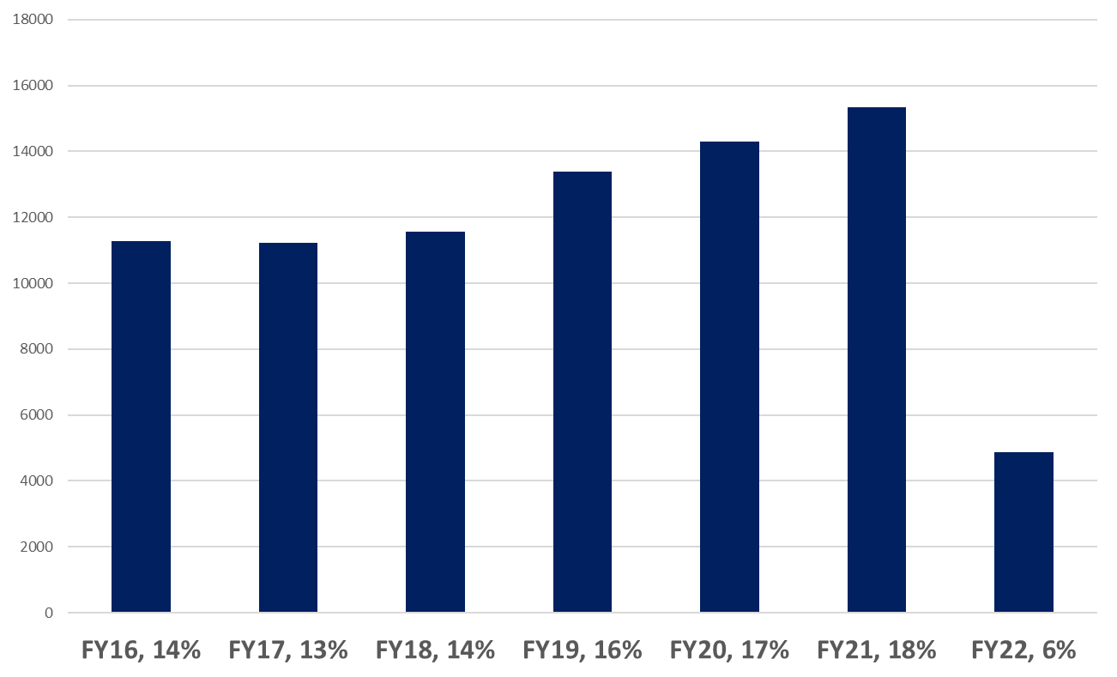
Alumni Participation as of 10/01/21​
​
FY21 Alumni Participation Goal: 19%
FY21 Alumni Participation To-date: 6%

Slide 37
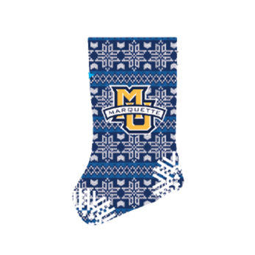
Upcoming Annual Giving Opportunities
​
Advent Calendar Partnership with Milwaukee Food Tours (opportunity to raise funds for Bridge to the Future) – September/October
President’s Society Fall Appeal (including targeted outreach around Time to Rise Windy City Challenge) – October
Athletics Fall Appeal – October
End of Calendar Year Appeal – November/December
Notes:
Advent Calendar:
We partnered with Milwaukee Food Tours to create a 12 Days of Marquette Advent Calendar that is available to purchase as a holiday gift on their website. The box includes 12 items from Marquette-owned small businesses, such a chocolates, coffee and other treats and a portion of the proceeds benefits Bridge to the Future Fund. I will include a link in the follow-up notes.
Windy City Challenge:
Through this challenge, we have an opportunity to unlock $250,000 for student scholarships from a generous benefactor when 110 donors from Chicago join the President’s Society as new members.
End of Calendar Year Appeal:
Focusing on the Ignatian Year as our theme

Slide 38
​
Digital Advent Calendar Dec. 1-25
Daily social posts and weekly emails
Submit your holiday favorites at https://tinyurl.com/MUadvent

Slide 39
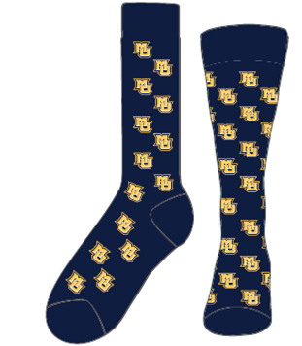
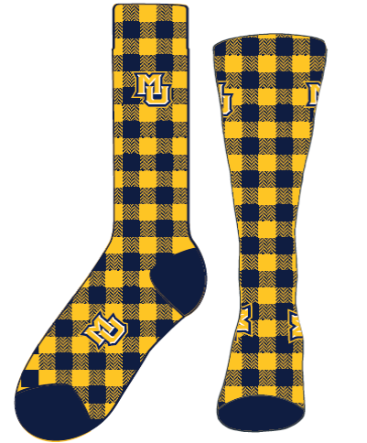
Give Marquette Day 2022
Save the date: Tuesday, March 1
New this year - Sock options
Get involved!
Sign up to be an advocate Head to givecampus.com and click “Sign Up” at the top of the page. Create an account from there!
Create a personal plea video
Invite your fellow alumni to participate
Sign up to text alumni
Notes:
This is our fifth annual Give Marquette Day.

Slide 40
Awards Committee Meeting
October 2021​
Standing committee to oversee the Alumni National Awards process and provide recommendations for the All-University award recipients and select the Pedro Arrupe Award for student service and leadership. Agenda:​
Awards website (Marquette.edu/awards) will be updated soon.
All-University Award nominations are being review by the committee members and recommendation will be provided by October 20 for MU leadership to review. Upcoming opportunities and ways to help
MUAA Alumni Donor Participation Committee Meeting
May 2021​

Slide 41
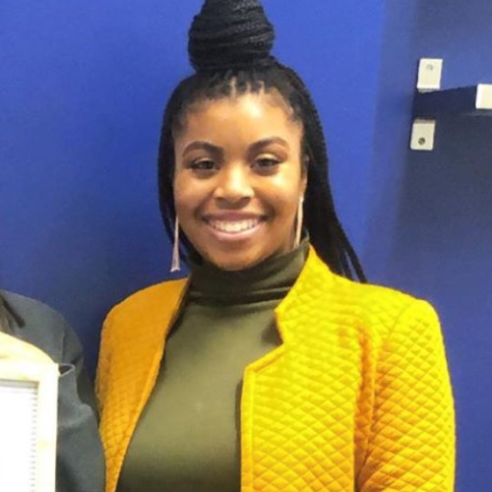
Pedro Arrupe Recipient
Laice Perry, Communication student
Laice is from Milwaukee, studying Communication Studies and Psychology
She is the Vice President of the Student Advisory Board
Also active in EOP/SSS TRiO as a Summer Program Peer Counselor
She is involved with Campus Curlz - “a natural hair and service-based organization whose goals are to enhance, educate and uplift”

Slide 42
Wrap-up and Reminders
Optional Focus Group: What Distinguishes a Marquette Graduate
Monday, November 8, noon – 1:00 p.m. CST
Winter Board Meeting (in-person) and in conjunction with National Marquette Day February 25 – 26
Notes:
Add all meeting dates

