Slide 1
Convention Planning Update and What it Will Mean for Marquette 136 Days from Today
Mary Czech-Mrochinski and Lynn Griffith Convention Steering Committee Co-chairs

Slide 2
DNC 2020
Will be like hosting four Super Bowls in four days (July 13-16, 2020)
50,000 visitors
5,000 Delegates
15,000 Media
30,000 corporate, government relations, political and campaign staff

Slide 3
Campus Convention Steering Committee
10-person committee that centralizes all operational and reputational decisions related to preparing for the convention
Sub-committees:
Academic
Facilities and Financials
Marketing and Communication
Operations
Security

Slide 4
Marquette and Milwaukee on the global stage
Marquette will serve as a non-partisan entity in line with our Catholic and Jesuit values
Maximizing the moment:
Marquette University Law Poll
Showcasing faculty experts
Student experience – regardless of political affiliation
Convention-related classes
Internships
Volunteering at events
Advertising and brand-building

Slide 5
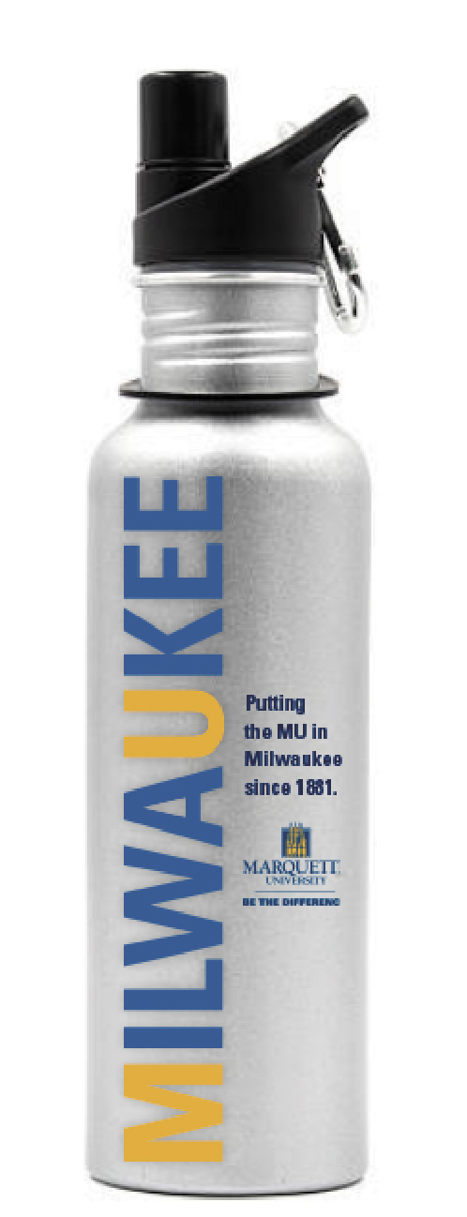
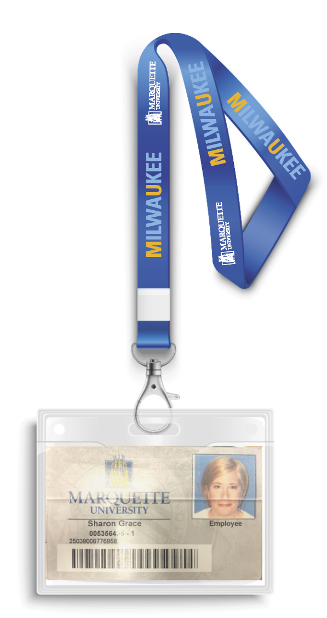
Potential Creative Campaign

Slide 6
What does this mean for campus?
A high volume of traffic and extensive travel delays
Possible daily re-routing of streets
Possible revised Milwaukee County Transit routes
Potential protests around the city
High volume of residence hall and event guests
Changes to university core function operations while remaining operational
Working from home, flex hours, etc.
Online classes/alternate activities
No youth camps

Slide 7
Maximizing revenues for scholarships
Residence halls are fully booked by law enforcement and media outlets
Students will be housed in Eckstein Tower and Humphrey Hall
Determining availability of university apartments, including The Marq to maximize housing revenues
Marketing event spaces to non-partisan groups for non-fundraising events.
Booked event spaces include The Varsity Theatre, 707 Hub, Weasler Auditorium and Marquette Place

Slide 8
Ensuring campus is safe and secure
Presence of federal law enforcement staying on campus and coordination with local/federal law enforcement
All buildings except the AMU will be locked
Marquette faculty, staff and students required to display MUIDs during convention
All outside individuals staying in university housing will be required to wear an identification lanyard and to provide a photo ID when entering and exiting residence halls
MUPD has created an event management plan to minimize disruption from protests, changes to traffic patterns and other security-related incidents

Slide 9
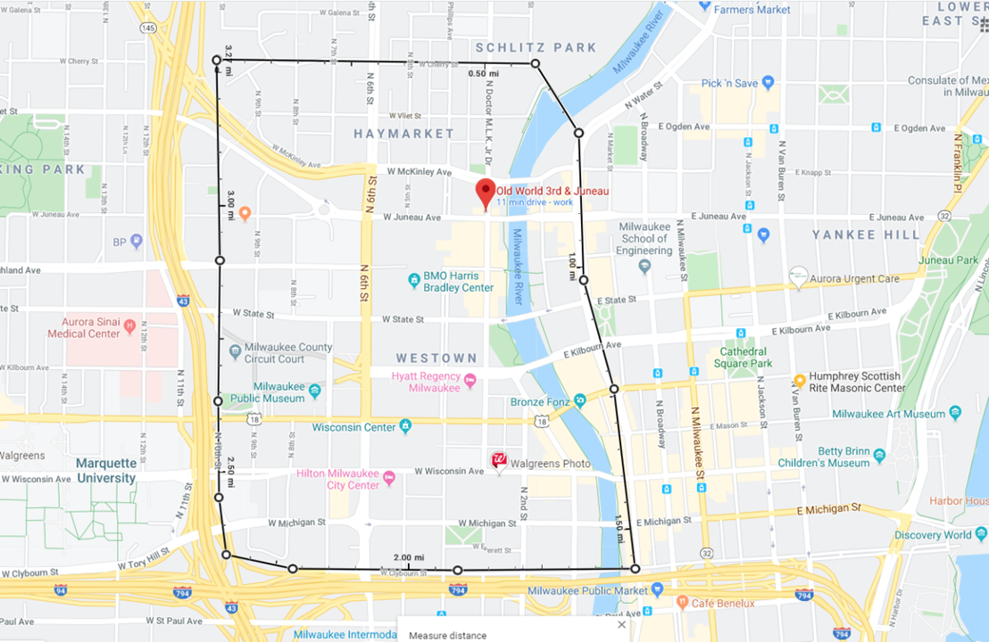
Convention Security Soft Perimeter

Slide 10
Questions?

