Slide 1
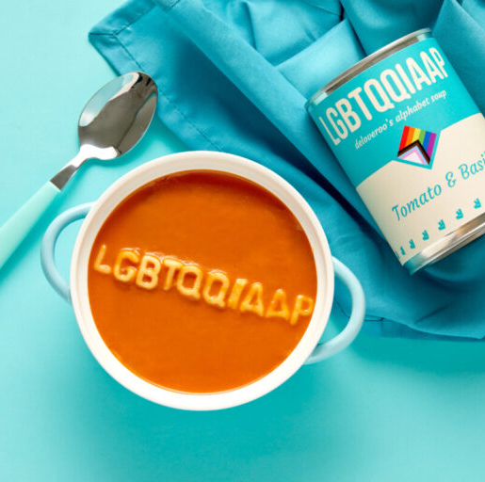

Alphabet
Soup
with Substance
with Katie (she/her) and Emma (she/her)

Slide 2
acknowledgement of limited perspectives
professional and student backgrounds
invitation of the experiences of others
the culture of our voices

Slide 3
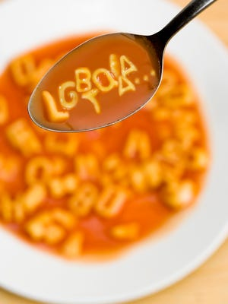
why the alphabet soup?
validating invisible identities
power of seeing yourself in text
range of diversity in this large community

Slide 4
highlighted terminology
Ally – (noun) a person who supports and advocates for members of the LGBTQ+ community, regardless of ally’s sexual, romantic or gender identity. ​
​
Asexual – (adj) experiencing little or no sexual attraction to others and/or lack of interest in sexual relationships/behavior. Asexuality exists on a continuum from experience of no attraction to sexual attraction only under specific conditions. Referred to as “grey” and “ace”.​
​
Cisgender – (adj) a person whose gender identity and biological sex assigned at birth align (e.g., man and male‐assigned). This results in privilege in a cisnormative society.​
Drag – (noun) exaggerated gender expression for entertainment. Drag Kings perform masculinity theatrically whereas Drag Queens perform femininity theatrically. The term “cross-dressing” is outdated for many reasons.
Gender-fluid – (adj) a person who does not identify with a single fixed gender or may feel a natural relationship between the ebb and flow of fixed (or unfixed) gender identities. (e.g. may use he/she pronouns)
​
Gender Non‐Conforming (GNC) / Non-Binary ‐ (adj) 1 indicates a gender presentation that does not fall within gender norms. 2: a gender identity that indicates a person who identifies outside the gender binary. ​
​

Slide 5
highlighted terminology
Homosexual – (adj) A medical term (referring to same-sex relations) that is stigmatizing due to its history and is widely discouraged and even considered derogatory (use gay/lesbian instead).​
Intersex – (noun) someone whose combination of chromosomes, hormones, internal sex organs, and genitals differs from the two expected patterns of male or female. Formerly known as hermaphrodite (or hermaphroditic), but these terms are now considered outdated and derogatory.​
​
LGBTQ+ - an acronym for “lesbian, gay, bisexual, trans* and queer” with a "+" sign to recognize the limitless sexual identities and gender identities used by members of the queer community.
Outing – (verb) exposing someone’s LGBTQ+ identity to others without their permission. Outing someone can have serious repercussions on employment, economic stability, personal safety, and religious or family situations.
Pansexual – (adj) a person who experiences emotional, physical, romantic, and/or sexual attraction for individuals, regardless of gender identities/expressions. With a greater awareness of gender spectrums (and gender non-conforming), some individuals may identify as Pan (colloquial slang) if they feel they are capable of interest in individuals outside society’s most rigid sex and gender stereotypes. Others find that pansexuality better captures their attraction to personality first and body second. ​

Slide 6
highlighted terminology
"Passing" - (verb) when a trans* person is perceived as a cisgender person due to aligning with cisnormative standards of gender expression​
​
Pronouns – (noun) ways that individuals communicate to others how to talk about them in the third person. There is movement away from the phrase “preferred pronouns” because they are not preferred but required when referring to that person. Pronouns are part of gender expression, much like hair, clothes, and mannerisms, so gender or sexual identities do not have a required pronoun attached to them
Queer – (adj) used as an umbrella term to describe individuals who identify as non-straight. Also used to describe people who have non-normative gender identities. Due to its historical use as a derogatory term, it is not embraced or used by all members of the LGBTQ community. The term queer may be used interchangeably with LGBTQ.​
​
Sexual Preference - (noun) an often-misused phrase for someone’s sexual and/or romantic minority identity. The word preference mischaracterizes the nature of attraction and the complexity of one’s holistic identity.​
​
Trans* – (adj) 1: An umbrella term covering a range of identities and expressions that transgress socially defined gender norms, often denoted with an *. 2: An umbrella term for anyone whose sex assigned at birth and gender identity do not correspond in the expected way in a cisnormative society.

Slide 7

what IS gender?
summation of behaviors and characteristics that have been deemed masculine or feminine.
Changes culturally and over time.

Slide 8
KEY 5 TERMS
​Biological Sex – a medical term referring to the chromosomal, hormonal, and anatomical characteristics that are used to classify an individual as female or male or intersex. Often referred to as “sex,” or specifically “sex assigned at birth.”
Gender Identity – the internal perception of one’s gender, and how they label/call themselves, based on how much they align or don’t align with what they understand their options for gender to be. Common identity labels include man, woman, non-binary, genderqueer, and more. Ones’ gender identity can be same or different from their SAAB.
Gender Expression – external appearance and performances of gender. It is usually expressed through behavior, clothing, body characteristics, voice, etc. –which may or may not conform to socially defined behaviors and characteristics typically associated with being masculine and feminine.
Romantic Attraction Identity - emotional, mental, spiritual, and/or psychological attraction to others, that may or may not align with sexual attraction. Attraction may be to certain genders, personalities, and/or characteristics.
Sexual Attraction Identity – the type of sexual and/or physical attraction one feels for others, that may or may not align with romantic attraction. Attraction may be to certain genders, sexes, personalities, and/or characteristics.
some define their attraction identity as “inherent or immutable”. frequently, attraction identity labels are gendered.

Slide 9
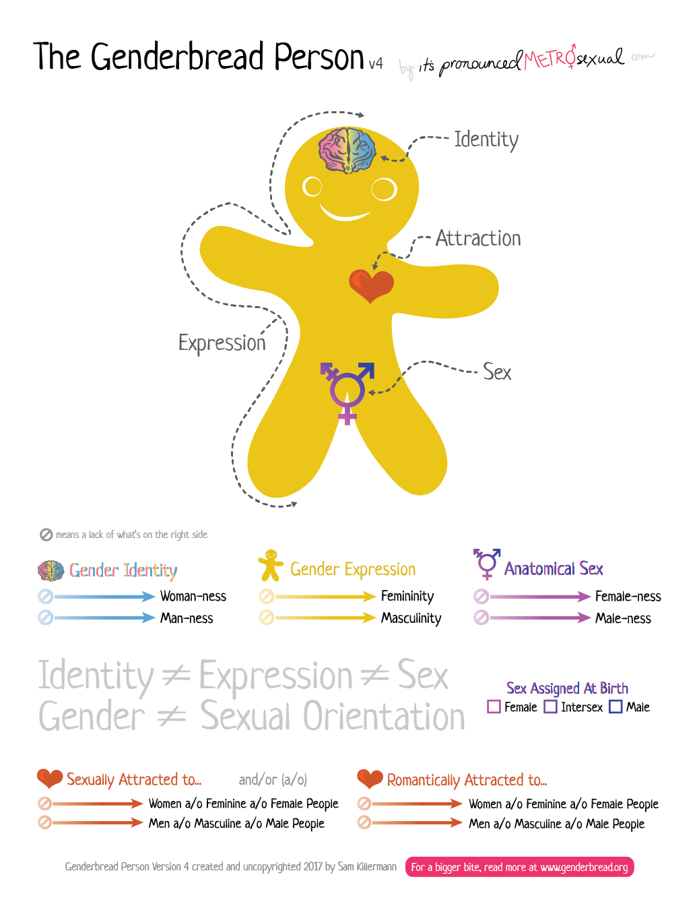

Slide 10
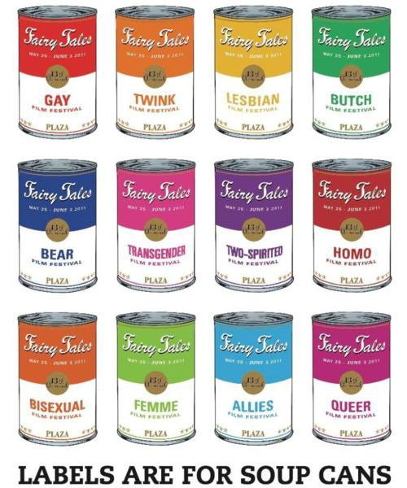
which identities are your most valued? how do you label yourself?
How does your “label” differ from the contents inside?
How do our LGBTQ+ students navigate feeling like a label?

Slide 11
HETERONORMATIVE
Common Mistakes
“Which one’s the man and which one’s the woman”
Assuming gay men are feminine
“You don’t look gay/trans/etc.”
Thinking their partner is their friend even if they’re obviously romantic [GAL PALS]
Assuming someone’s straight

Slide 12
INVASIVE
Common Mistakes
Asking about gender affirming surgery
“You just haven’t found the right ____”
“But you look so good as a ____”
Discussion on “passing” and validation

Slide 13
INVALIDATING
Common Mistakes
Assumptions that gay or trans* people are predatory/watching you change
Assuming that bisexuality isn’t real/”pick a side”/bisexuality is selfish
Whispering the word gay as if it’s a bad word

Slide 14
Using someone’s correct pronouns
Displaying yours
Using representation in examples
Not assuming anyone is straight
Using inclusive terms such as:
  partner, spouse, signification other, parent, sibling
Use they/them if you’re unsure
microvalidations
for everyday life

