Slide 1
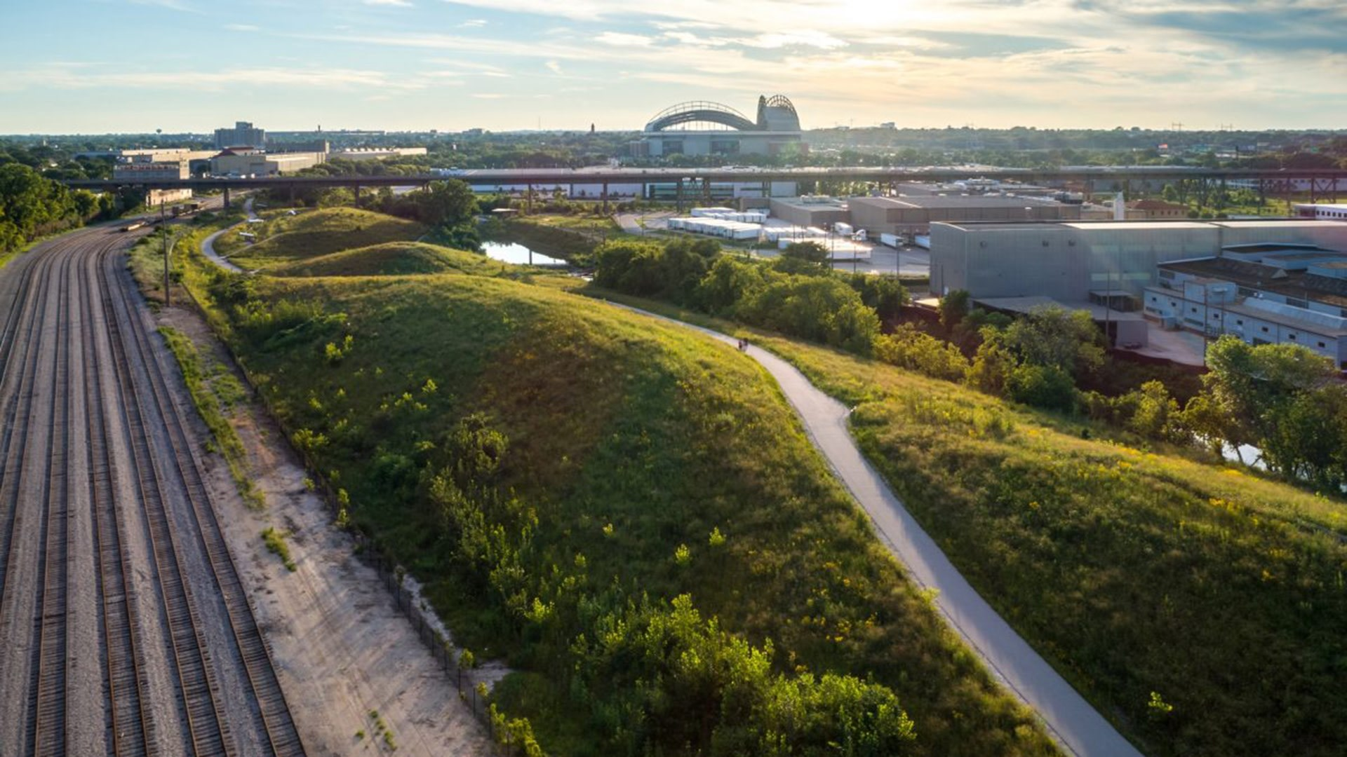
MARQUETTE UNIVERSITY &
CARING FOR OUR COMMON HOME
SOUP WITH SUBSTANCE
FALL 2022

Slide 2
FOUNDATION
Caring for our Common Home UAP
Today’s environmental crisis is impacting in a particular way on the poor and vulnerable. Action is needed urgently by Christians and by all people of good will.
IPCC’S CLIMATE CHANGE REPORT:
Total net anthropogenic GHG emissions continue to rise
Global GHG emissions in 2030 associated with the implementation of nationally determined contributions announced prior to COP2624 would make it likely that warming will exceed 1.5°C during the 21st century
Even if we ceased all emissions today, the negative effects of climate change will still impact us for 30+ years such as:
  Increased storm frequency and intensity
  Increase in 100yr flood events
  Extreme heat and wildflowers
  Sea level rise
  Ocean acidification

Slide 3
FOUNDATION
Laudato Si Encyclical
SIX CHAPTERS:
What is happening in our common home-degree of human intervention associated with consumerism and business has made our earth less beautiful and rich.
The Gospel of creation- earth was here before us and has been given to us-reject notion that we have dominion over other creatures and accept that we have a duty to steward the earth now and for future generations.
The human roots of the ecological crisis- the way we tend to search for meaning of human life has gone awry leading to the ecological crisis by way of the technocratic paradigm.
Integral Ecology-we urgently need a humanism capable of bringing together the different fields of knowledge, including economics, in the service of more integral and integrating vision that includes human, family, work, environment, ecosystem, etc.
Lines of approach and action- a global consensus is essential for confronting the deeper problems, which cannot be resolved with unilateral actions on the part of individual countries.
Ecological education and spirituality- humans need to change. We forgot or lack awareness of our origin, mutual belonging to this earth and future to be shared with all beings.
Notes:
Laudato Si (Praised Be) encyclical by Pope Francis is the most comprehensive Vatican document to date on environmentalism, ethics, and Christian faith. The document is intended for all people, of all faiths. While the arguments are founded in theological convictions, these convictions are put into a general philosophical language that expands across all moral reasonings includes human rights, natural law, character, justice and consequences.
Everything, human and non-human, is connected. The human failure occurs when we forget we are all connected

Slide 4
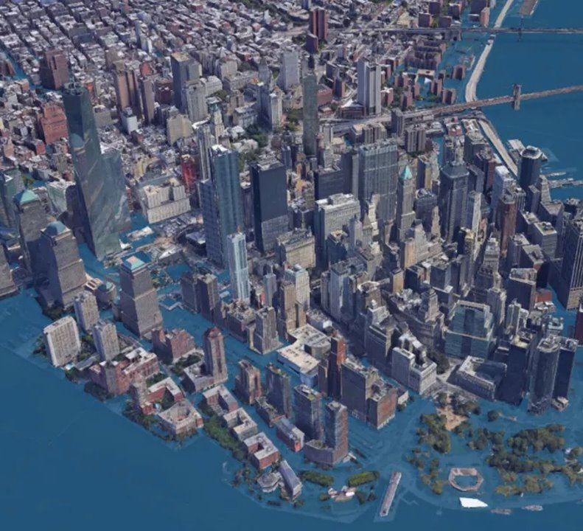

RISKS CLIMATE CHANGE POSES TO HEI'S
Climate change poses real risks to our physical infrastructure as well as our social systems and financial security.
We have already seen how a sudden and significant change in the status quo can disrupt an entire institution's operations and social structure.
Sea level rise --> impacts institutions located in coastal regions
Wildfires --> impacts institutions situated in wildfire country
Extreme heat --> impacts all institutions in North America
Extreme and frequent flooding --> impacts Midwest and coastal regions
Notes:
John Elkington coined the phrase in 1997.
Typically associated with sustainability and business but can be applied when thinking about how to achieve an enhanced quality of life in our communities.
You might have seen an overlapping venn diagram coined people, planet and profit or economic vitality, social equity and environmental protection. We are shifting away from the venn diagram model where all circles are the same. Go to 1:38 in video https://www.youtube.com/watch?v=2f5m-jBf81Q

Slide 5
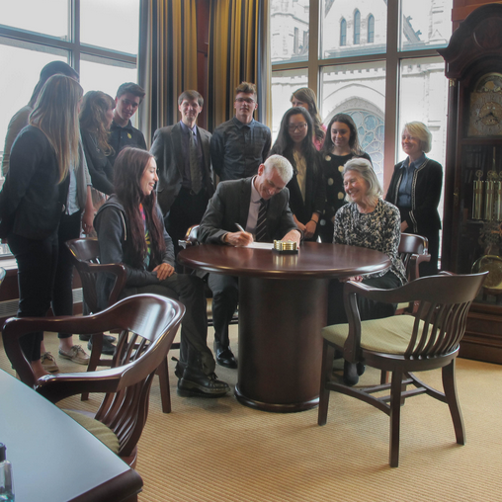
MARQUETTE’S COMMITMENT
2015-President Michael Lovell signed the Saint Francis/Laudato Si pledge
PRAY and reflect on the duty to care for God’s Creation and protect the poor and vulnerable.
LEARN about and educate others on the causes and moral dimensions of climate change.
ASSESS how we, as an institution, contribute to climate change by our own energy use, consumption and waste.
ACT to change our choices and behaviors to reduce the ways we contribute to climate change.
ADVOCATE for Catholic principles and priorities in climate change discussions, especially as they impact those who are poor and vulnerable.

Slide 6
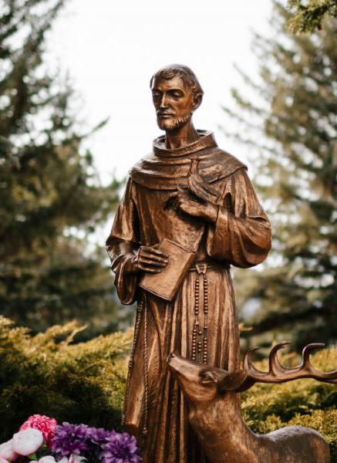
PRAY
Sustainability and environmental champions within Marquette Mission & Ministry Office
  Mission Conversation: Exploring Integral Ecology
  In the past: Tree blessings, Feast of Assisi Day celebration
Opportunities
  Integration and understanding of UN 17 Sustainable Development goals and how they relate to our morals and value→ how they are related to faith
    No poverty, zero hunger, reduced inequalities; peace, justice and strong institutions
Resources for Prayer
  Catholic Climate Covenant
  The Jesuits: The Society of Jesus

Slide 7
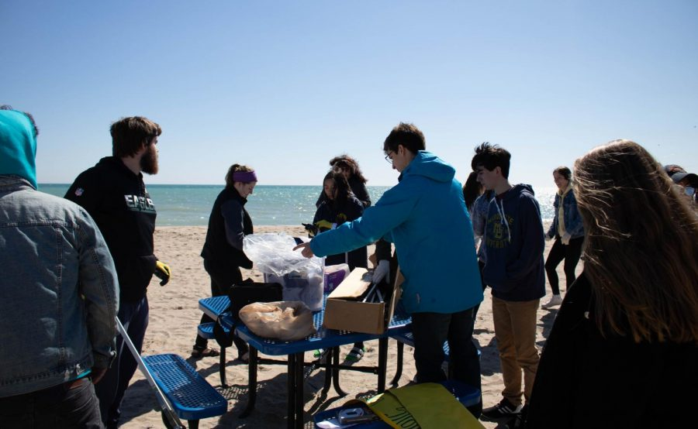
LEARN
30 undergraduate courses that are sustainability-focused or inclusive
10 graduate courses that are sustainability-focused or inclusive
14/46 departments that offer sustainability-focused or inclusive course
Abundant faculty-led research projects and integrating sustainability into curriculum

Slide 8

ASSESS
Completed Sustainability, Tracking, Assessment and Rating System (STARS) report in 2021, received a Bronze Rating in 2022
Opportunities
  Laid foundation to create a strategic plan for advancing sustainability and decarbonizing Marquette University.
  Strategic tranportation planning
  Identified Marquette’s strengths, weakness, opportunities and threats to advancing across operations, academics, engagement, planning & administration
  Report is available on MU sustainability website
  2022-2023 opportunities for student engagement in the strategic planning process

Slide 9
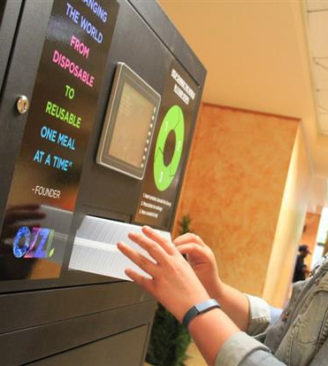
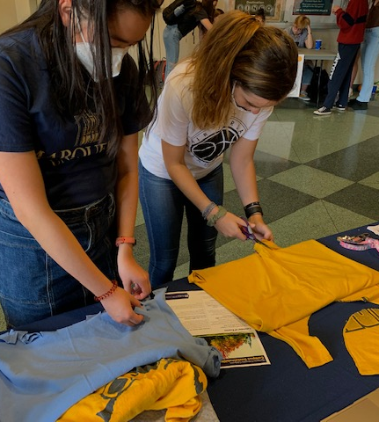
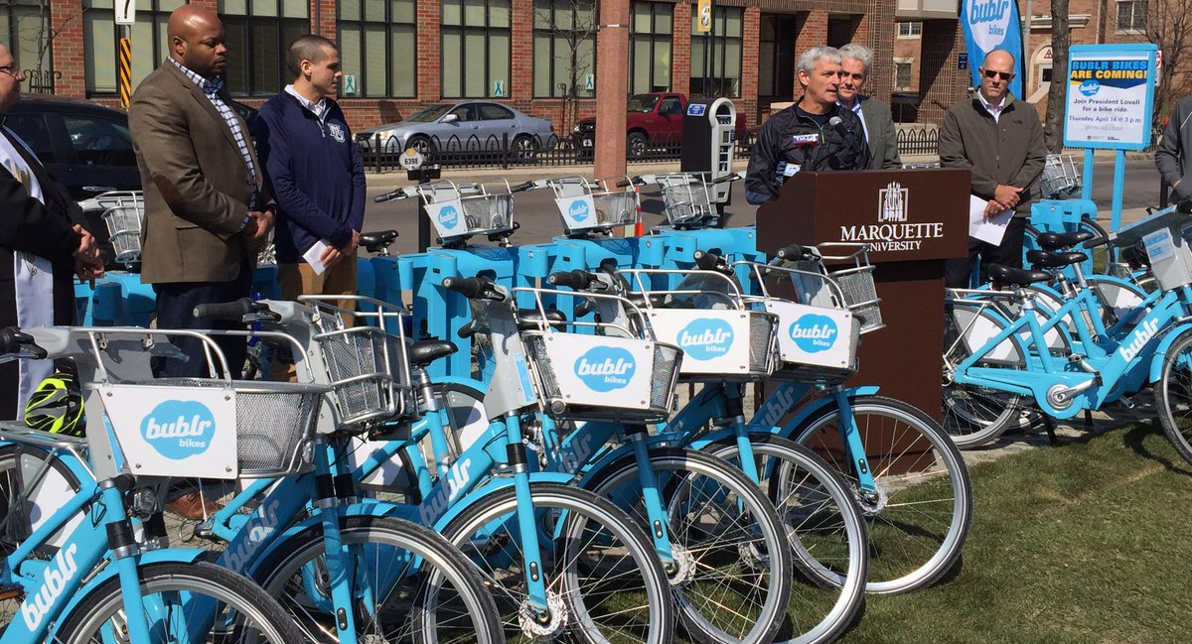
ACT
6 LEED certified buildings and use of green building frameworks for remodels, renovation and building projects
2 solar arrays on campus
Infrastructure to support biking and other alternative transportation options
Home to more than 40 tree and shrub species native to southeastern WI
Policies in purchasing that support social and environmental responsibility
MUPD converting fleet to hybrid vehicles
Sustainability Internship Program in Marquette Sustainability to implement programs across campus
Write new campus sustainability roadmap with new targets, goals and strategies

Slide 10
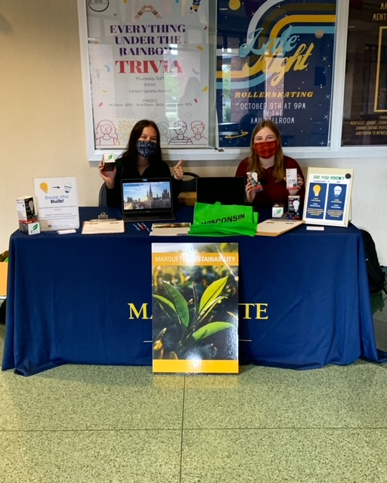
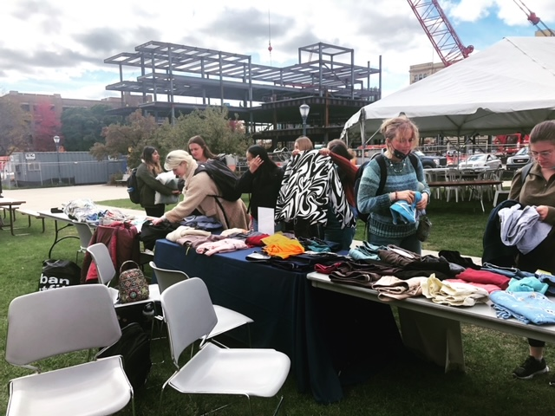
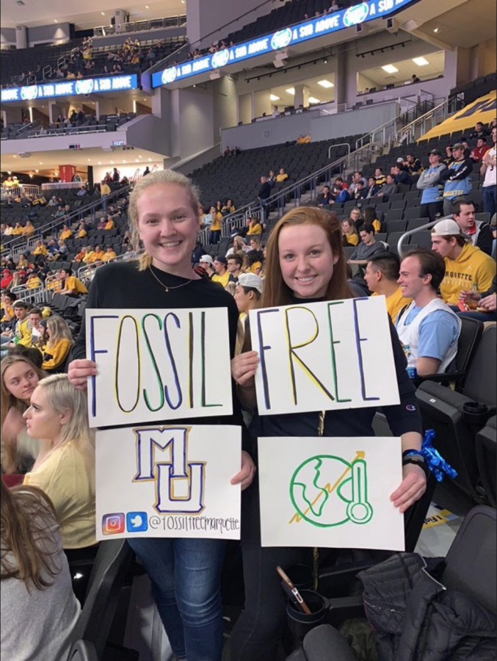
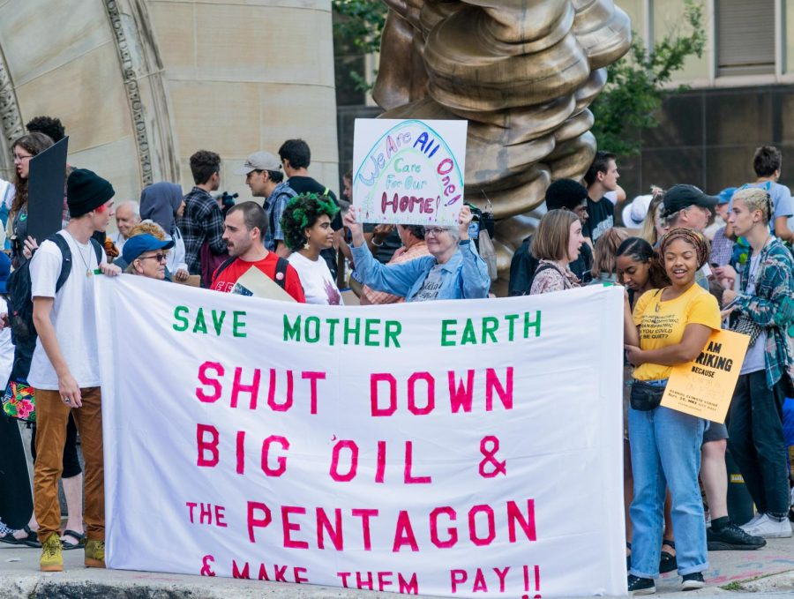
ADVOCATE
.
Student organizations supporting and advocating for climate change and the impact of the poor & vulnerable
  Students for An Environmentally Active Campus (SEAC)​
  Fossil Free Marquette​
  Native American Student Association ​
  Ocean Conservation Club
  Biology Undergraduate Students ​
Sustainability interns and students engage others in peer-to-peer education and outreach to provide deeper understanding.

Slide 11
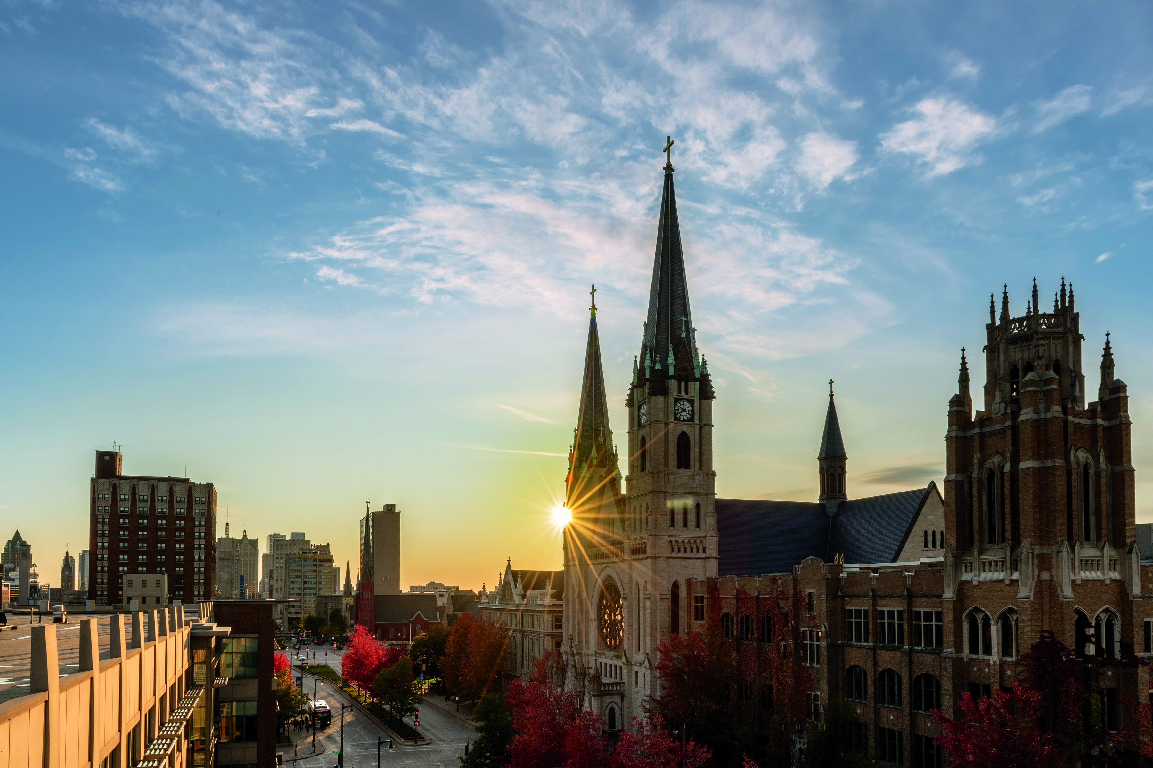
BE THE DIFFERENCE
.
The integral ecology framework challenges us to deepen and broaden our compassion and to care for creation and the poor in our neighborhoods, nations and world.
Find a climate/environment/sustainability thread in course projects and coursework
Use our campus as a living laboratory ---> Good ideas can be put into action!
  Go Wild! Project
  Energy modeling and decarbonization
  Stormwater
  Economic and environmental costs of using goats for weed control over herbicides
  Could we plant, maintain a campus farm-what would it take?
Make monthly, semester, or annual commitments to shift your personal behaviors and commit to holding others accountable.
Climate mitigation, adaptation and species survival is an effort that requires the leadership of many.

