Slide 1
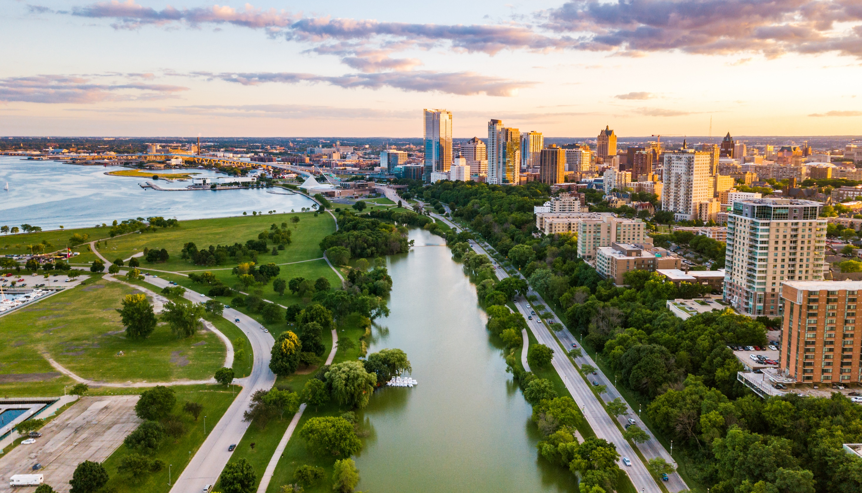
Erick Shambarger
Environmental Collaboration Office (ECO)
City of Milwaukee
Milwaukee.gov/eco
Towards a World Class Eco City
The City of Milwaukee’s efforts on Climate and Environmental Sustainability

Slide 2


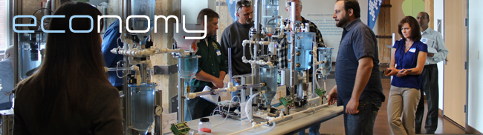
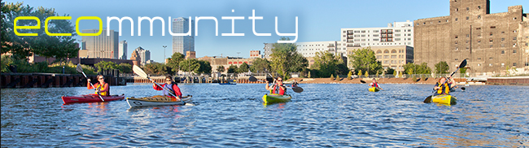
The New Triple Bottom Line
Make Milwaukee a world class eco-city on America’s Fresh Coast.
Develop practical and racially equitable solutions that improve people’s lives and the economy.
Protect and restore the natural eco-systems that are integral to our long-term prosperity.
Develop community and global partnerships
Implement award-winning programs and the City’s Refresh Milwaukee sustainability plan.
Developing new Climate and Equity Plan with City-County Task Force on Climate and Economic Equity

Slide 3



Three Plans that Guide Our Work
2013 2019 2023

Slide 4

Core Sustainability Programs

Slide 5

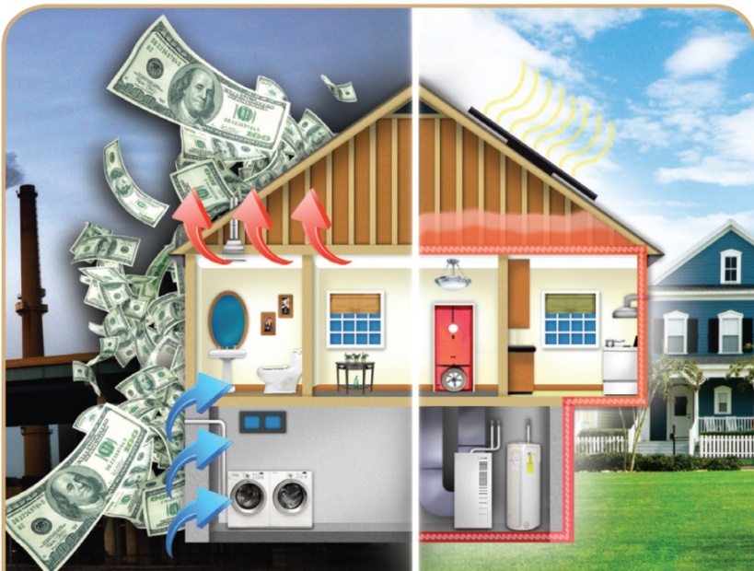
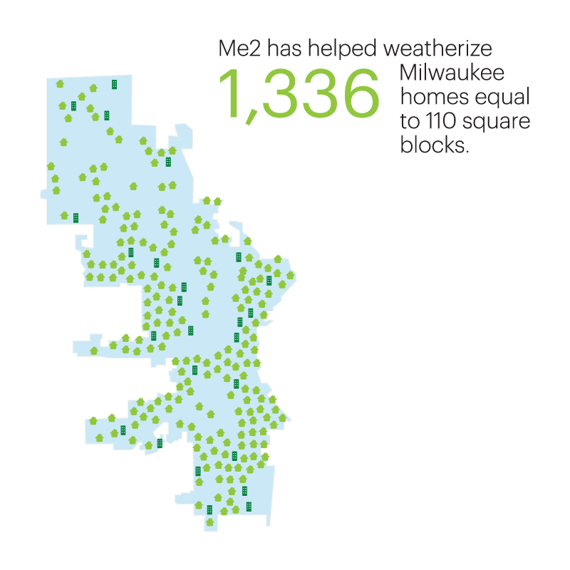
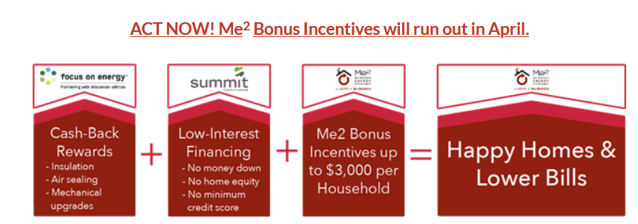
Don’t let your energy dollars go up in smoke!
SmartEnergyPays.com

Slide 6


Slide 7


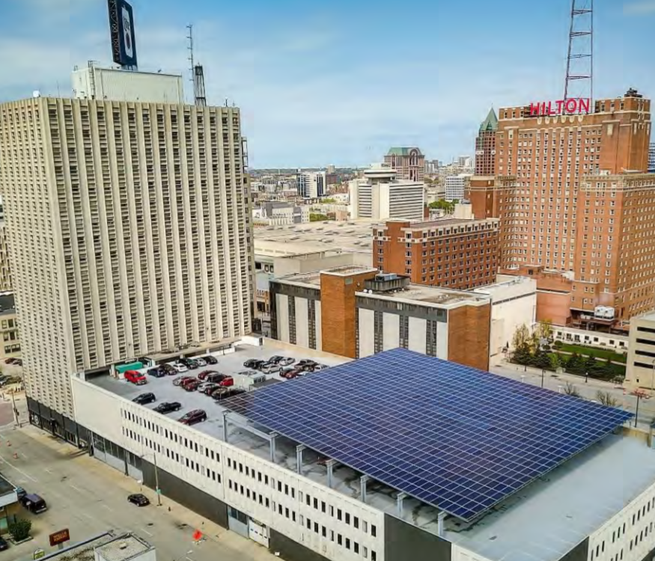
Commercial Buildings
PACE financing overcomes financial barriers for energy efficiency, renewable energy, and water efficiency projects
US Department of Energy has named our PACE program a national “implementation model”
19 projects valued at over $40.4 million have been approved, saving building owners $2.4 m annually
Milwaukee.gov/PACE

Slide 8

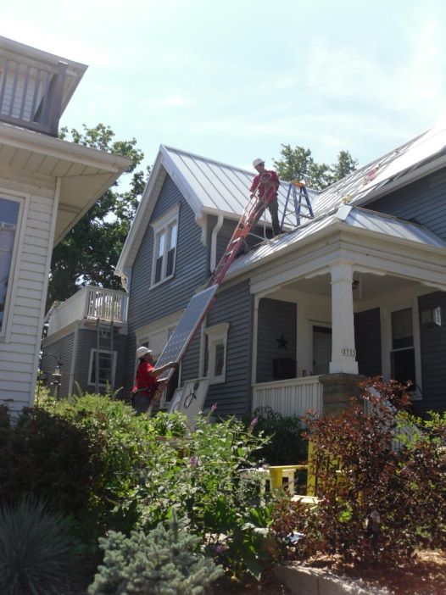
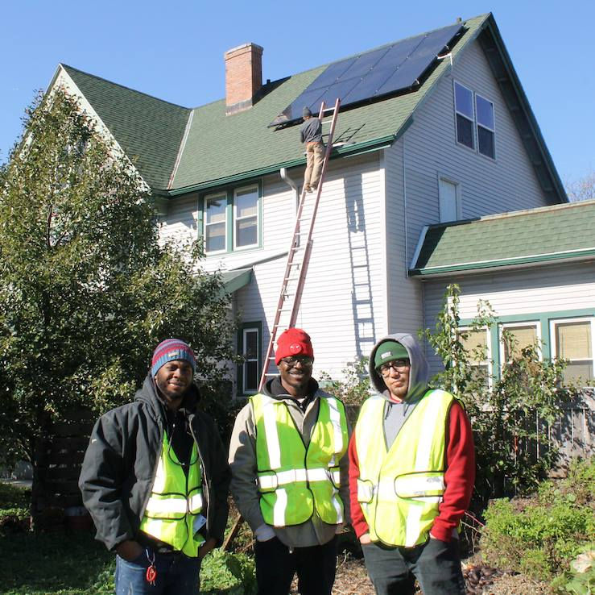
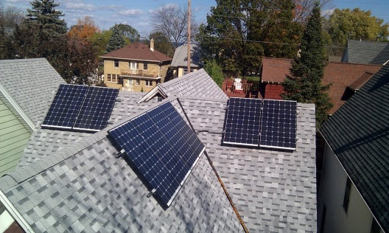
Solar Energy
MilwaukeeShines.com
MILWAUKEE SHINES supports solar energy projects and policy to help create clean, renewable energy and local jobs.
Group Buys
Workforce development
Improved permitting, planning and zoning
282 homeowners have installed 1.3 MW of total solar

Slide 9
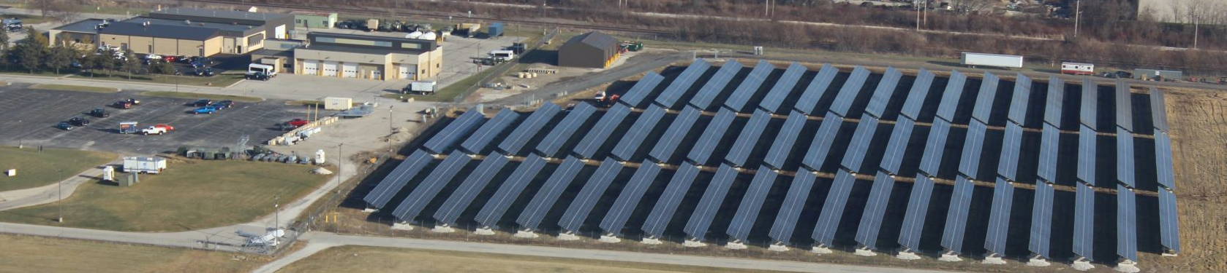
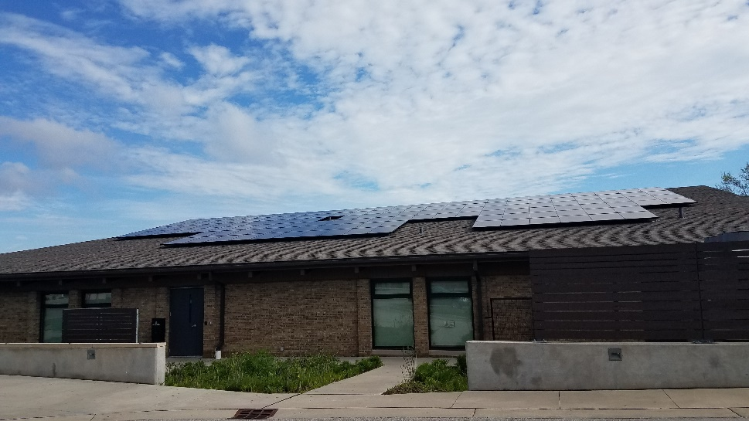
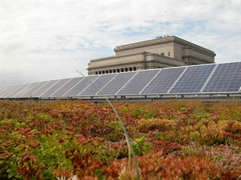
Solar Strategy
Goal: 25% by 2025 Renewable Power For City Facilities
Strategies?
City builds solar
City works with solar developers to finance Solar
Collaboration with We Energies
All of the Above

Slide 10

Milwaukee’s Green Infrastructure Plan
Climate Adaptation in the code
Green Streets
Green Development
Green Parking Lots
Green Jobs with Equity focus
Green Schools
Milwaukee.gov/GI

Slide 11
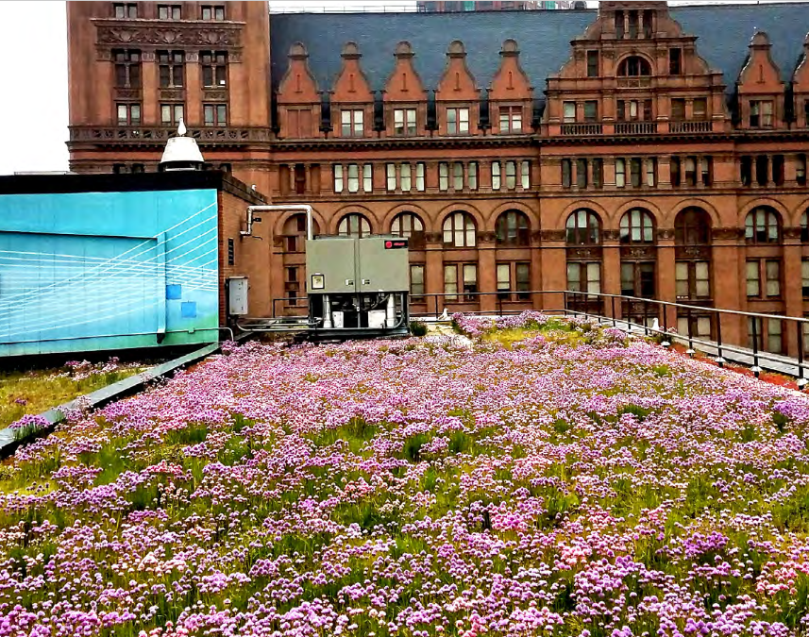
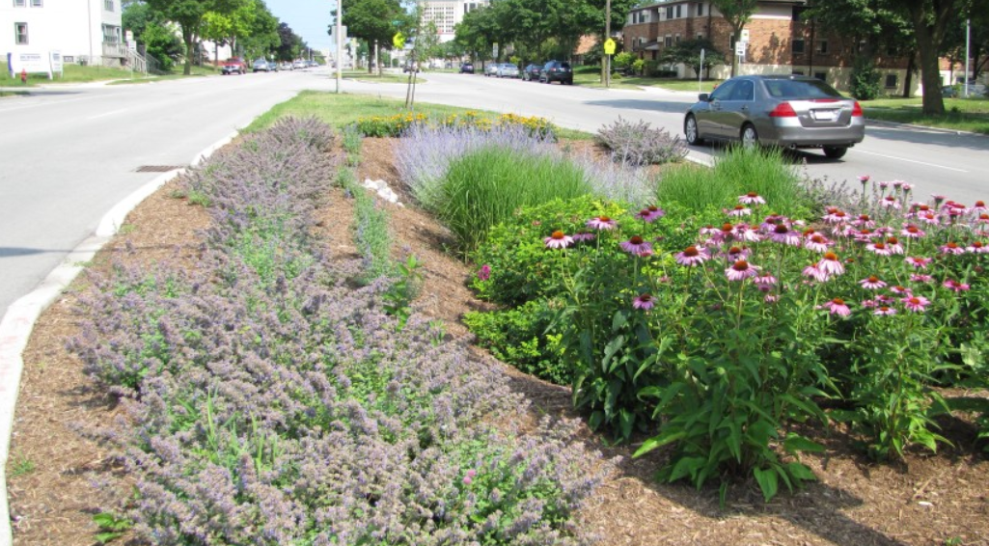
GREEN INFRASTRUCTURE
Bioswale. Photo credit: WUWM
Notes:
Kevin

Slide 12
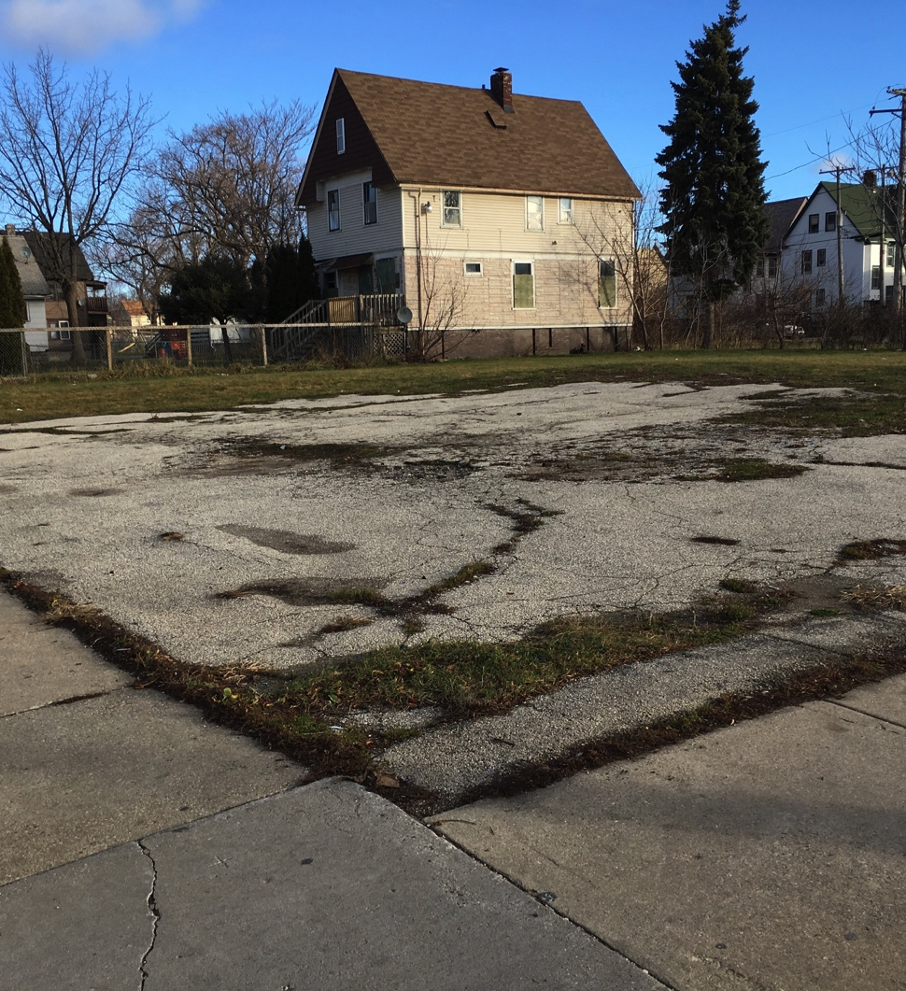
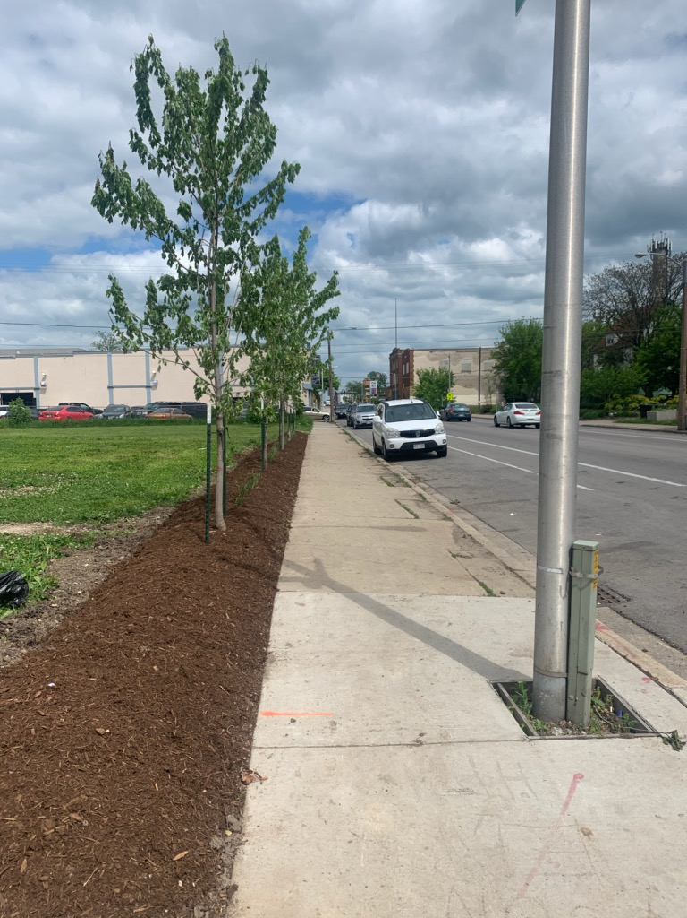
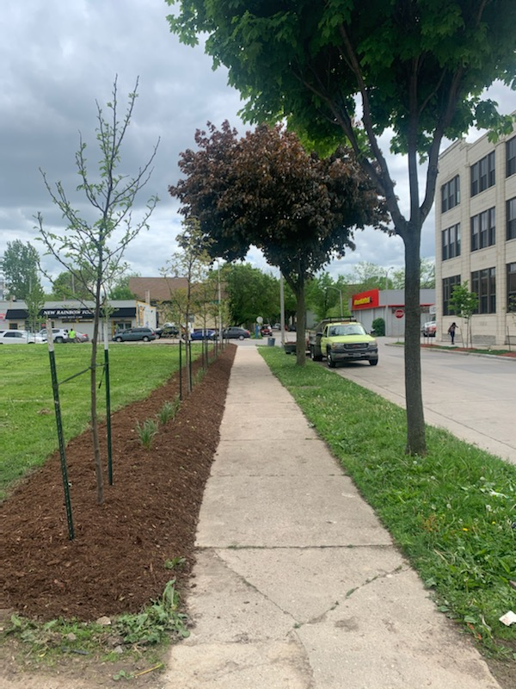
Landscape Edging 15th and North
After, 15th Street
Before
After, North Ave

Slide 13
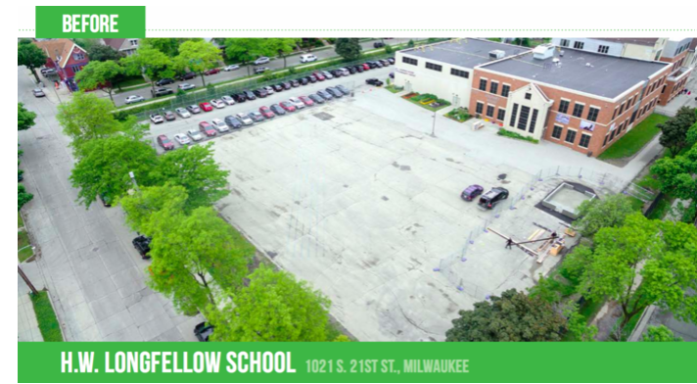
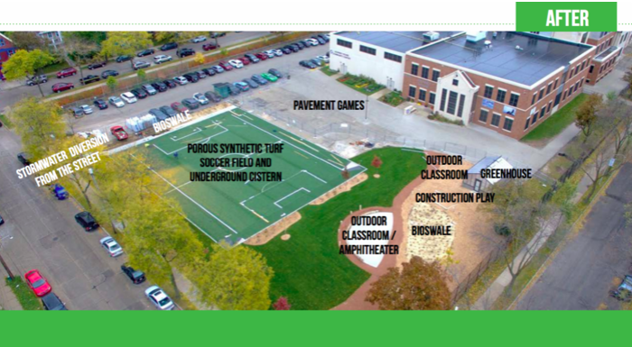

Green Schools www.gscm.refloh2o.com/

Slide 14

Climate and Equity Plan
Milwaukee.gov/ClimatePlan
Reduce community greenhouse gas emissions 45% by 2030 and net zero by 2050
Create green jobs and improve racial and economic equity

Slide 15







Ten Big Ideas
Nature in the City
Healthy Homes (Retrofits)
New Net Zero Energy Homes
Commercial Building Standards
Waste Reduction & Sustainable Consumption
Green Jobs Accelerator
Electric vehicles
People-Centered Transportation
Resilience Ambassadors
6. Net Zero Electric Grid
Notes:
The proposals are organized around Ten Big Ideas that identify actions we can take to reduce emissions and improve our city. All include an equity component – creating or expanding family supporting green jobs.
Some of these proposed recommendations are already in partial development or deployment, but all need to be approved by the Common Council.
And full implementation will depend on funding by the city and county governments.
Let’s take a look. The first three recommendations are focused on buildings.

Slide 16

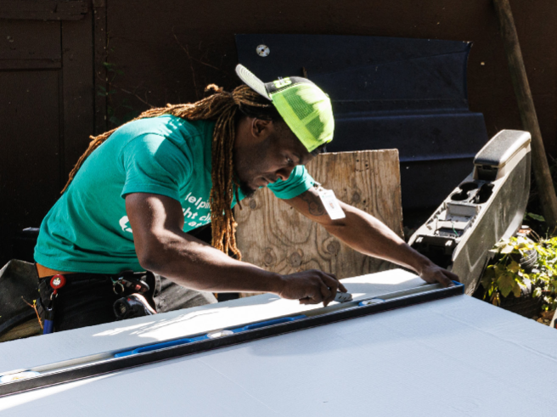
Green Jobs Accelerator
Build Excitement
Clarify Career pathways
Transitional jobs with career ladders
Training with supports
Employer DEI agreements
Notes:
The Green Jobs Accelerator will link workers to training and employment resources in the green jobs sector, which will enable us to address climate change.
Goal: Create an inclusive workforce in the green jobs sector.
Why This Is Important
Climate: We need workers who are skilled in producing clean energy, increasing the energy efficiency of our buildings, and caring for the environment.
Economic Equity: Workers in our community – regardless of race or gender – should be able to benefit from the increasing number of well-paid green jobs.
Recommendations
Clarify career pathways
Recruit potential workers and link them to training with supports (including CDL, OSHA-10, other skills)
Link to employment opportunities
Transitional jobs with career ladders
Community benefits agreements for publicly funded projects
MOUs with employers for diversity and inclusion goals
Support black and brown employers
Need to scale up now to prepare for major federal infrastructure investments

Slide 17


Green and Healthy Homes
Energy efficiency coordinated with lead abatement
Continue and expand existing home weatherization and solar programs
Better coordination and customer navigation among housing repair programs
Notes:
Home energy efficiency upgrades can reduce our use of energy, thereby cutting household costs and decreasing greenhouse gas emissions. When combined with lead abatement, they make homes safer for our children and families.
Goal: Reduce the amount of energy consumed in heating and cooling our homes and running appliances, while addressing lead safety.
Why This Is Important
Climate: Housing accounts for 31% of carbon emissions in Milwaukee. Energy efficiency is one of the most cost-effective ways to save help households save money, reduce greenhouse gas emissions, and create jobs.
Economic Equity: Low-income households, particularly those in predominantly Black or Hispanic neighborhoods, spend almost twice as much of their income on energy as white households. They also report the highest levels of lead poisoning with lead poisoning affecting one-in-four children living impoverished neighborhoods.
Recommendation details:
Support a holistic approach to housing renovations: coordinate lead abatement, energy efficiency, and other home improvements
Streamline systems to help residents enroll in housing programs
Expand the Me² program and Weatherization Assistance
Develop strategies to replace gas appliances with electric, including cold climate heat pumps
Support contractor and workforce development

Slide 18

New Net Zero Homes
New affordable homes built on scattered vacant lots
Net Zero Energy
Attractive and durable
Factory built
Manufacturing jobs
Notes:
New technology in modular housing makes it possible to build new, energy efficient homes, that are less expensive and safer to build.
Goal: Build new energy efficient and climate-ready affordable housing.
Recommendation details:
Work with an “off-site” building system manufacturer. I.e. construct complete wall systems in a factory setting, which can be assembled into homes on vacant lots.
New homes designed for durability, affordability, attractiveness, and high energy efficiency standards
Supports the Community Development Alliance housing plan to advance equitable housing
Background information
The City of Milwaukee has approximately 1,750 buildable vacant lots scattered throughout neighborhoods suitable for single-family or duplex development

Slide 19

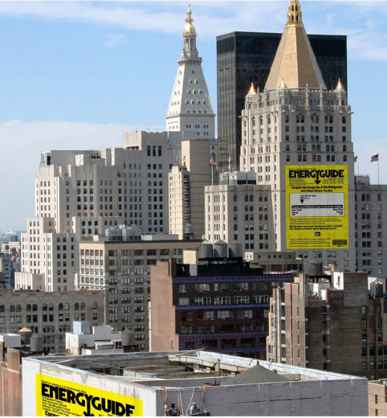
Commercial Building Benchmarking
Required Reporting of Annual Energy Use
Phased-in energy standards later in decade
Advocate for stronger State building energy code
Notes:
Measuring the use of water and energy enables large businesses to monitor their use of these resources and establish benchmarks for future use.
Goal: Enable large building owners to reduce water use and greenhouse gas emissions.
Why This Is Important
Climate: Commercial and industrial buildings are responsible for 45% of greenhouse gas emissions in Milwaukee – the largest single source.
Economic Equity: Inefficient buildings that consume large quantities of water and energy, reduce the availability of resources for the public, drive up the costs of these resources, and contribute to local pollution.
Recommendation details:
Establish a Commercial Building Energy Benchmarking ordinance (annual energy reporting)
Phase in a Building Performance Standard that requires buildings to meet greenhouse gas reduction targets over time
Engage stakeholders with an equity lens to help refine the policies
Advocate with the State of Wisconsin to adopt the international model energy code
Background
Commercial buildings include office buildings and commercial space, as well as multi-family apartment buildings with more than 4 units.
State of Wisconsin controls the building code
Since 2012, the City of Milwaukee has championed the U.S. Department of Energy’s Better Buildings Challenge, with voluntary participation of 133 commercial buildings in the city
Recommendations are supported by leading national climate policy organizations including by ICLEI-USA, IMT, ACEEE, USGBC
Mayor Johnson joined the Building Performance Standard Coalition, a White House CEQ led effort of over 30 states and local governments to implement building performance standard policies by Earth Day, 2024

Slide 20

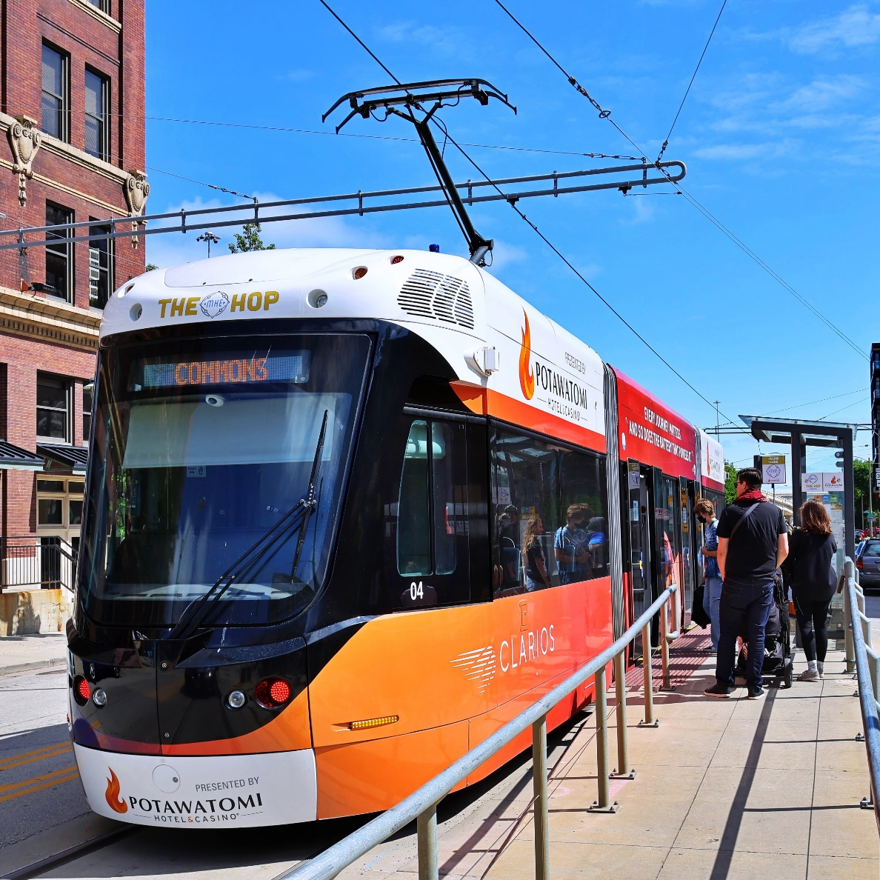
People – Centered Transportation
Expand and Modernize Transit
Walking and biking
Land Use and Zoning
Notes:
Making transit, biking, and walking more accessible meets the transportation needs of more people while reducing greenhouse gas emissions from vehicles.
Goal: Decrease the use of combustion engine vehicles and the number of single-passenger vehicle trips.
Why This Is Important
Climate: Transportation is a major source of global warming, accounting for 22% of carbon emissions in Milwaukee.
Economic Equity: Everyone, especially low-income families, benefit from the ability to walk, bike, or use transit to get to work and other places.
Recommendations
1. Transit
Expand Bus Rapid Transit (7 new routes proposed by SEWRPC)
Coordinate streetcar expansion with the County
Improve existing route frequency and facilities
2. Active Modes (Walking and Biking)
Connect trails to the 30th Street Corridor
Add protected bike lanes
Complete design changes to 27th St., Fond Du Lac Ave., Capitol Dr., 35th St.
3. Land Use & Zoning provide the infrastructure to support these initiatives
Increase Transit-Oriented Development and reduce space reserved for parking
Update zoning codes to increase density (e.g. allow accessory dwelling units); eliminate parking minimums on development
Advocate to the State to allow for inclusionary zoning laws
Background
Prosperous cities and neighborhoods feature mixed uses, vibrant streets, and are safe for pedestrians and bicyclists
Designing cities around car travel and highways have contributed to urban population declines, high-speed reckless driving, disconnected people from jobs, and created the economic burdens of car ownership
Achieving “mode shift” to walking, biking and public transit depends on long term infrastructure and land use changes.
Equity is woven throughout this proposal. Inequitable transportation access results from a legacy of discriminatory housing, land use and transportation policies that this plan seeks to address.

Slide 21

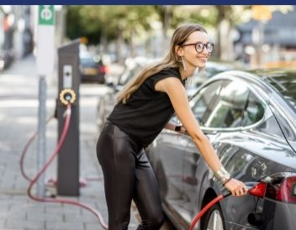
Electric Vehicles
Charging network plan
City fleet
Commercial properties requirements
Public Awareness
Notes:
Creating a widely distributed charging infrastructure will enable more people to use electric vehicles, which create less pollution and fewer greenhouse gas emissions.
Goal Enable the transition to electric vehicles.
Why This Is Important
Climate: Gasoline and diesel-powered vehicles are a major source of air pollution and global warming, accounting for 22% of carbon emissions in Milwaukee.
Economic Equity: Low-income and minority neighborhoods have greater exposure to vehicle emissions that contribute to asthma, bronchitis, and cancer.
Recommendation details:
Adopt an equitably designed charging network for vehicles.
By 2023, develop a city ordinance that requires EV charging infrastructure at parking lots, multi-family residential buildings, mixed use developments and other commercial properties.
Advocate for supportive EV policies with State of Wisconsin and utilities
Background
The bipartisan infrastructure bill allocates $7.5 billion to build EV charging networks.
EV’s have no tail-pipe emissions
Absent significant policy and program intervention EV adoption will not achieve its potential toward achieving climate and equity goals in MilwaukeAlthough the Milwaukee area has a higher concentration of EV adoption than most of the state, EVs are still less than one percent of all registered vehicles in the City of Milwaukee and Milwaukee County.

Slide 22


Clean Electricity
Rooftop solar
Statewide advocacy for utility scale solar and supportive policy
Municipal purchases of renewable energy
Notes:
Transition to clean and renewable energy sources can power our electric grid.
Goal: Reduce, and eventually eliminate, emissions from the electric power sector.
Why This Is Important
Climate: The electric grid that provides power to our homes, businesses - and ultimately our cars – is currently generated from burning fossil fuels – including coal -- which contribute to climate change.
Economic Equity: Instead of purchasing gas and coal from out of state, we can invest in renewable energy, which creates local jobs.
Recommendations
Support robust and competitive rooftop solar market and utility-scale investments in renewable energy
Purchase 25% to 100% of the City’s municipal electric needs from We Energies through new proposed “Community Energies” program (DRER-alternative)
Advocate at the State level through Wisconsin Local Government Climate Coalition and direct intervention on PSC cases
Background –use as needed to answer questions
By 2025 – in three years -- the city plans to have 25% of its energy coming from renewable sources
We Energies is the sole public electric utility in our area. They are regulated by the Public Service Commission of Wisconsin.
We Energies’ fuel mix is mostly coal and gas. It announced plans to eliminate coal by 2035 and be carbon neutral by 2050.
Current state and utility policies regarding rooftop solar lag other states
A greener grid underpins other strategies for electrification of vehicles and buildings

Slide 23
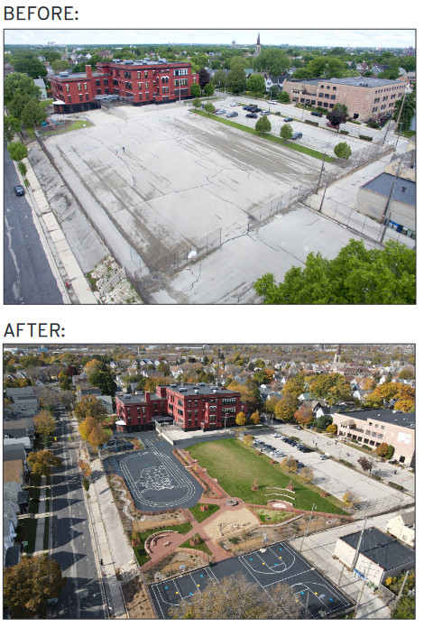

Nature in the City
Protect natural land
Transform schoolyards
Expand the tree canopy
Incentivize de-paving
Notes:
Natural areas and green space contribute to the overall health of a community, while decreasing the amount of carbon dioxide and pollutants in the air.
Goal: Protect remaining natural areas and equitably grow Milwaukee’s tree canopy and green infrastructure to benefit the environment, expand employment opportunities, and improve public health.
Why This Is Important
Climate: Trees and other plants absorb carbon dioxide and other emissions that pollute the air and contribute to climate change.
Economic Equity: Low-income and minority households in areas with limited tree cover are more affected by heat waves and air pollution.
Recommendations
Protect Environmentally Sensitive Lands (especially next to Lakes and Rivers)
Expand the Green and Healthy Schoolyard Redevelopment Program (double by 2030)
Implement the Branch Out Milwaukee Campaign
(This plan centers on developing community-based partnerships to build understanding of the social, health, economic, and environmental benefits of urban tree canopy; maintaining Milwaukee’s existing canopy; planting trees in accordance with community-defined priorities; and employing local residents for community organization and education, tree planting, and tree maintenance. )
Green-Cooling Commercial Lots
(Incentivize private commercial property owners to de-pave portions of their parking lots and replace those areas with native trees and plants to help curb urban heat, reduce flooding, beautify the City, and increase biodiversity).
Background
Trees remove carbon dioxide from atmosphere and create oxygen
Excessive amounts of pavement create urban heat islands, increase flood risk, and reduce biodiversity
Less tree canopy in communities of color
City adopted a Green Infrastructure Plan in 2019
Photo: Lake Park in Milwaukee, Baluzek Getty Images

Slide 24


Was Waste Reduction & Sustainable Consumption
Prevent food waste
Rescue surplus food
Feed hungry people
(FEED = “Food Excess Equitable Distribution” partnership)
Plastics reuse systems
Notes:
Properly storing and distributing food to those that need it will keep more food out of landfills, thereby reducing greenhouse gas emissions.
Goal: Reduce the amount of food that is wasted and sent to landfills.
Why This Is Important
Climate: 40% of all food in America is wasted and sent to landfills, which emit methane and other greenhouse gases. At tht same time, families face food insecurity.
Economic Equity: Food recycling feeds people and creates jobs.
Recommendations
Initiate the FEED Milwaukee Collaboration
FEED = “Food Excess Equitable Distribution” to rescue surplus food and distribute it to hungry people
Develop an educational/outreach campaign to encourage residents, restaurant owners, grocery stores, and institutional cafeterias to manage the amount of food they prepare and donate the surplus
Identify barriers and opportunities for food donation, handling, and distribution, including apps to connect people and food
Background
Food and organic materials that decompose anaerobically in landfills create methane, a powerful green house gas
Food insecurity and health problems related to food are an equity concern.
US EPA’s “Food Recovery Hierarchy” prioritizes the best uses for excess food
Secondary Strategy: Support plastic re-use systems to reduce waste from takeout containers and cups

Slide 25

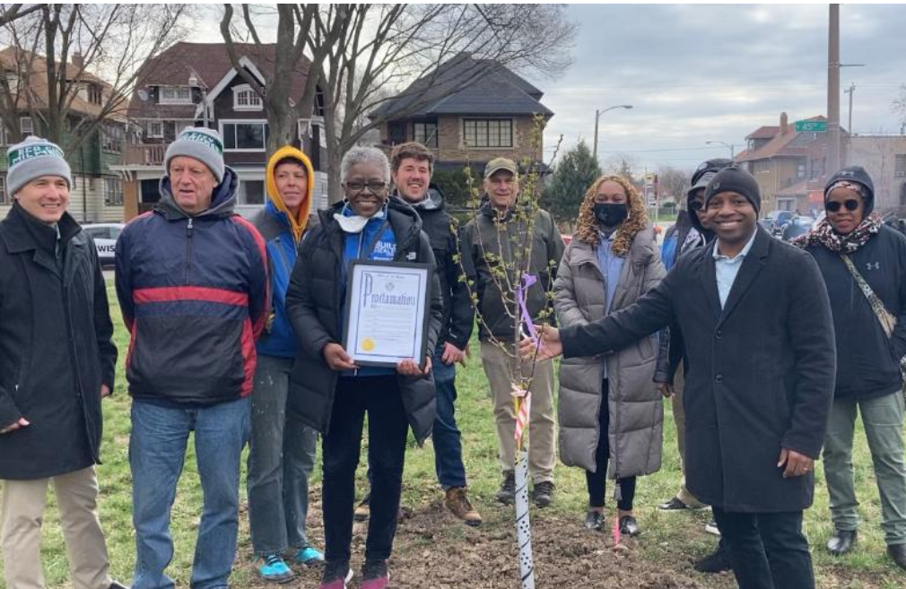
Resilience Ambassadors/ECO Neighborhoods
Trusted messengers
Educate and collaborate on new and existing climate and health programs
Notes:
Ambassadors can help residents access the services they need to improve the energy efficiency and safety of their homes, recover from disaster, and green their neighborhoods.
Goal: Ensure equitable access to community climate mitigation and recovery resources.
Why This Is Important
Climate: Widespread utilization of climate mitigation and recovery services will help our community to become more resilient.
Economic Equity: Residents in our most vulnerable communities are most heavily impacted by climate change.
Recommendations
Work with trusted messengers to connect residents with resources, such as
City’s housing programs, including lead abatement, energy efficiency, and other programs
MMSD Pipe Check program
City anti-displacement programs
Prioritize flood-prone neighborhoods & review floodplain vulnerability
Resiliency hubs – provide one-stop shops for assistance
Background
How do we prepare residents for climate change impacts that are already happening?
Risks: Flooding, Heatwaves, extreme cold.
MMSD Resilience Plan
ECO EPA Environmental Justice Grant

Slide 26

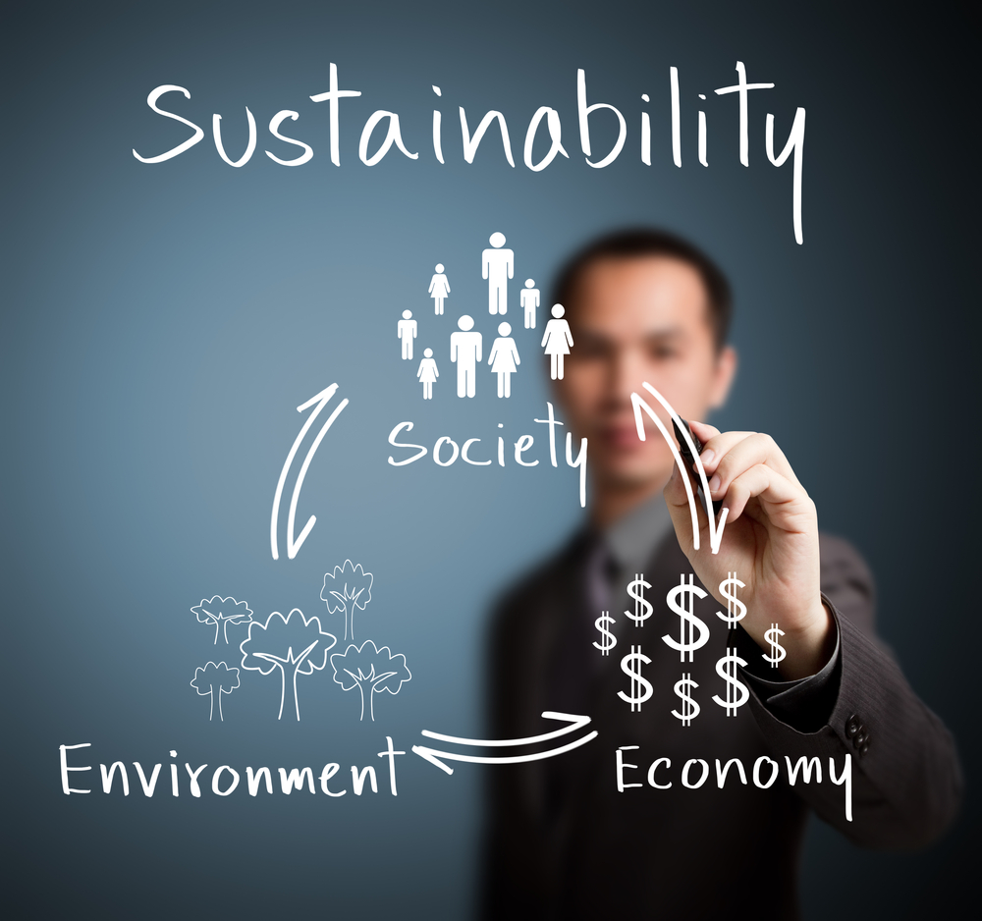
Paying For the Plan
Reallocating existing budgets for fossil fuel economy and climate impacts
Financing tools to pay for costs that yield long-term savings
Federal Infrastructure bill (IIJA) and Climate Bill (IRA).
Notes:
Understand existing spending on the fossil fuel economy, + repairing the damage of climate change
Reallocate existing budgets for climate friendly solutions. For example, the millions of dollars spent annually on road expansions can be used for safer streets
Financing tools like Me2 loans and Property Assessed Clean Energy Financing make loans available to people and businesses so they can afford energy efficiency improvements and solar energy
Utilize new federal funds available through the Infrastructure Investment and Jobs Act and Inflation Reduction Act.
The Plan provides a detailed outline that aligns the 10 Big Ideas to new funding sources.

Slide 27

AND
RESPONSIBILITY

Slide 28
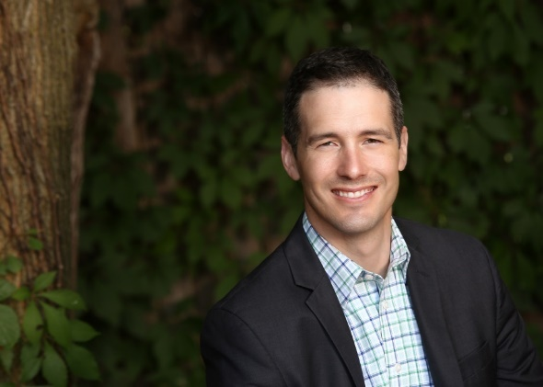
Let’s Collaborate
Erick Shambarger Director of Environmental Sustainability eco City of Milwaukee eshamb@milwaukee.gov
milwaukee.gov/eco

