Slide 1
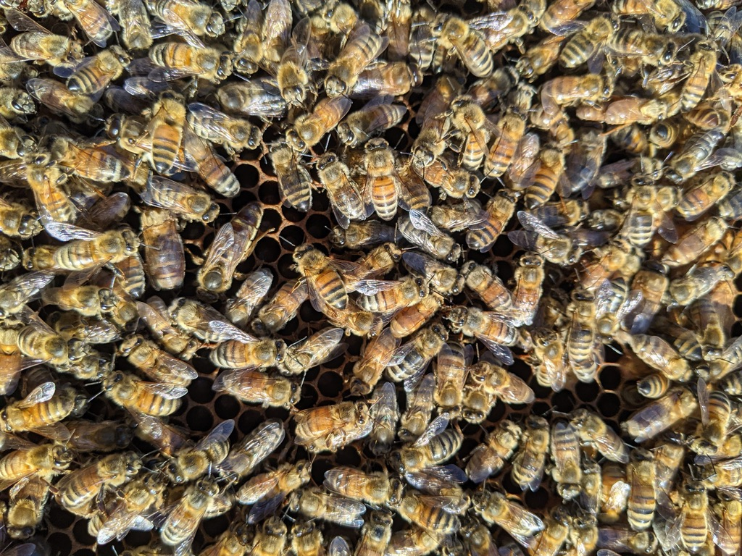

Slide 2
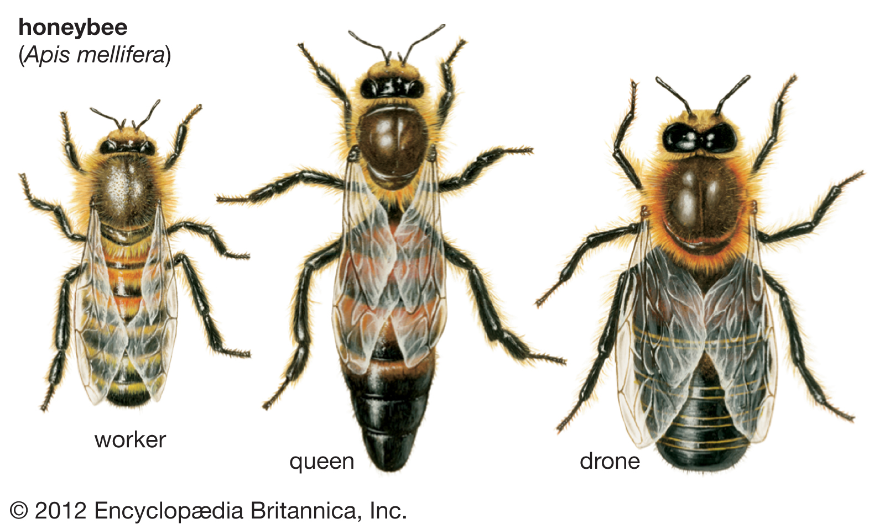

Slide 4
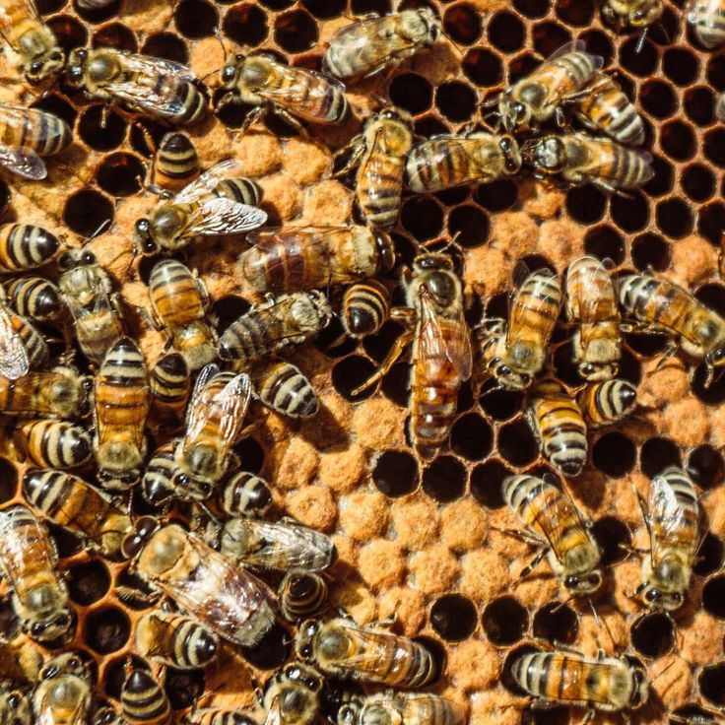
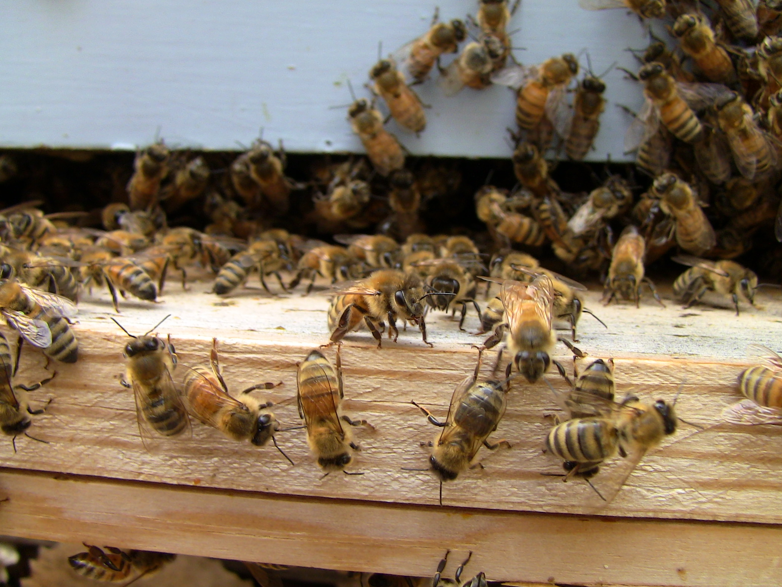
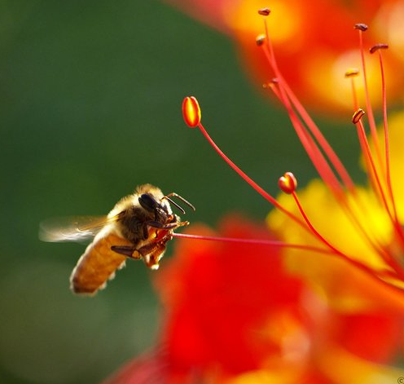
Introduction
Nurse
Guard, Fanner, Undertaker
Forager
0-12 days
12-21 days
21-40 days
Notes:
Nurses are the youngest bees, and perform many of the tasks inside the colony, like cell cleaning, feeding larvae, and feeding the queen

Slide 5
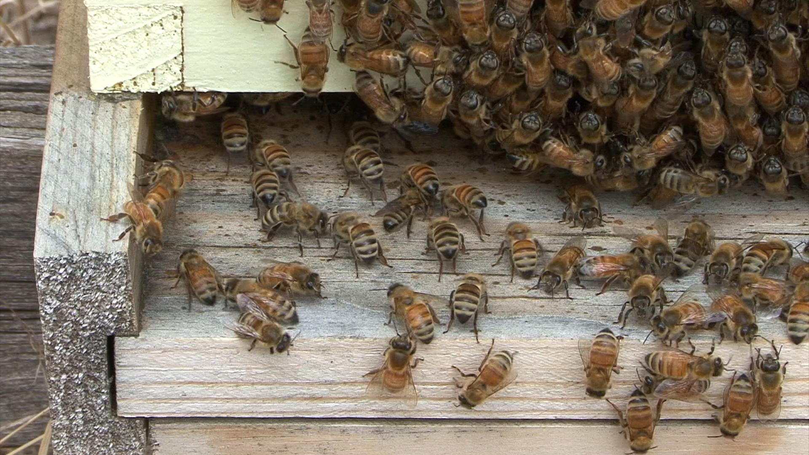
Video:
Peter Erb
Notes:
Fanning is a thermoregulatory behavior to keep the colony at 36C so larvae inside develop correctly

Slide 6

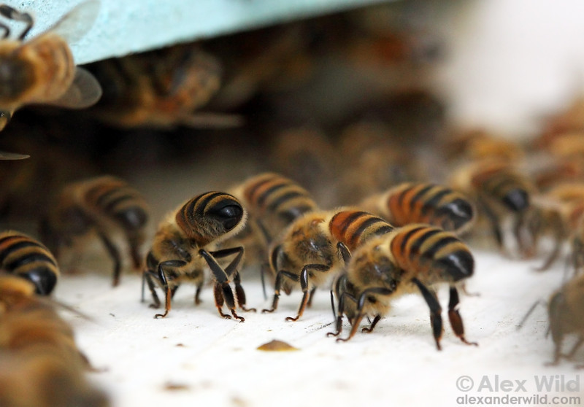

Ecological
Information
Social
Information

Slide 7
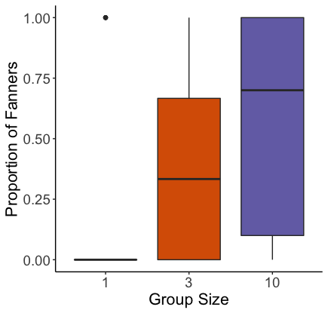
Probability of Fanning
Cook & Breed 2013

Slide 8
Probability of Fanning
Cook & Breed 2013

Slide 9
Probability of Fanning
Cook & Breed 2013

Slide 10
Q1 - Results
Probability of Fanning
Cook & Breed 2013
X²= 24.917, df=2, p<.001, n=240

Slide 11
Cook & Breed, Animal Behaviour 2013
X²=27.0117, df=3, p<0.001, n= 240

Slide 12
Cook & Breed, Animal Behaviour 2013
X²=27.0117, df=3, p<0.001, n= 240

Slide 13
Cook & Breed, Animal Behaviour 2013
X²=27.0117, df=3, p<0.001, n= 240

Slide 14
Cook & Breed, Animal Behaviour 2013
X²=27.0117, df=3, p<0.001, n= 240

Slide 15
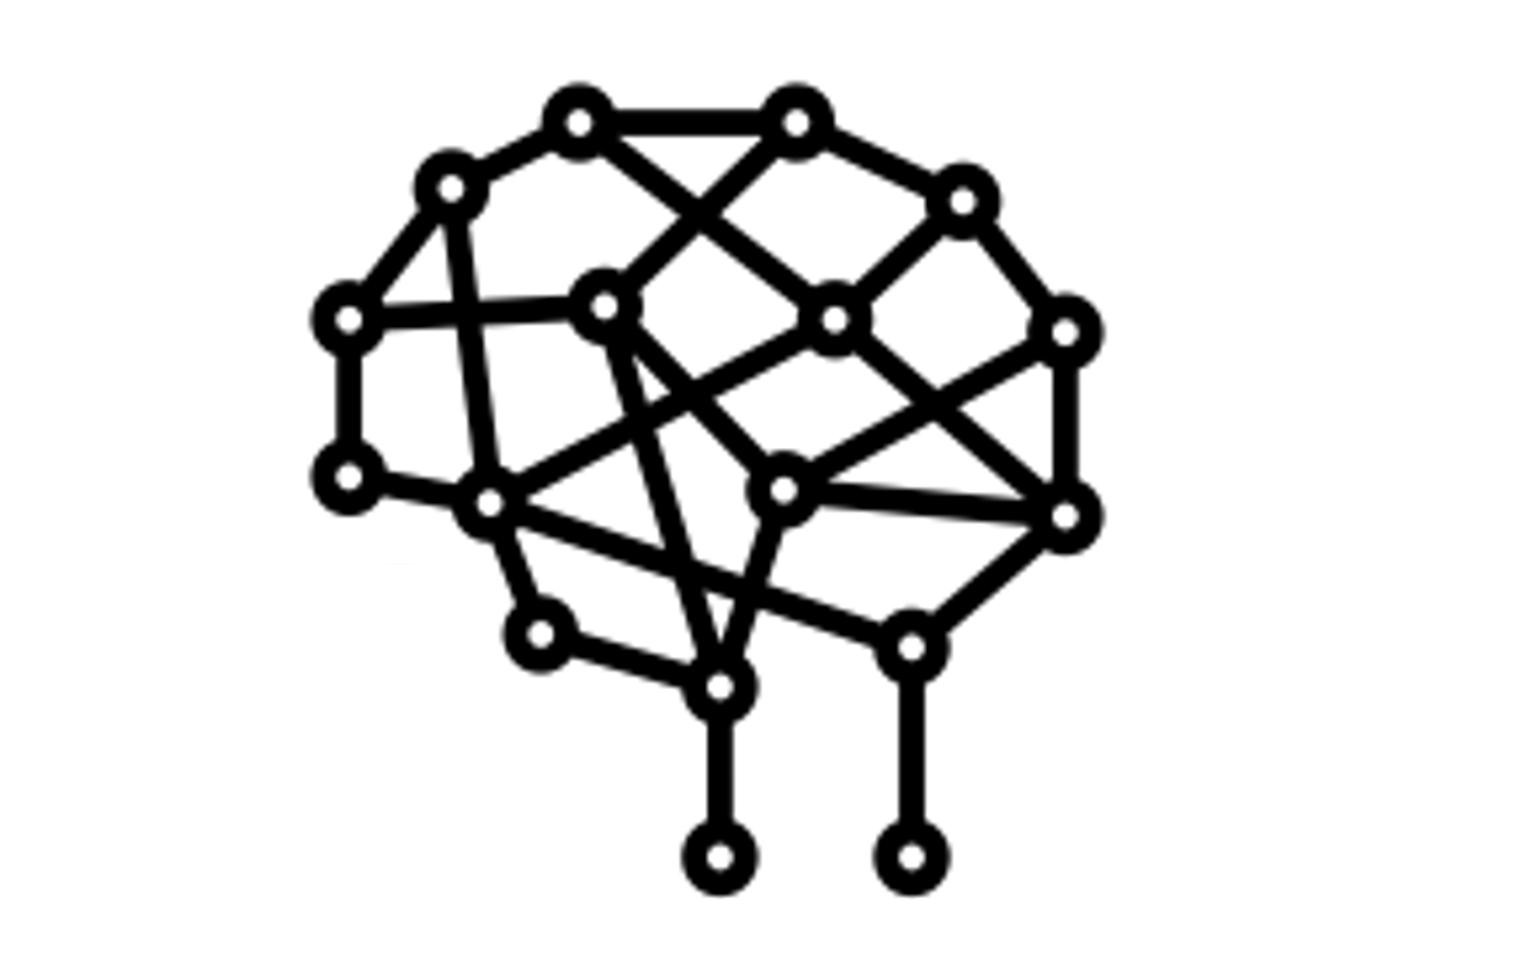
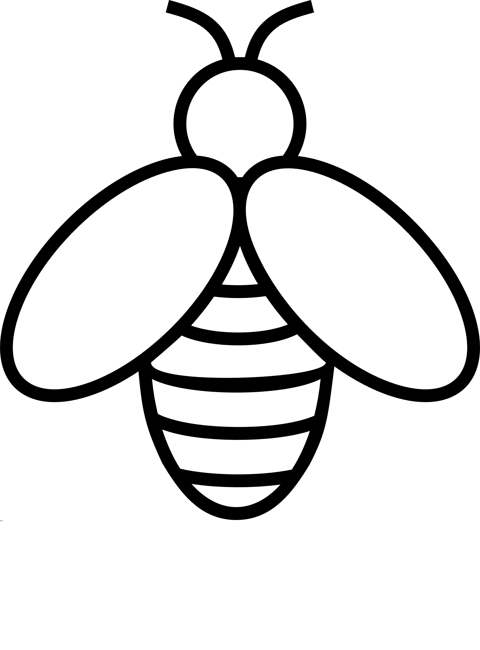
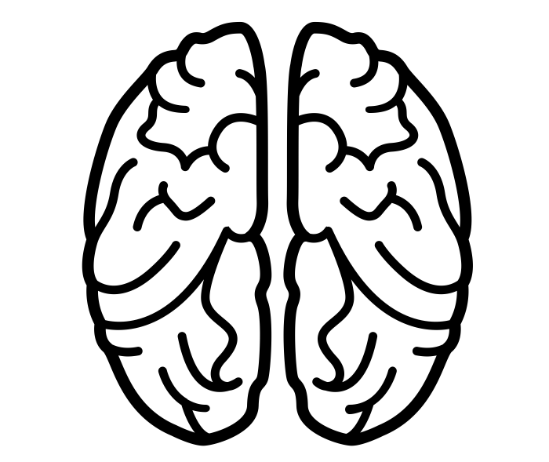
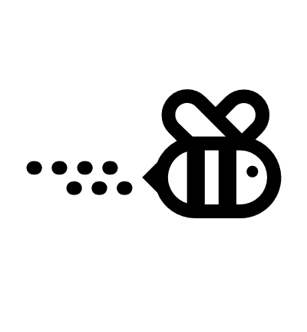

Collective Behavior
Environmental Cues
Social Environment
Neurophysiology
Behavior
Transcriptomics

Slide 16
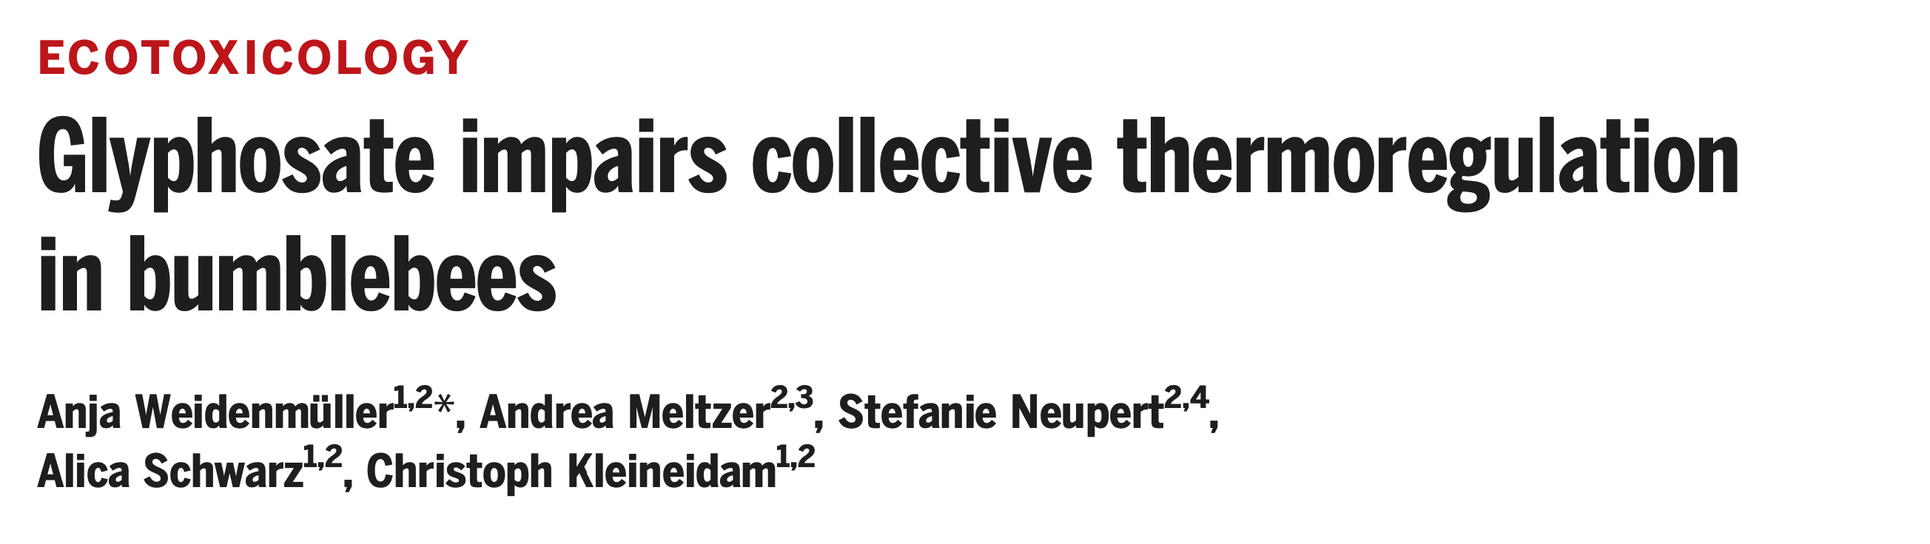

Slide 17
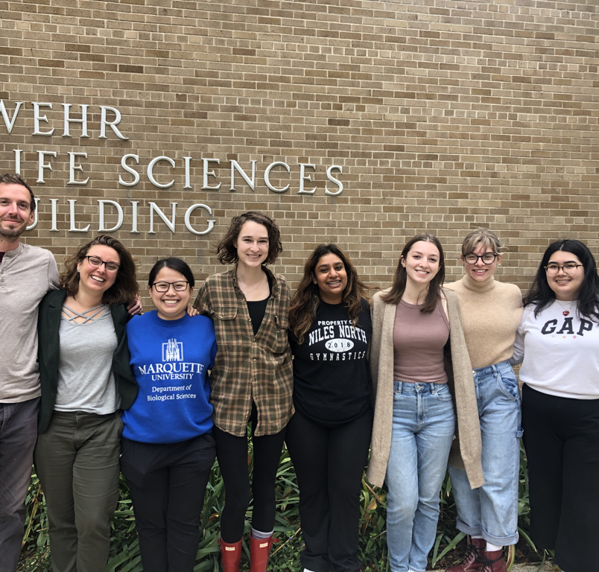
Justine Nguyen, PhD Student – Effects of antibiotics on fanning behavior and communication
Macnessa Fidlin, Undergraduate Student – Effects of glyphosate on fanning behavior

Slide 18
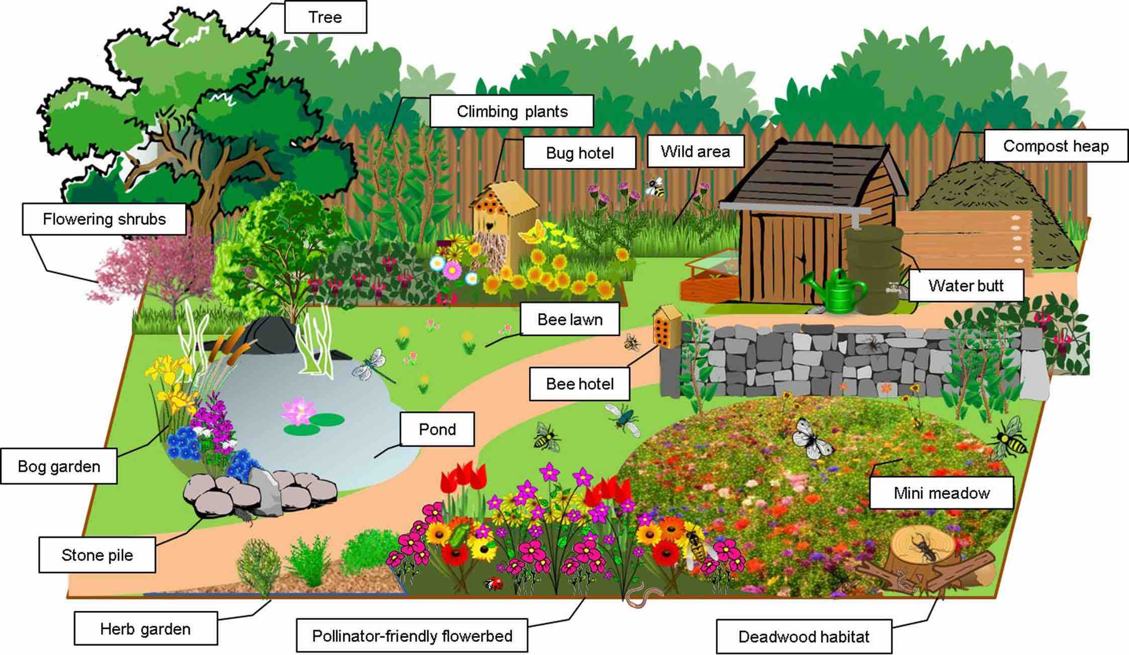
Over 300 Native Bee Species in Wisconsin!
Solitary or semi-social
Nest in logs, twigs
Overwinters in grass, stems, leaves
Don’t use herbicides or pesticides
Plant flowering plants
Leave areas of yard “wild”

