Slide 1
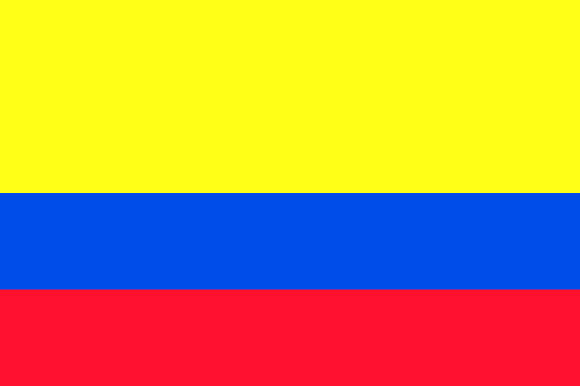
Peacebuilding, and Women and Indigenous Leadership in Colombia
Gabriel Velez and Jane Blossom
Marquette University
Soup with Substance
March 29th, 2023

Slide 2
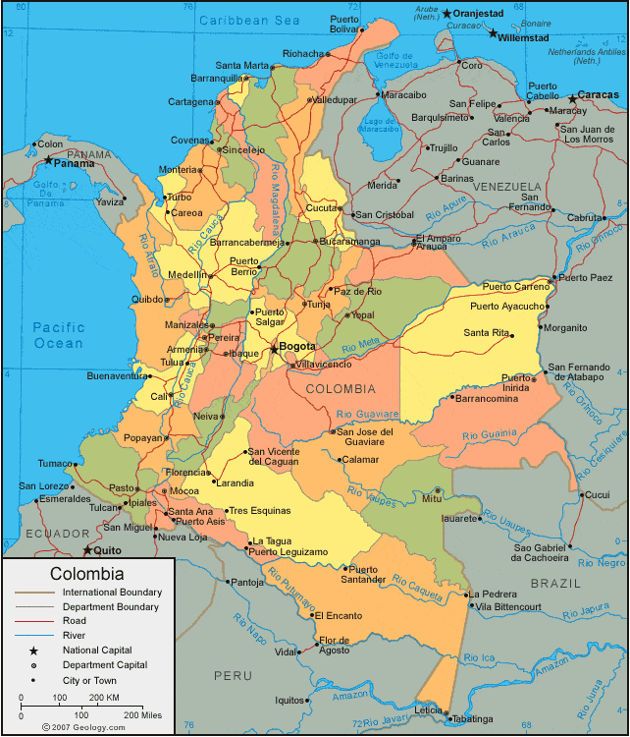

Slide 3
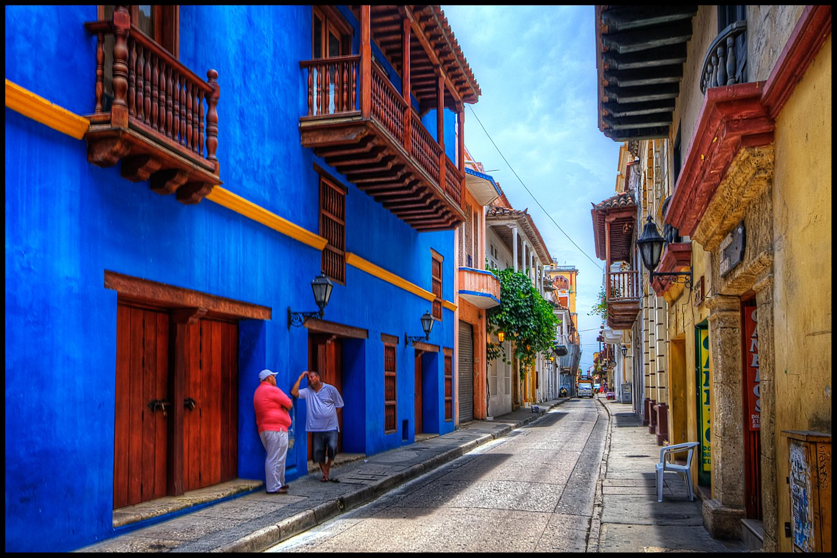
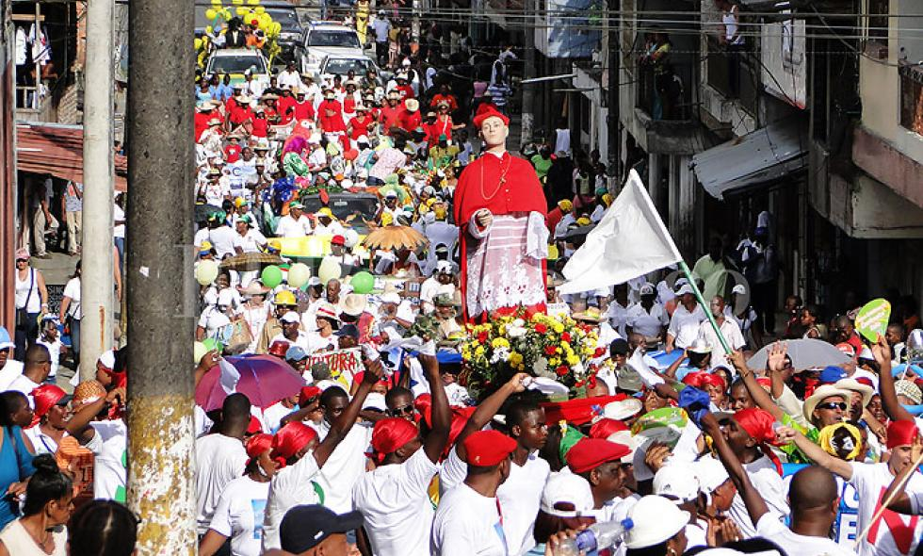
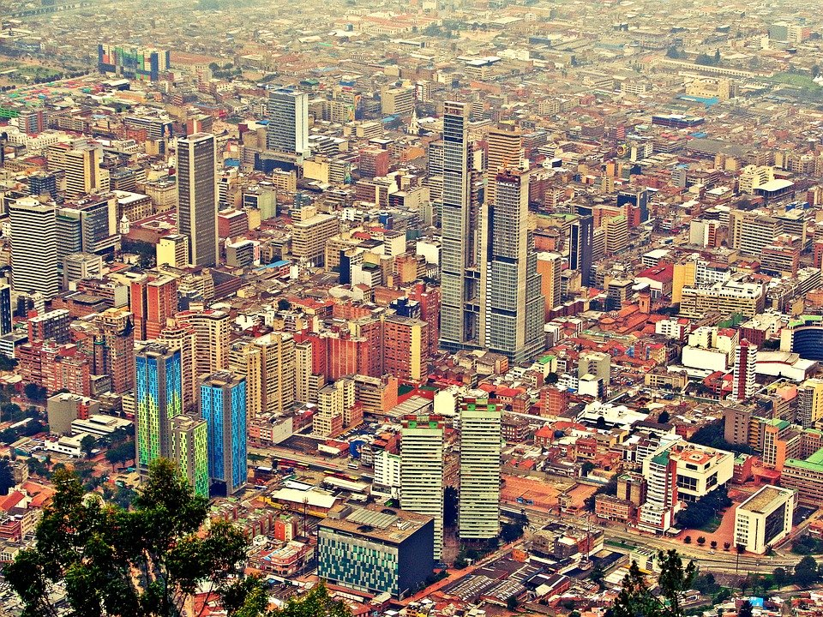
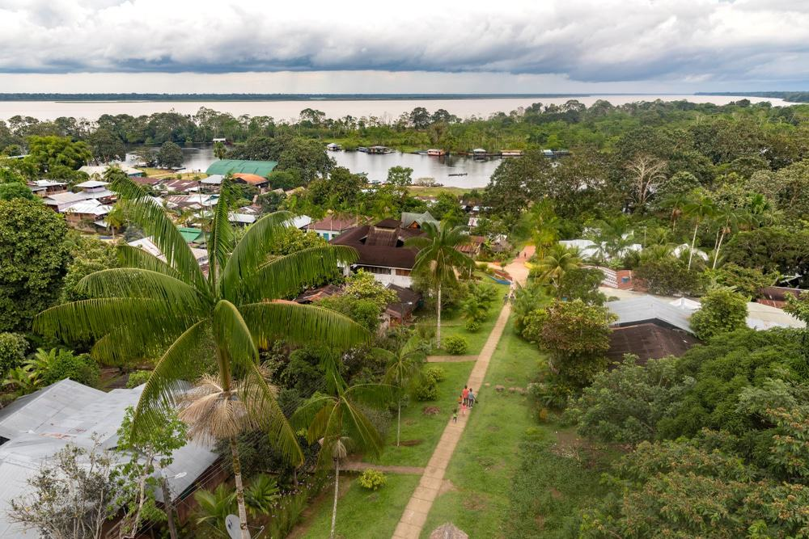
Cartagena
Buenaventura
Leticia
Bogotá

Slide 4
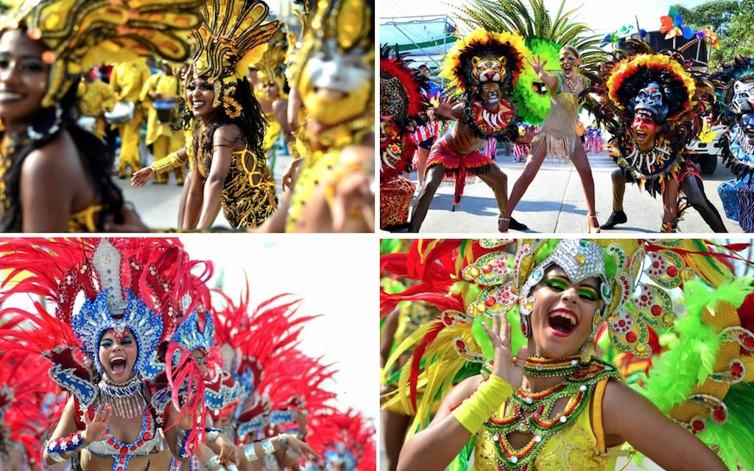
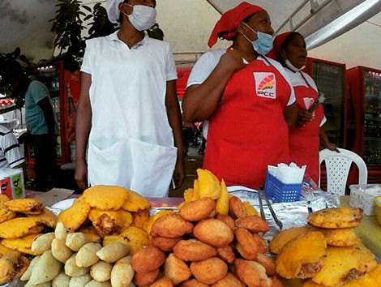
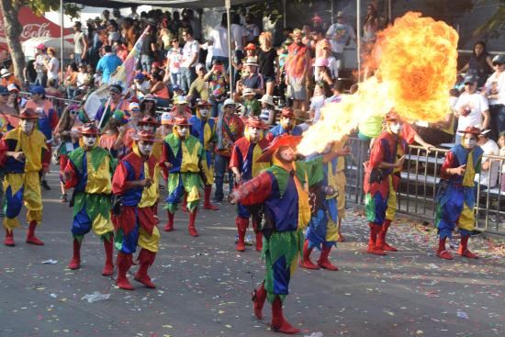
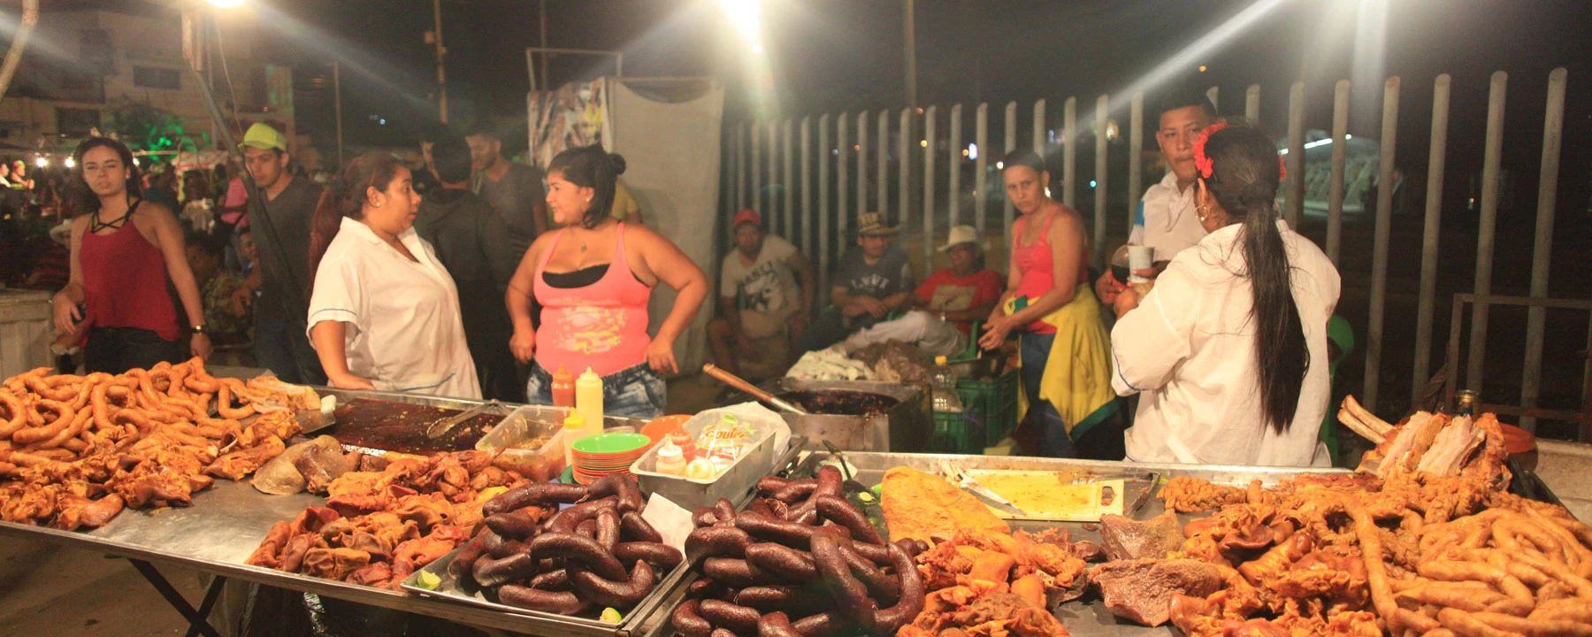
Notes:
https://www.vice.com/en/article/vvqnkb/colombias-carnaval-is-an-assault-on-the-senses

Slide 5
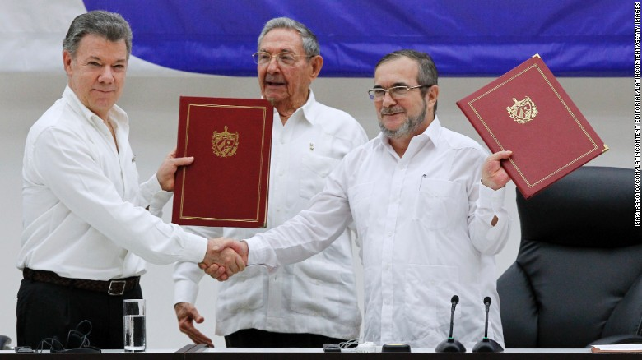
Peace in Colombia

Slide 6
Discourses about Youth
I am going to ask of all youth across the country the immense favor that they help me. This year is a consequential year for Colombia - we are going to sign the peace accords with the FARC - and so you [youth] are of special importance for Colombia. We are counting on youth to legitimize the peace.
Colombian President Juan Manuel Santos

Slide 7
Conflict in Colombia: A Brief Timeline
Late 1950s- Early 1960s
Emergence of guerrilla
Late 1980s, Early 1990s
Peace Processes
1948
Gaitán Assassinated, Leading to La Violencia
2002-2010
Declining Violence
1957
National Front (Power Sharing)
1980’s
Rise of Narcotic Production/Trade
Late 1980s through 1990s
Emergence of Paramilitaries
2012
Current Peace Process Begins
Notes:
Women and children constitute 78 per cent of Colombia’s IDP population, and a disproportionate number of the IDP population is Afro-Colombian or indigenous.3
Sexual and Gender-Based Violence
The 1991 Constitution and subsequent legislation and judicial findings recognize women’s rights, penalize violence against women and gender-based violence, guarantee women’s political participation and leadership roles in peacemaking and peacebuilding, provide equal access to State resources for women, and guarantee women’s relief and recovery from the conflict.8

Slide 8
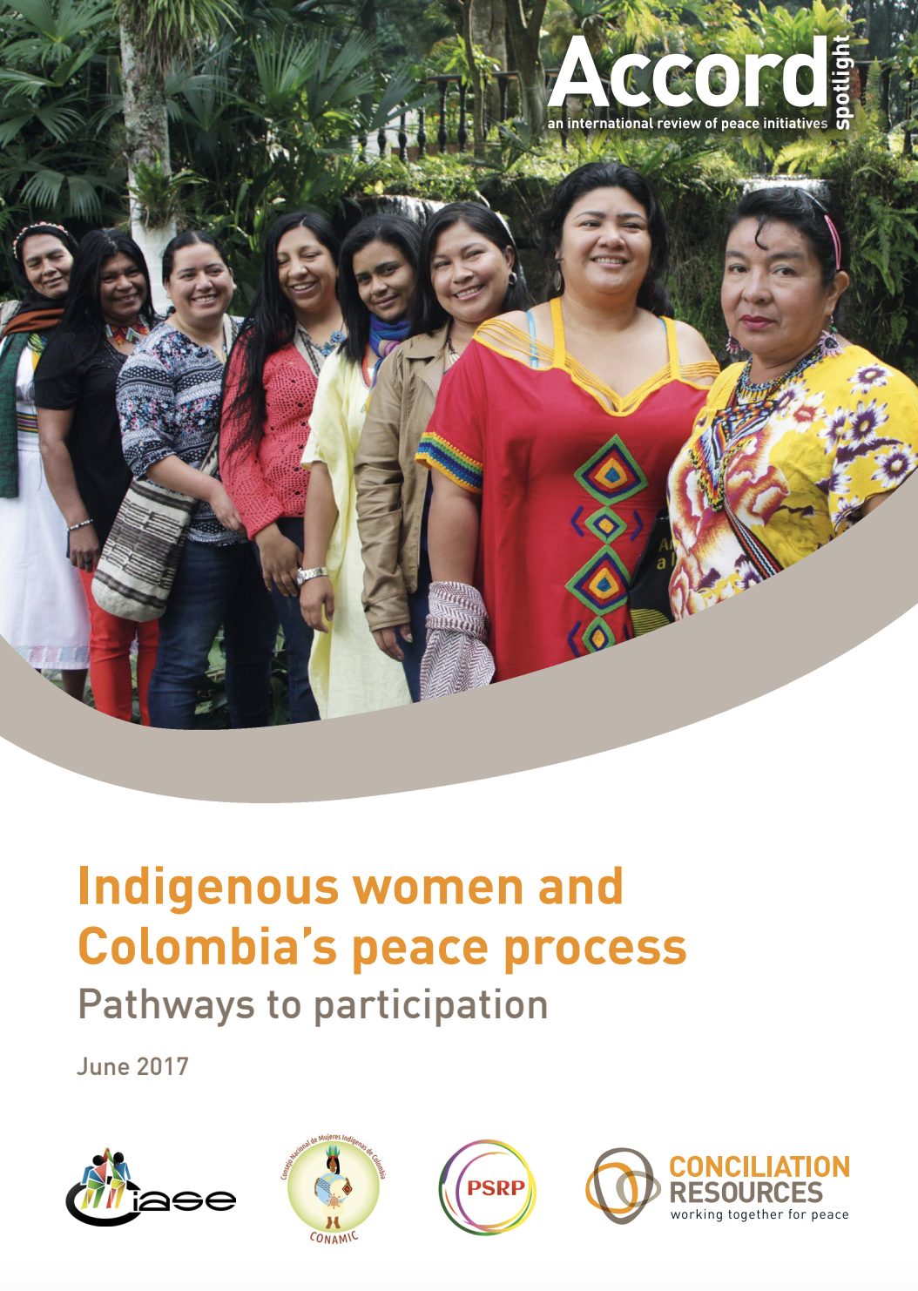
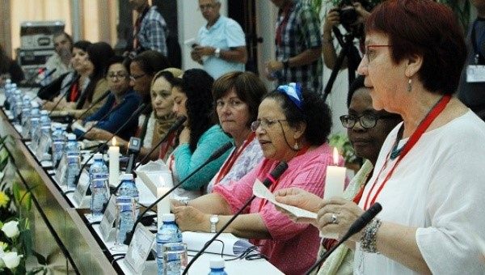
A Focus on Women and Indigenous Peoples
Sets an international standard for the inclusion of indigenous women in peace processes.
Women’s and indigenous women’s organizations lobbied effectively in Havana peace to safeguard their meaningful participation
Final Peace Agreement
  Provisions focused on gender and indigenous peoples
Notes:
In Colombia, then, progressive legislation, judicial decisions, and executive decrees back women’s rights and promise to address sexual and gender-based violence.

Slide 9
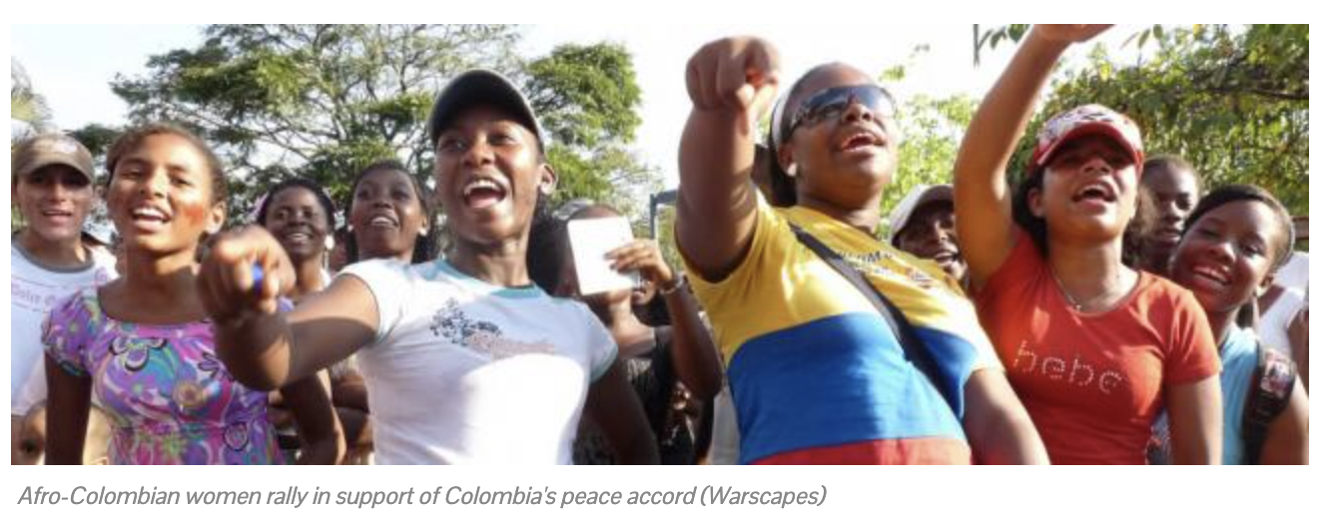
Legacy and Challenges
Recognition of gender shaping conflict and need to address this, but….
Provisions related to women and gender—land programs with a focus on women and their incorporation into decision-making—have been the least implemented
Women’s participation in policy planning remains low, commitments at the state level (particularly those to ex-combatants) have been broken
Widespread assassinations of Afro-Colombian and Indigenous human rights leaders
Violence against women has increased since accords were signed
Notes:
minist organizations in Colombia depart from the mainstream narrative of the armed conflict by seeing the treatment of women during wartime not as exceptional, but rather as part of a continuum that stretches from everyday patriarchy and racism to colonial systems of domination.
but indigenous women in Colombia continue to experience multiple forms of discrimination that restrict their political participation, including in the peace process.
2 An inclusive political settlement in Colombia must incorporate both collective indigenous and individual women’s rights.

Slide 10
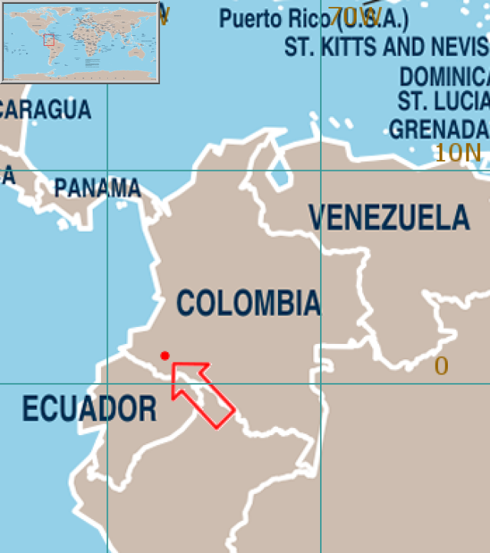

Slide 11
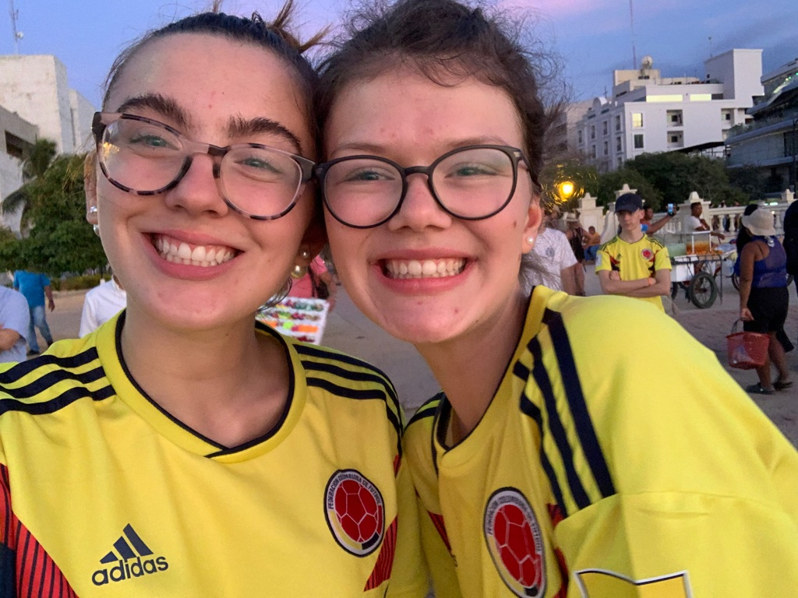
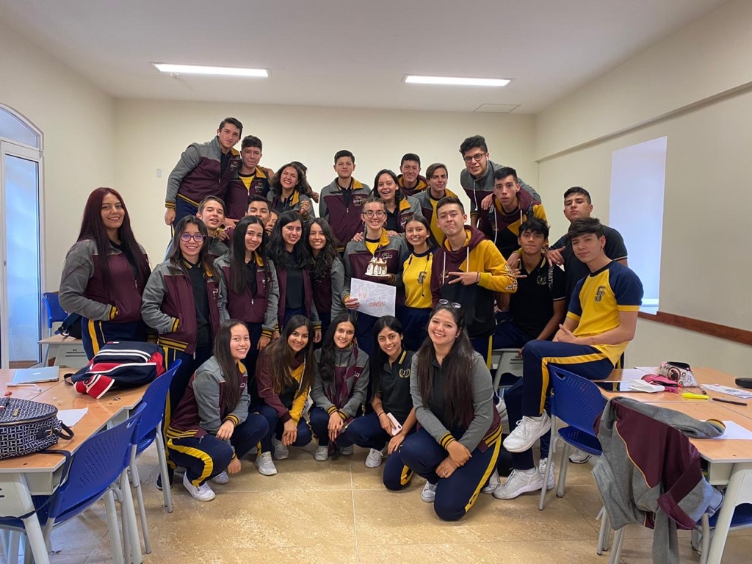

Slide 12
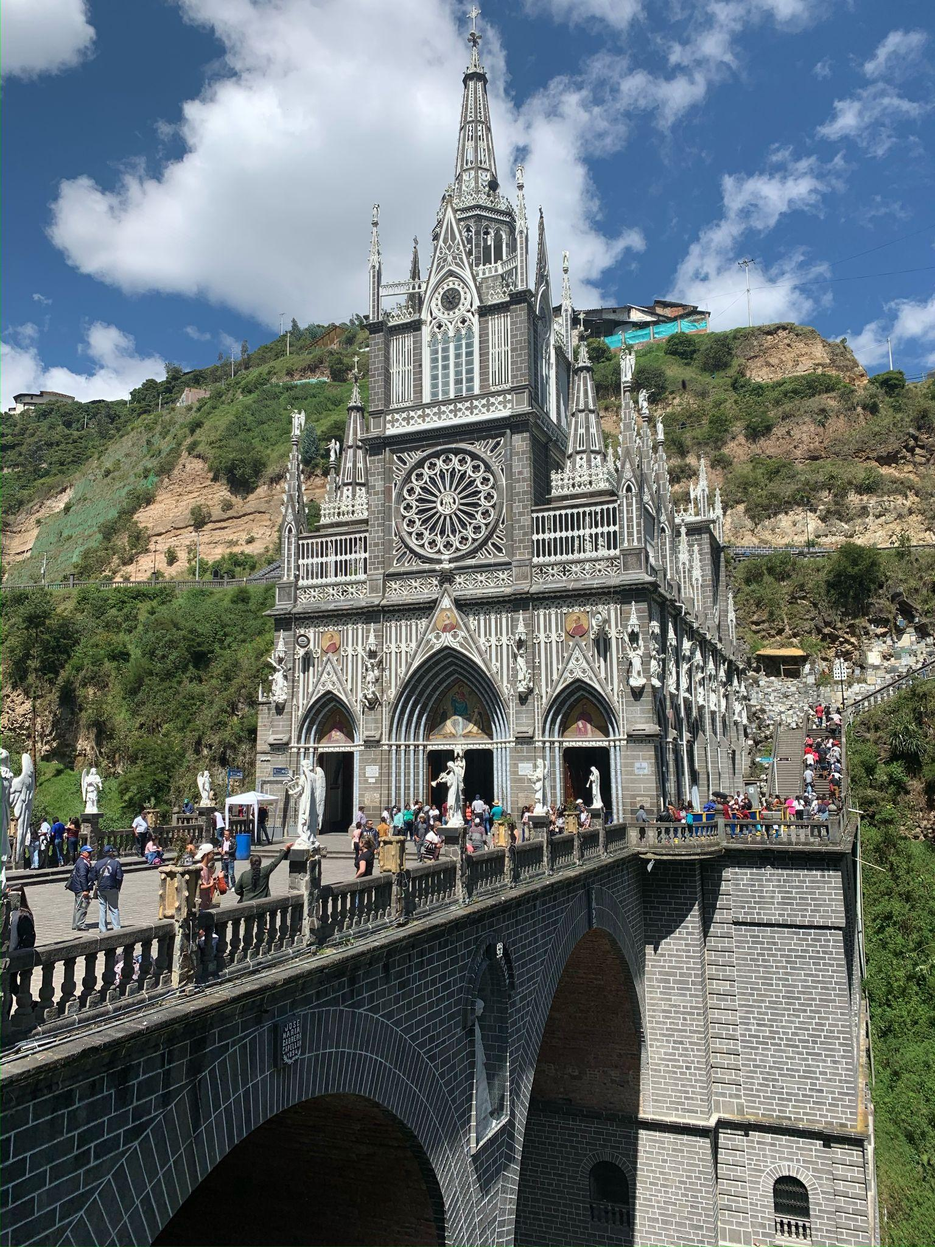
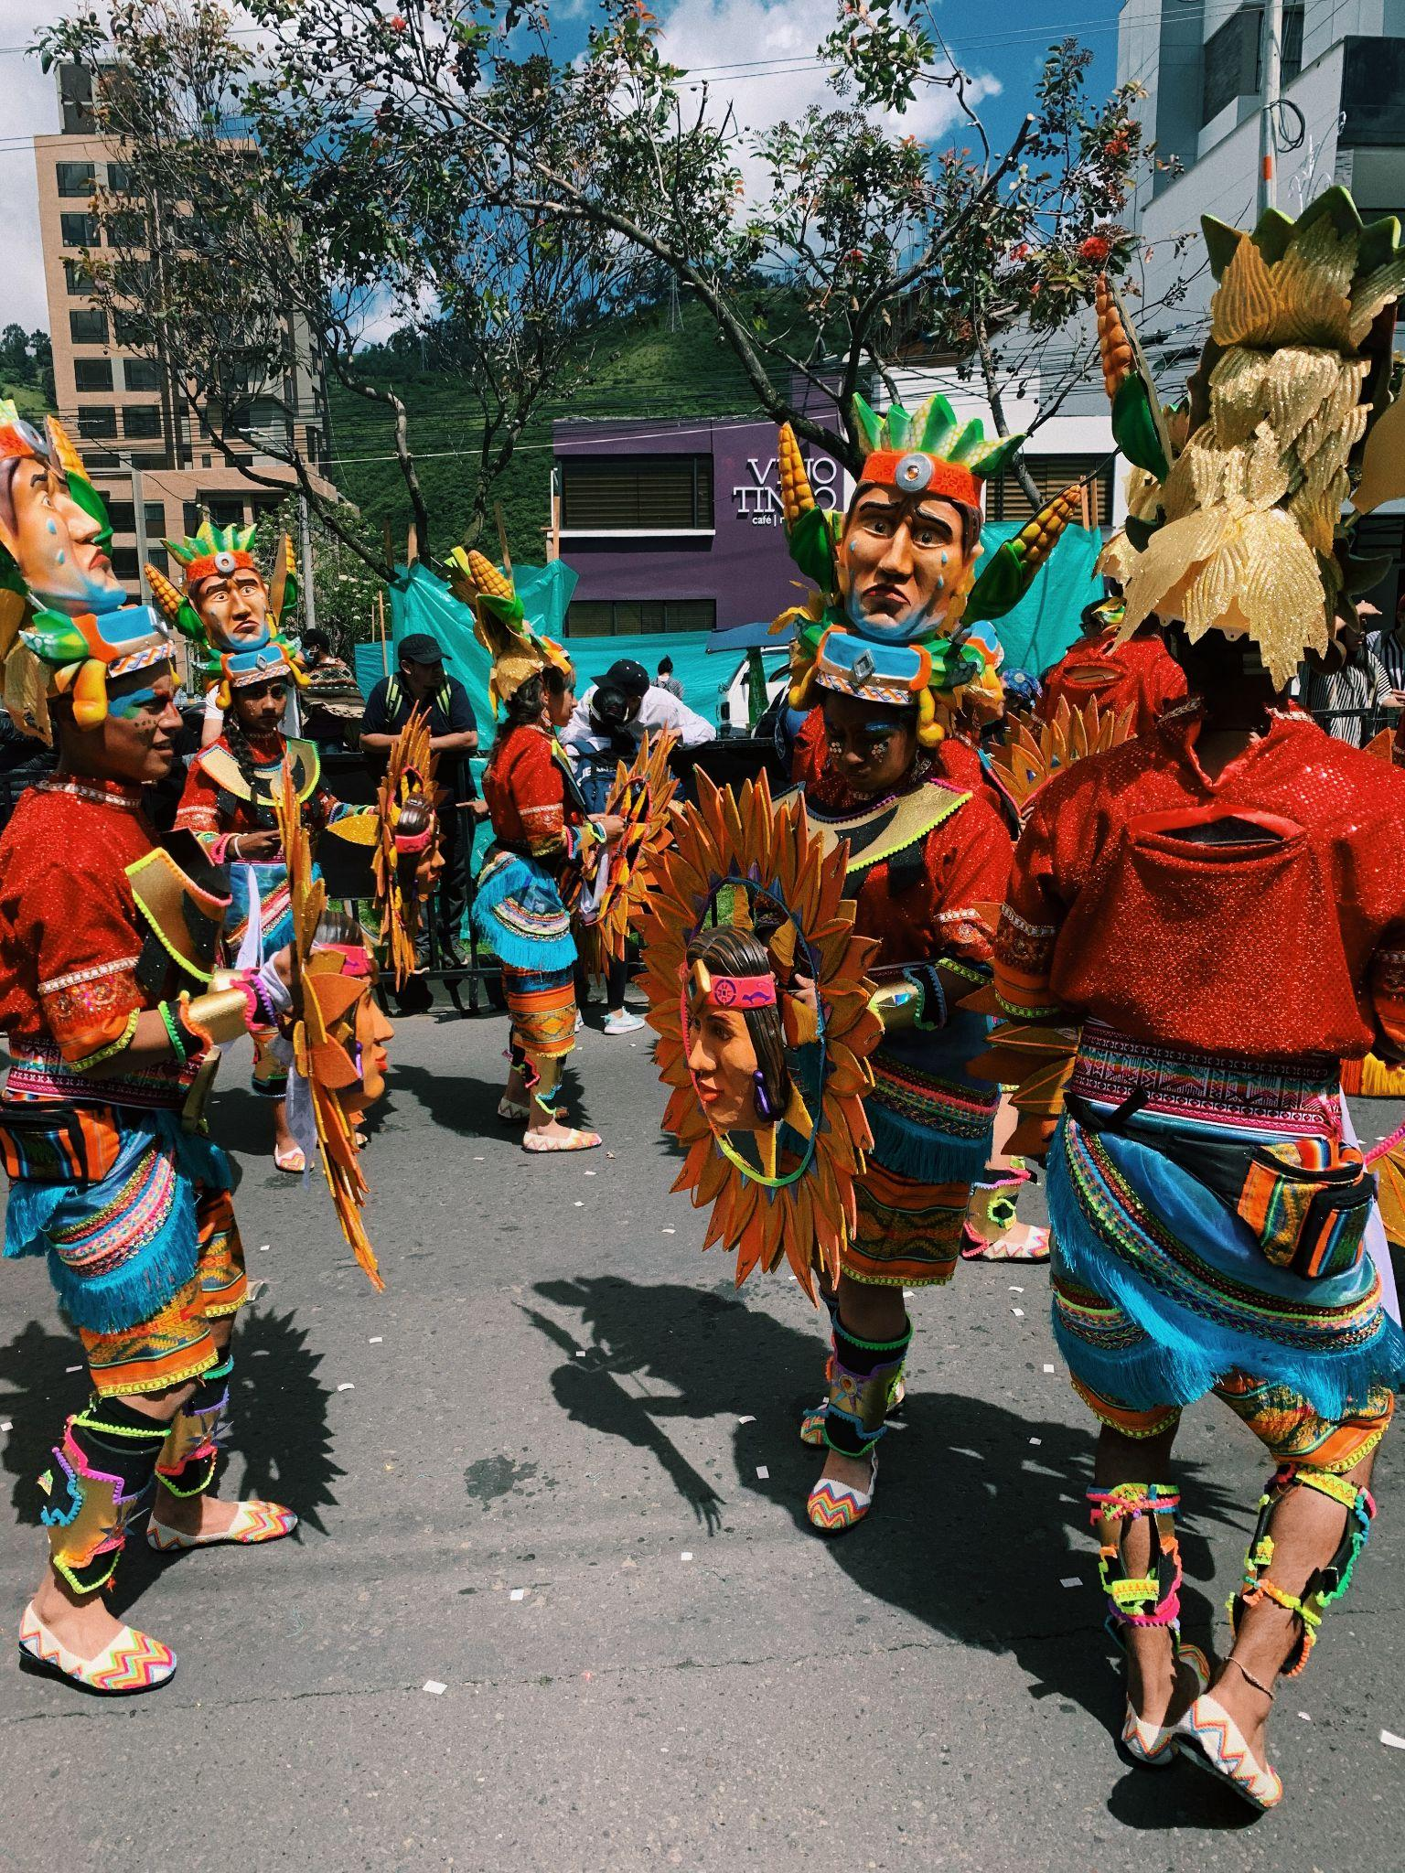
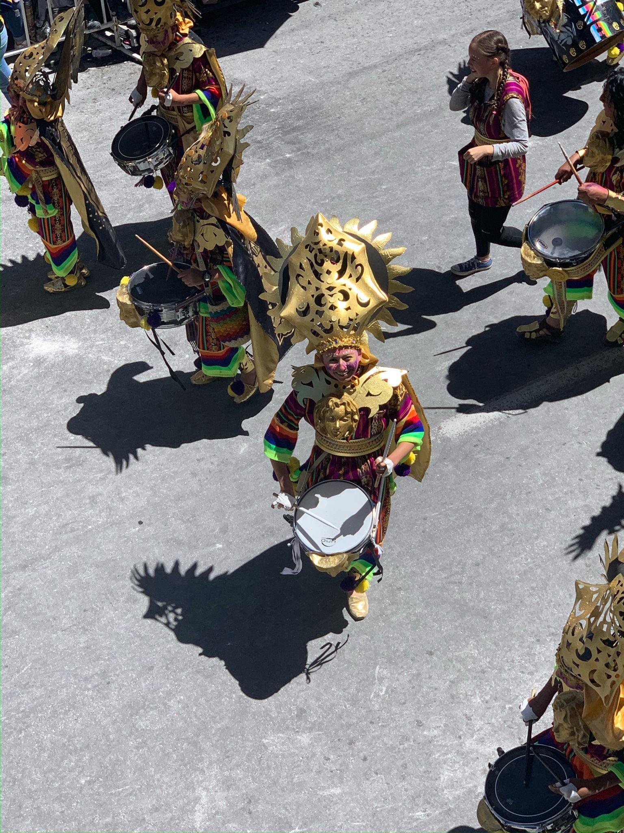

Slide 13
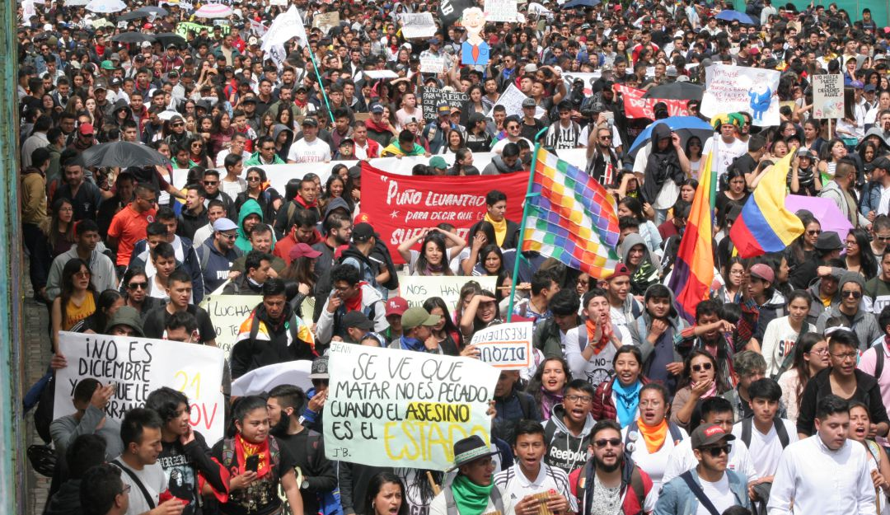

Slide 14
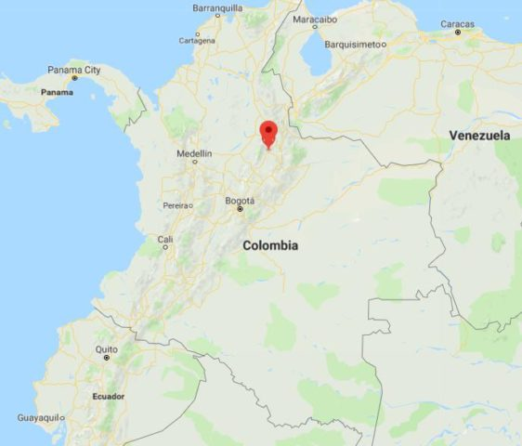

Slide 15
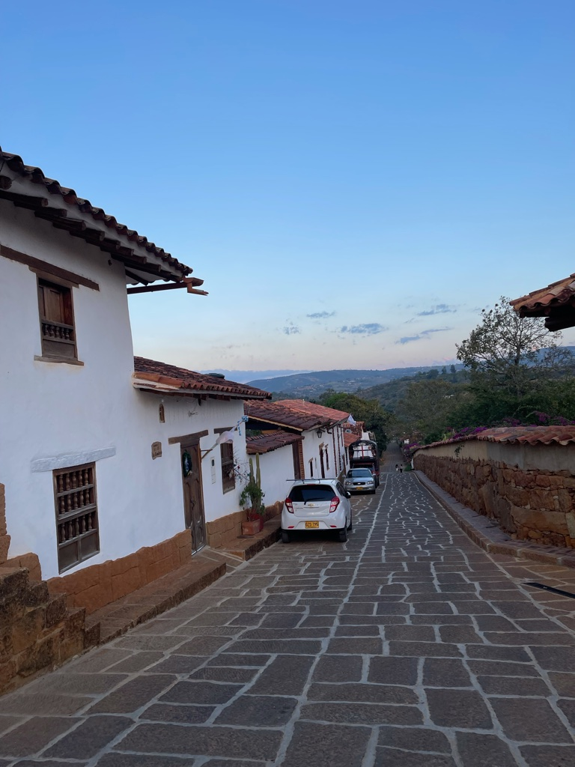
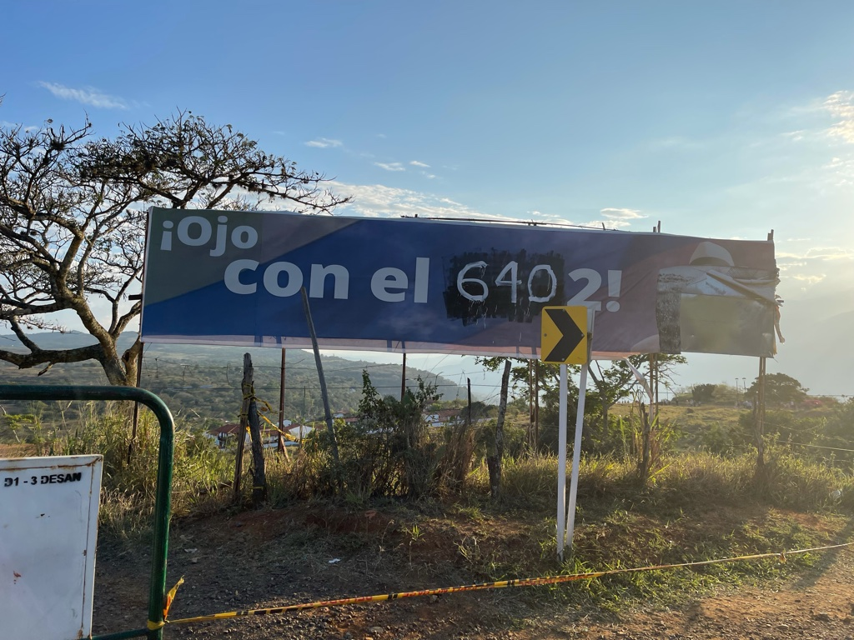

Slide 16
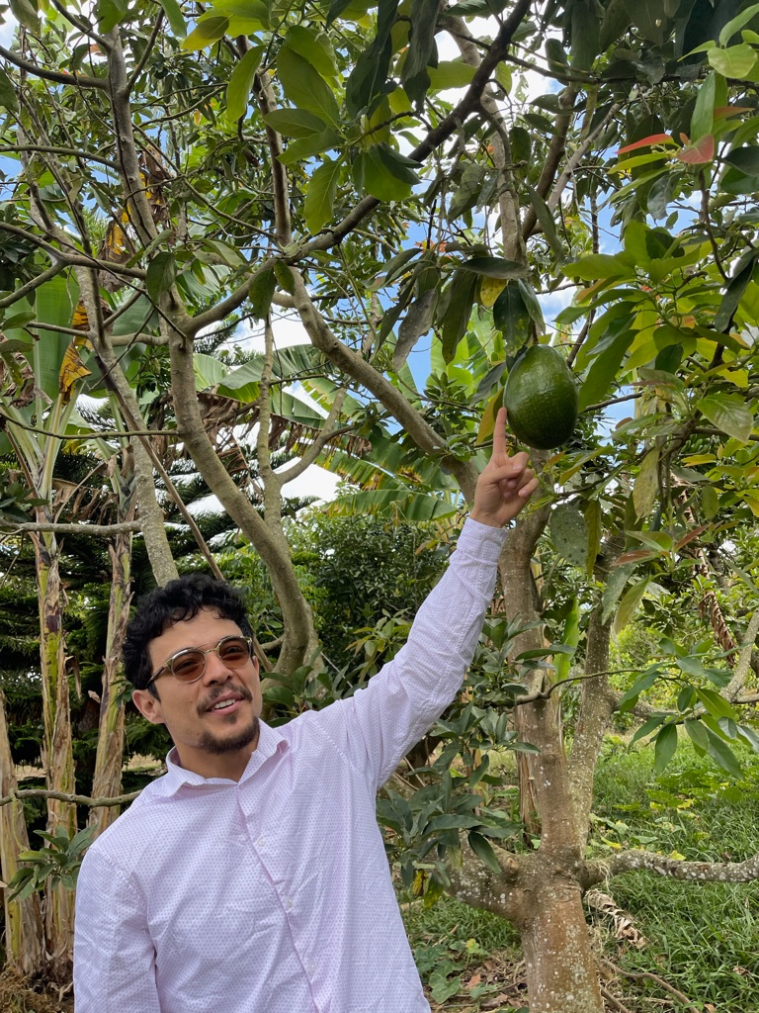
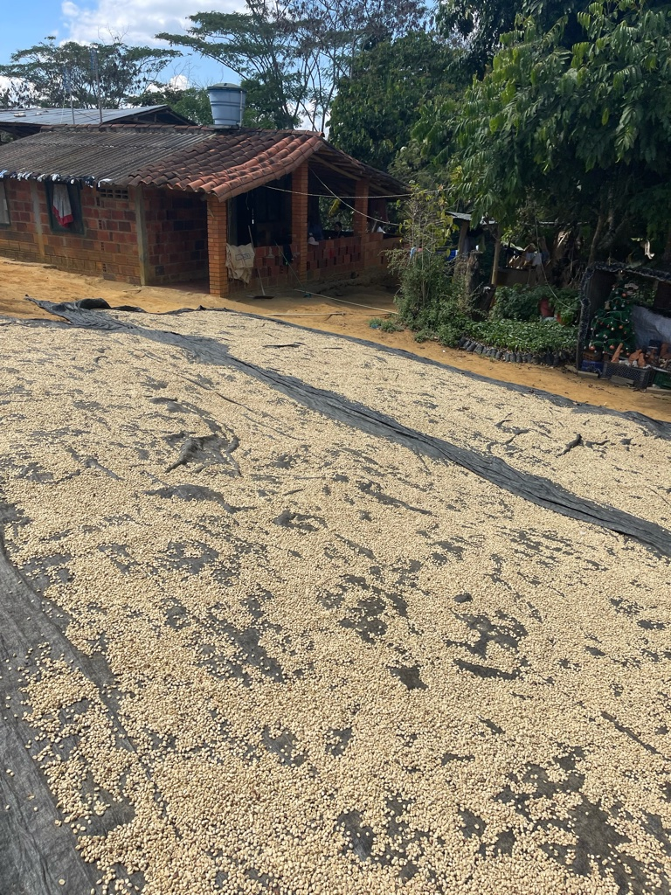
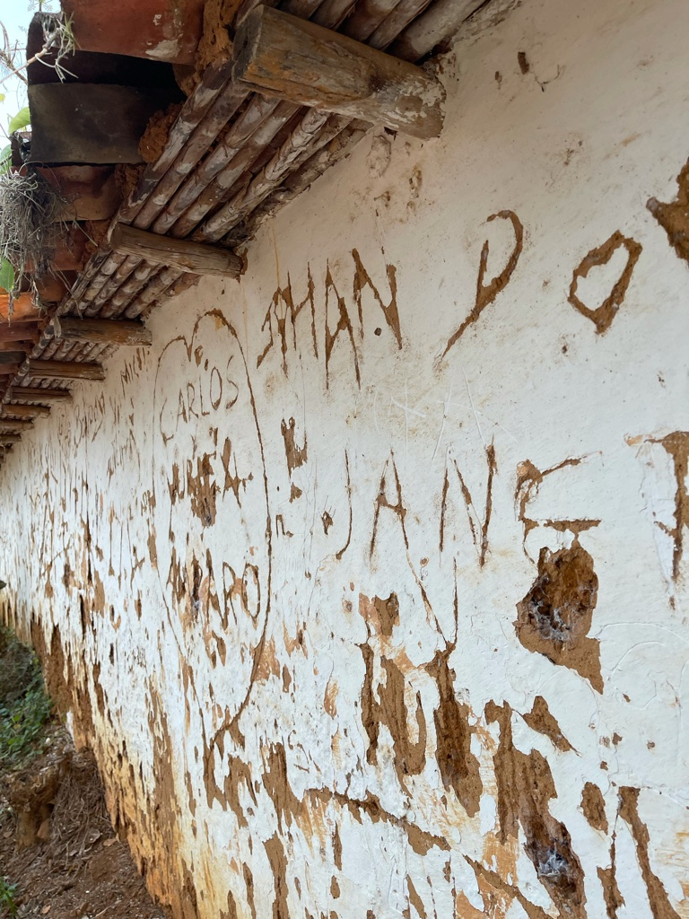

Slide 17
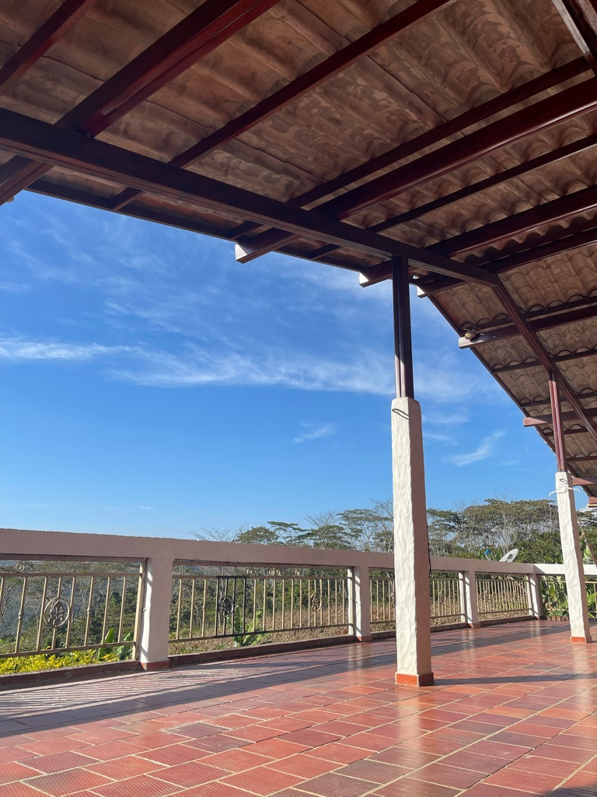
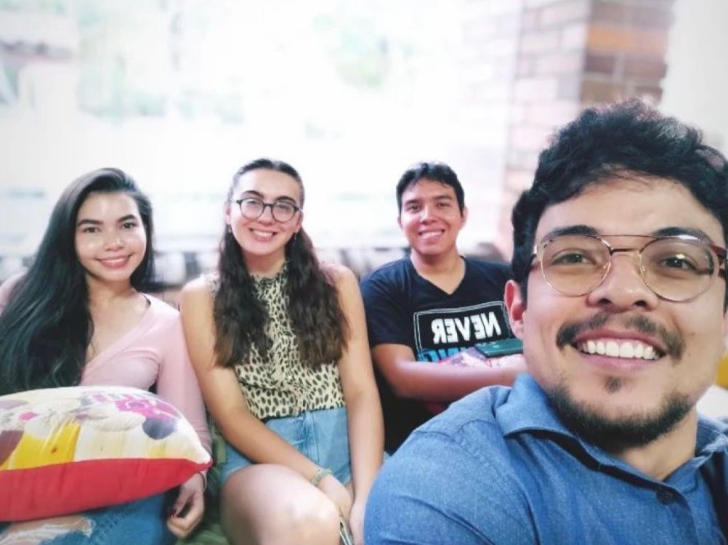

Slide 18
