Slide 1

Soup With Substance
Perspectives from Muslim Students
Dana Sharqawi & Lojain Gamar

Slide 2
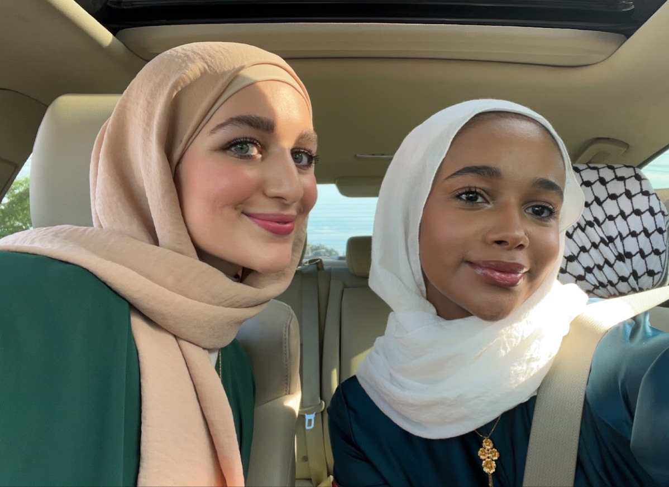
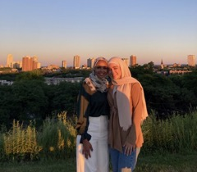
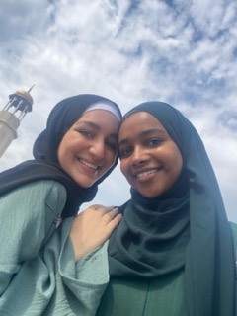
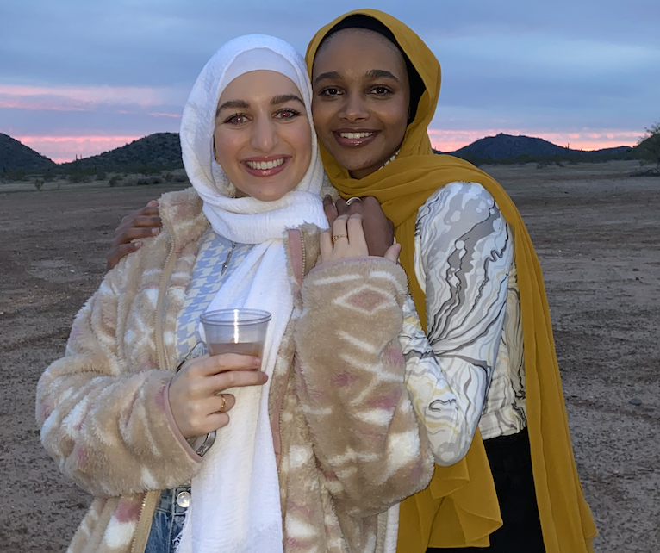
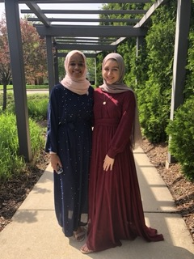
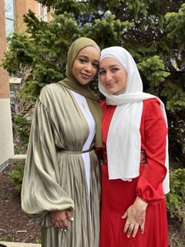
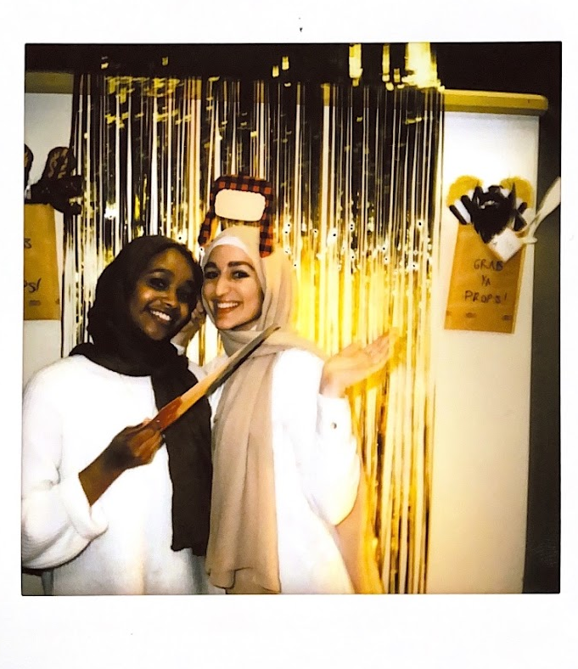
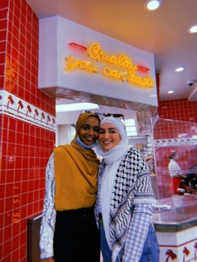
Who we are?
Notes:
How many of you have been the only minority or person of color in at least 3 or more of your classes?
Name, major, year
FUN FACT: KNOWN EACH OTHER 10+ YEARS

Slide 3
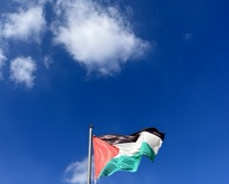
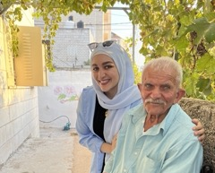
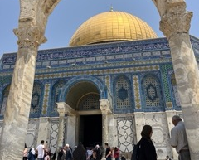
Background - Dana

Slide 4
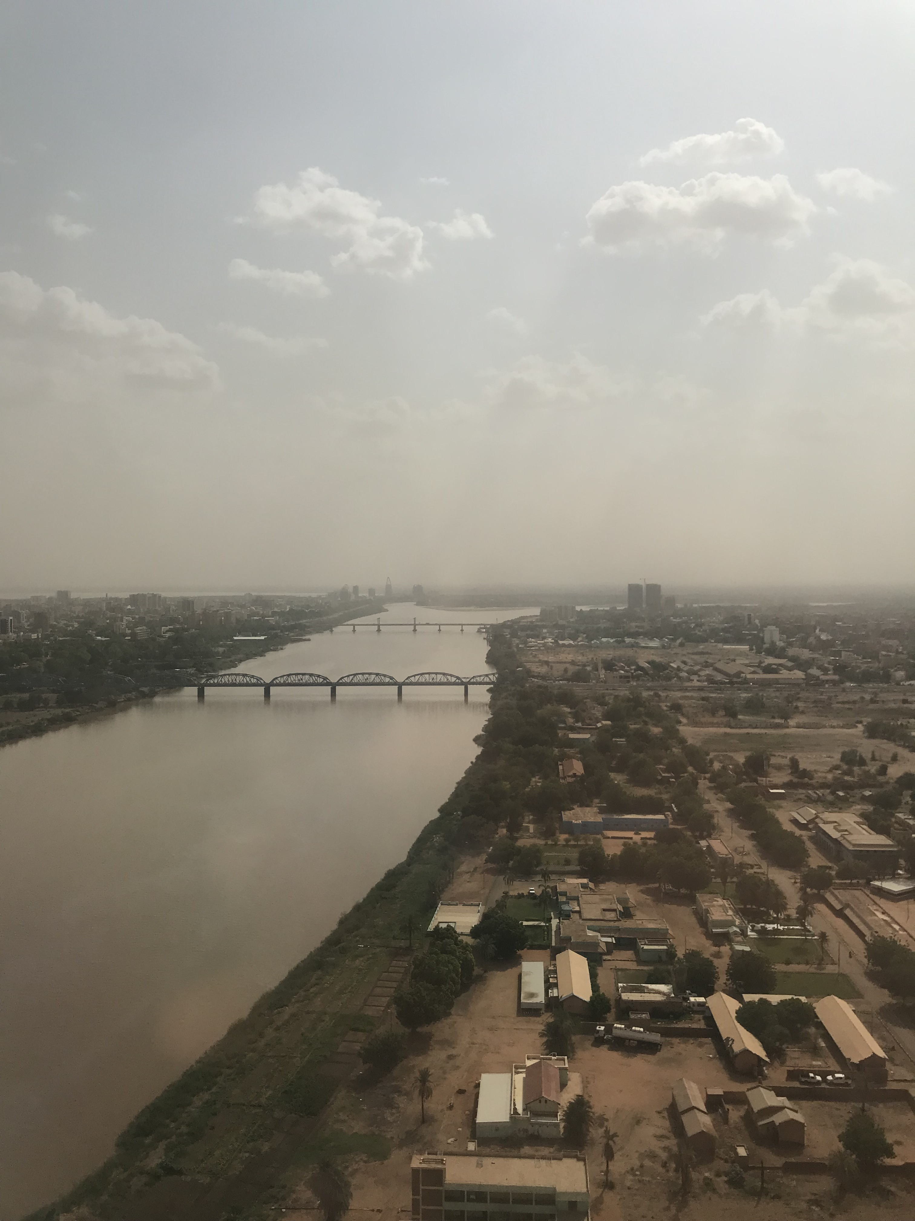
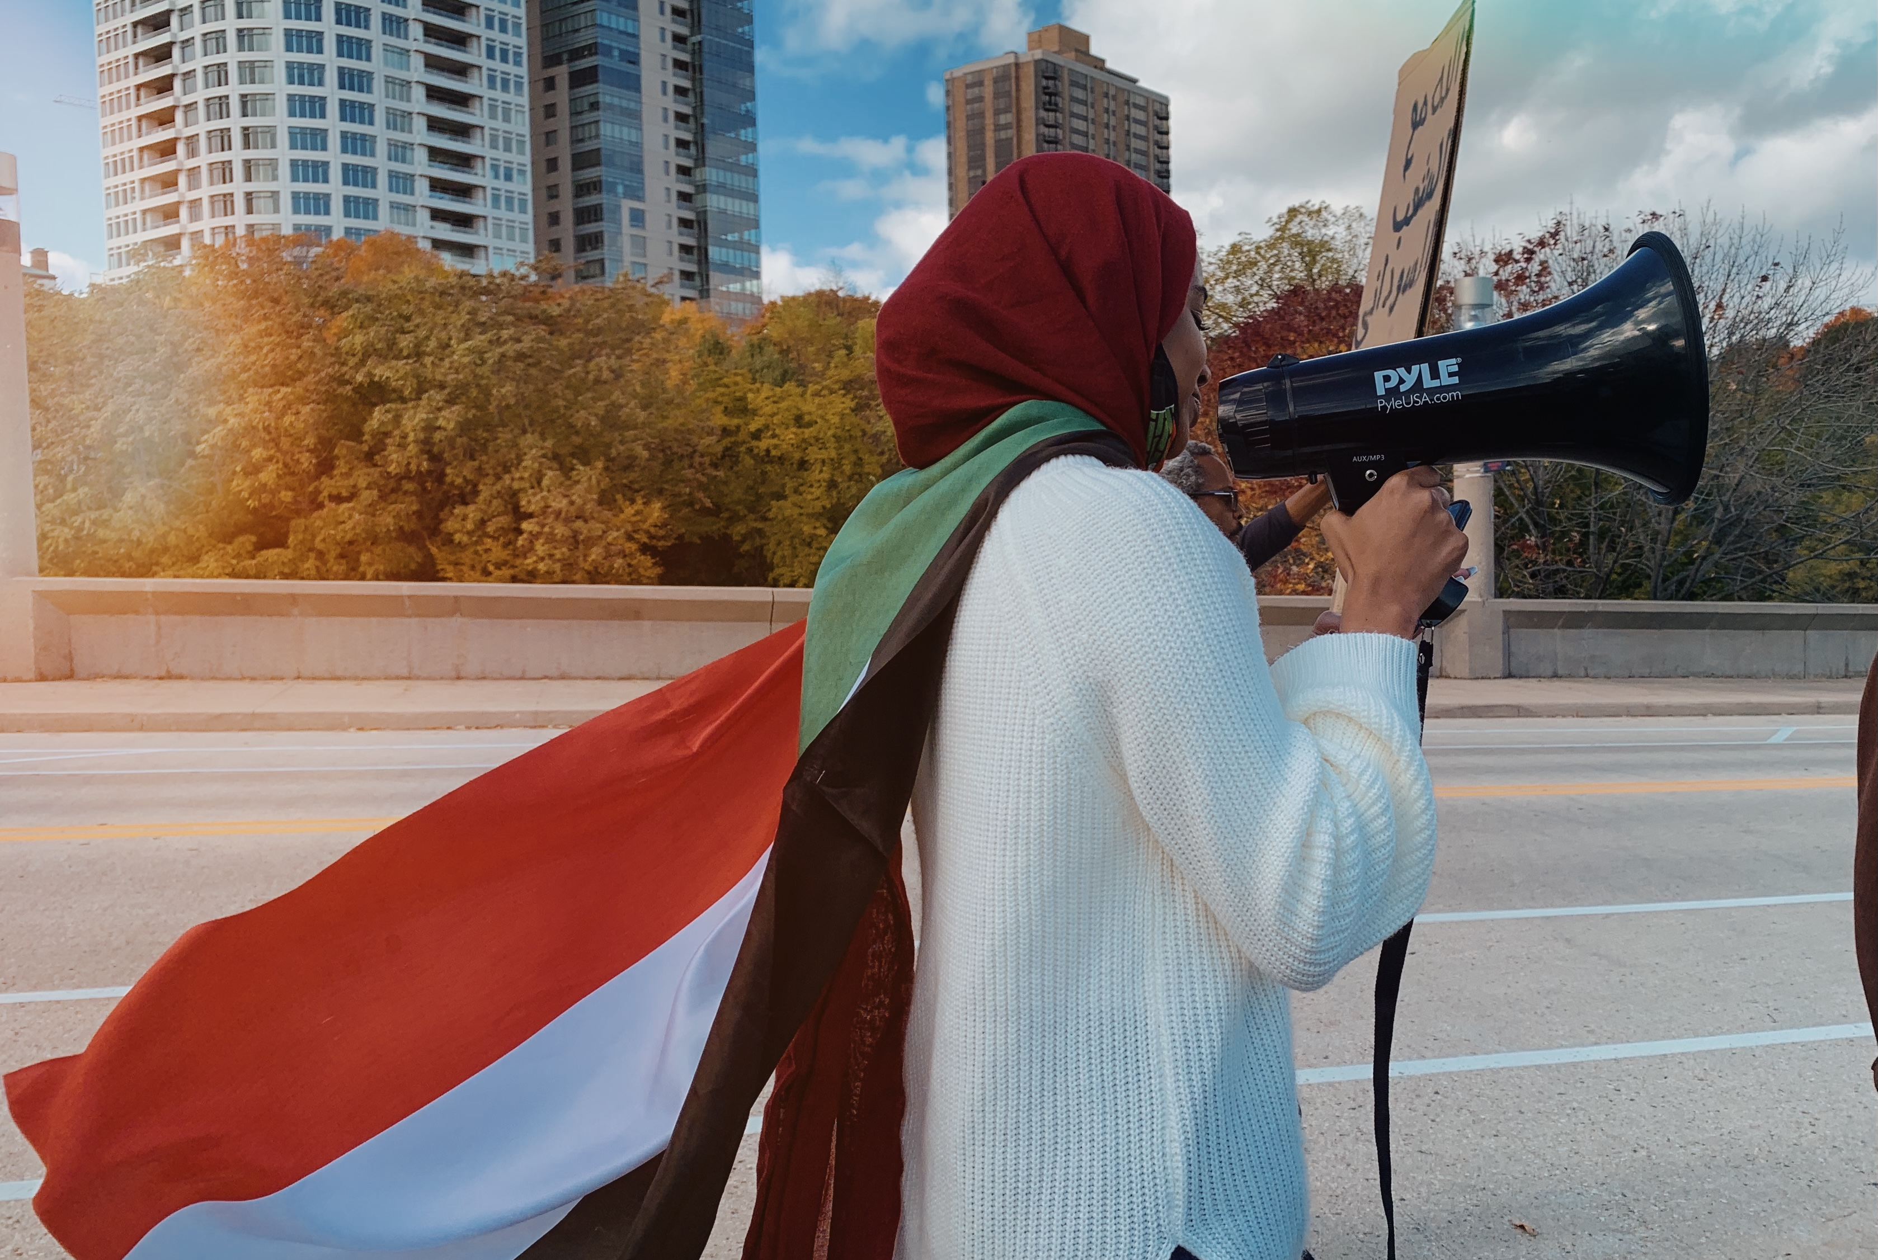
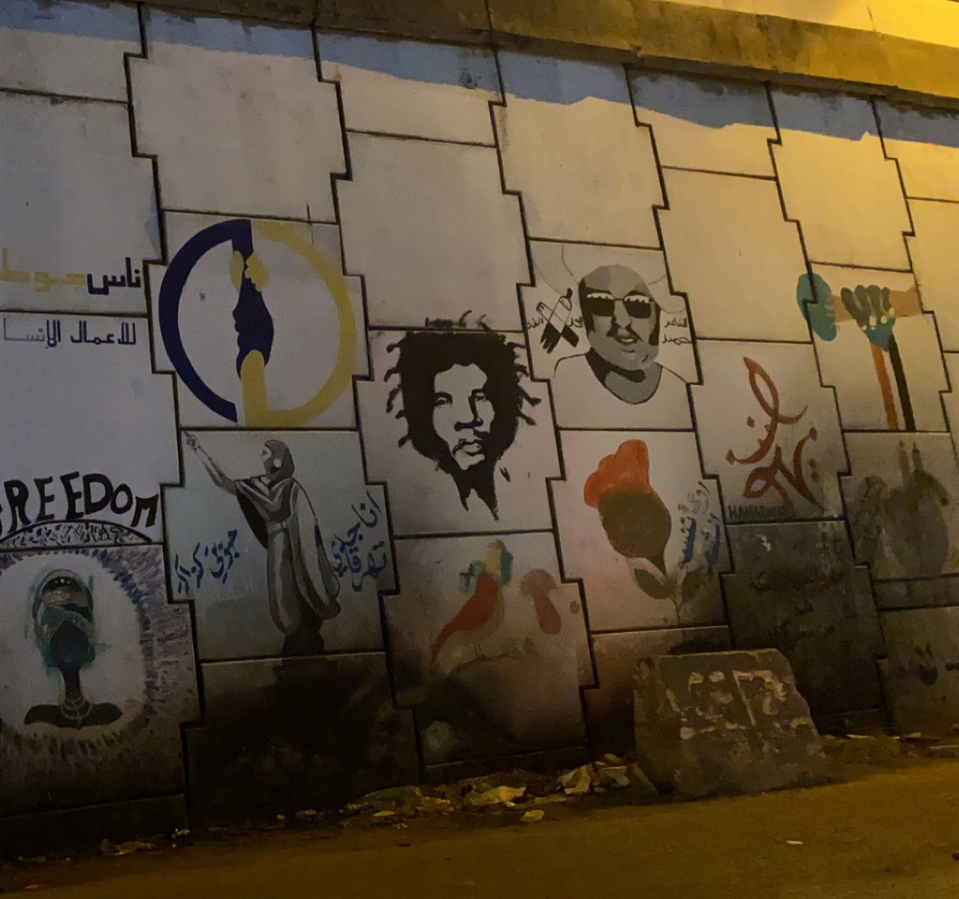
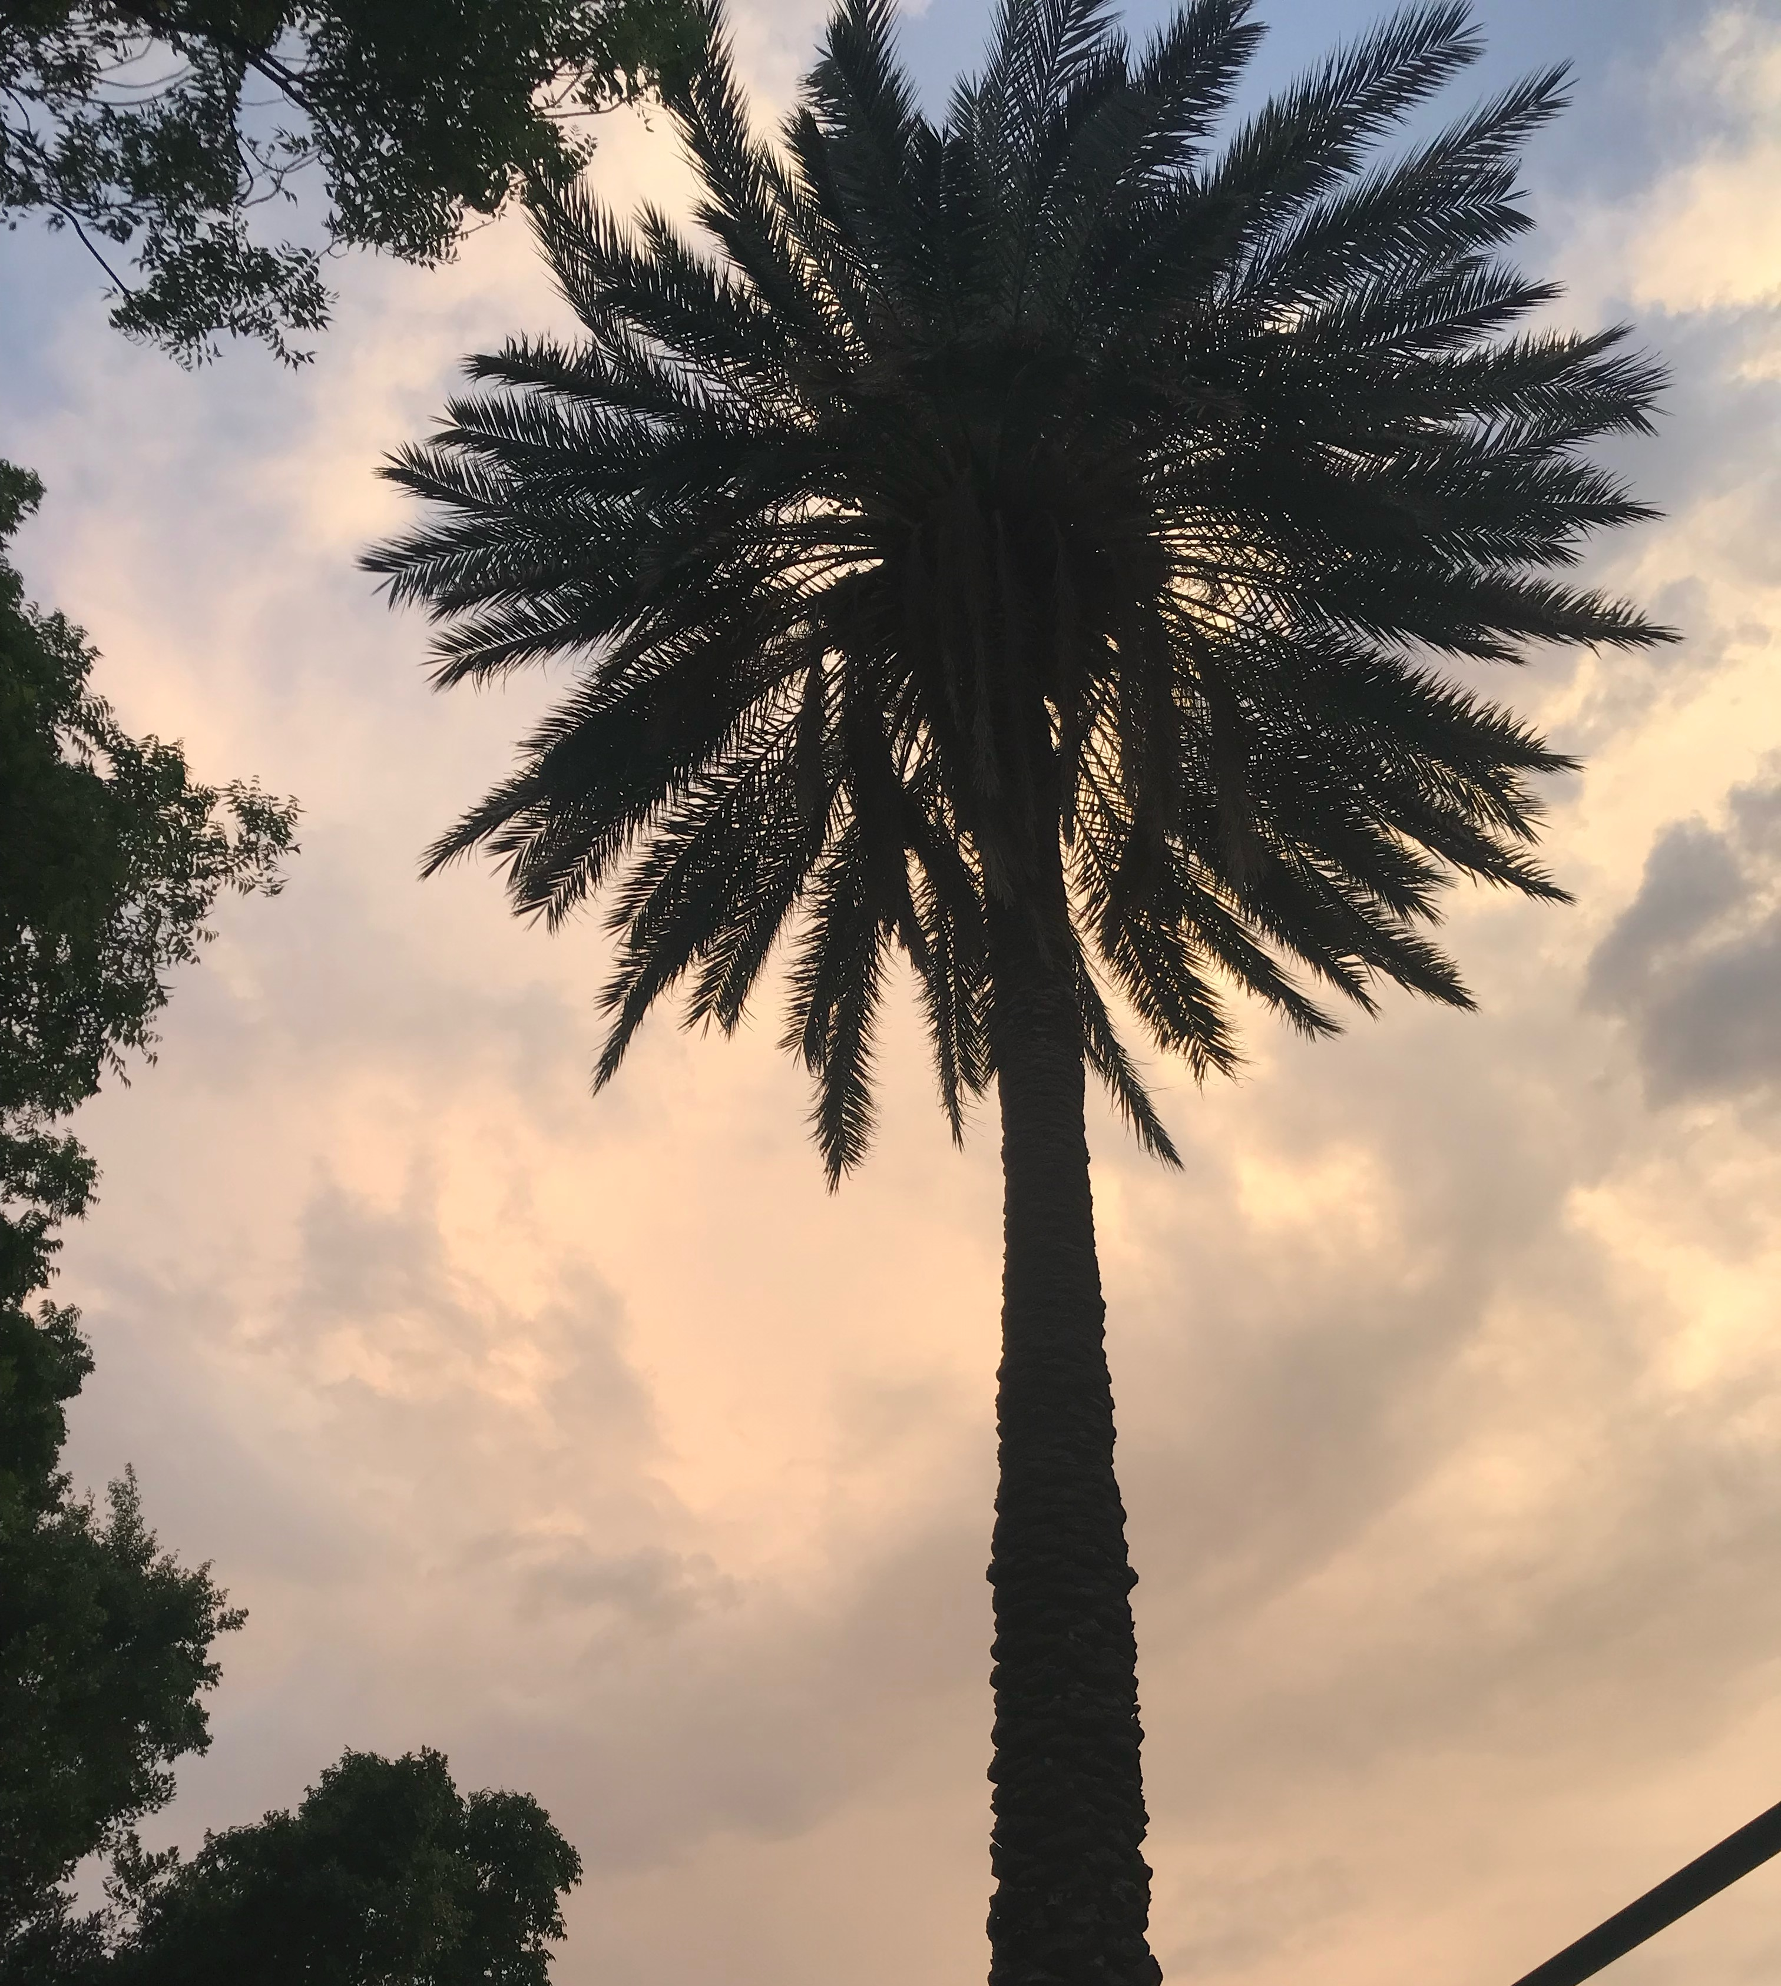
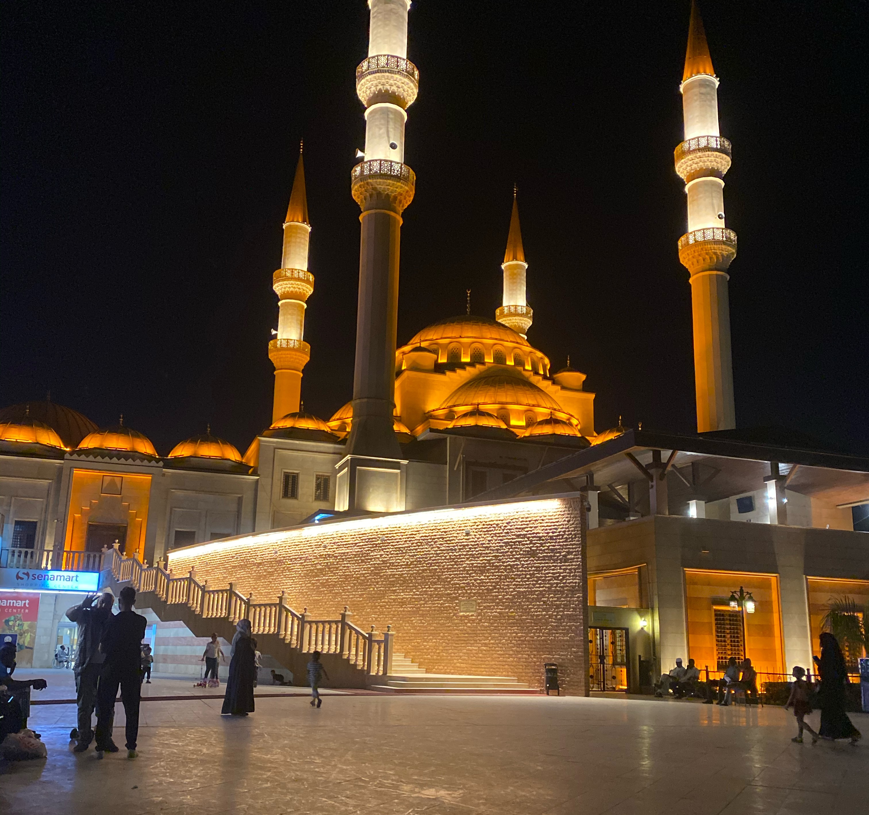
Background - Lojain

Slide 5
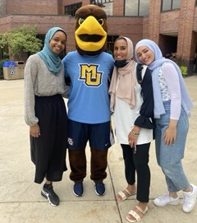
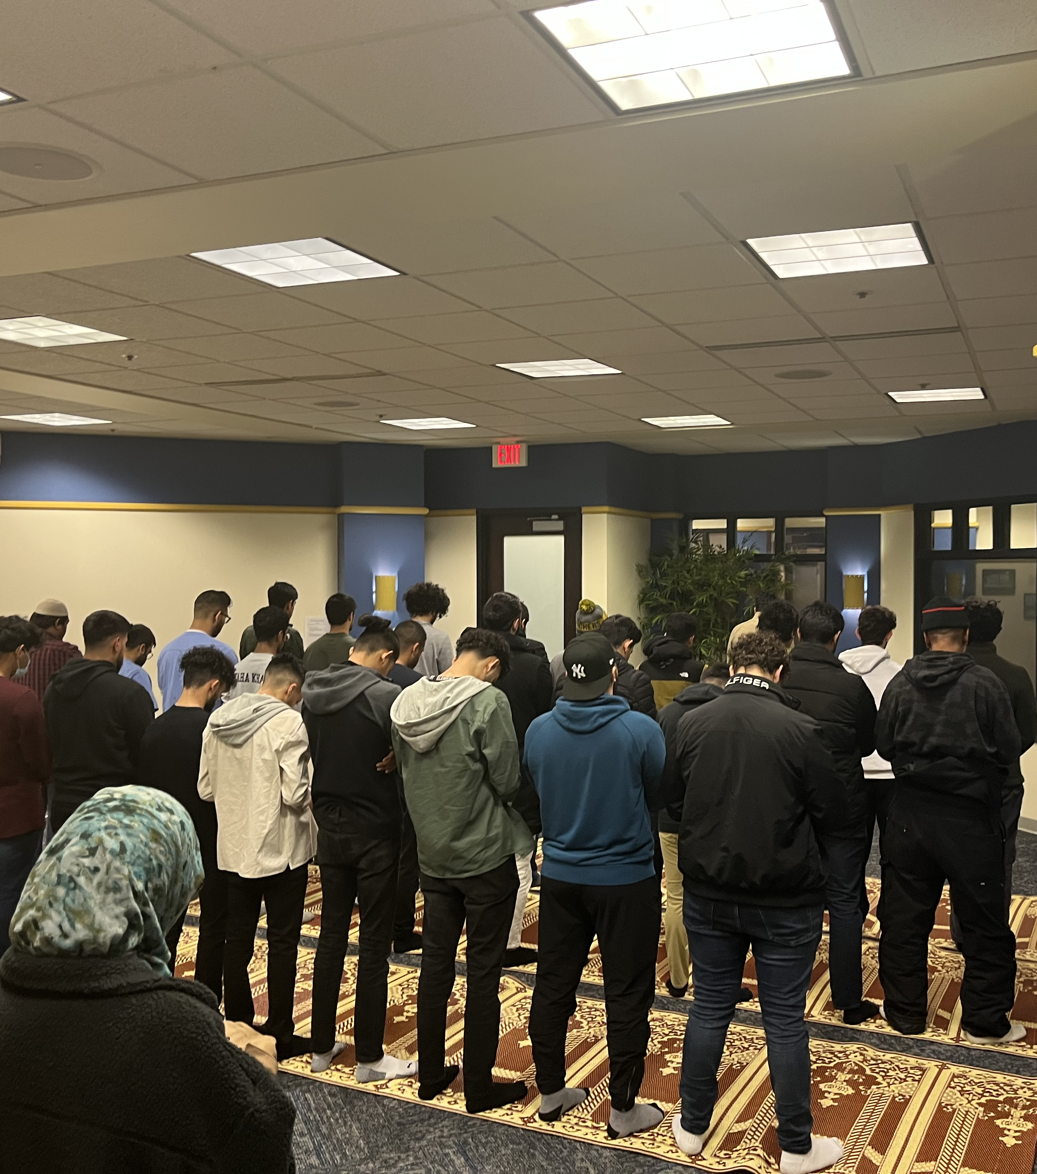
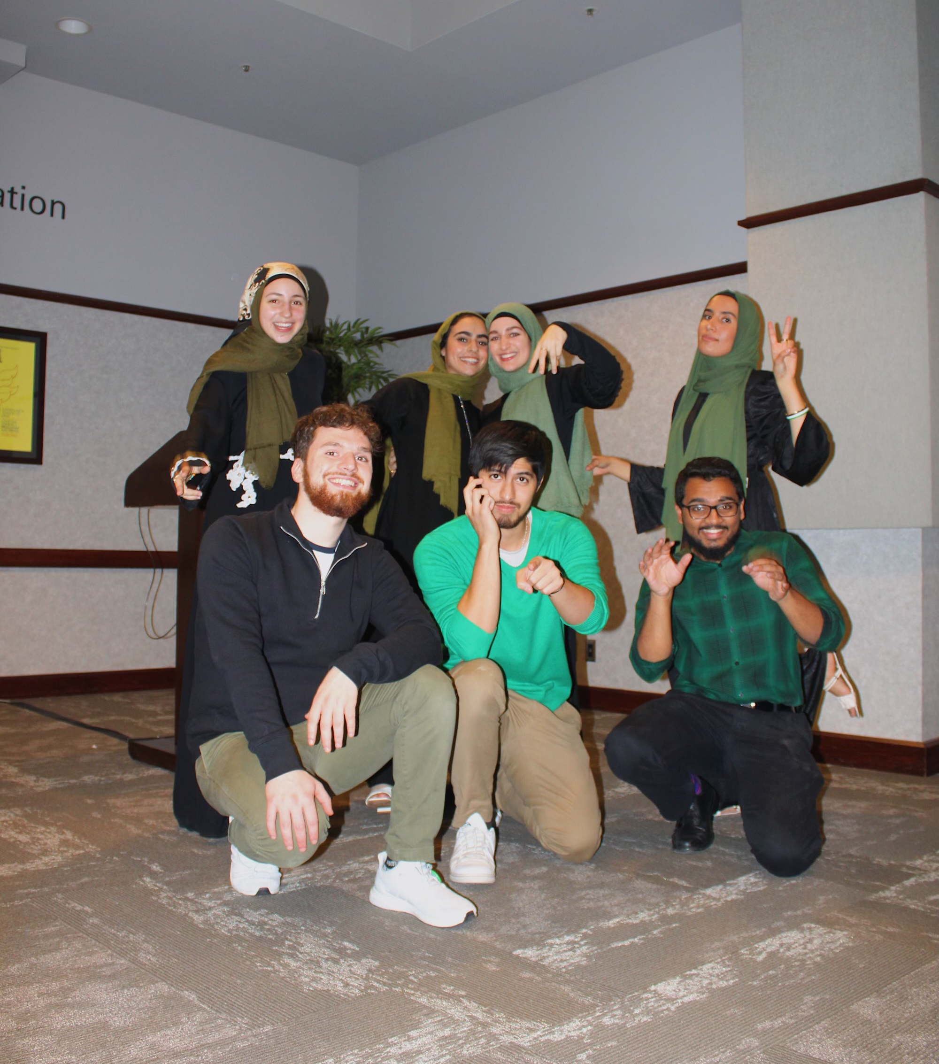
Our Experience at MU
Notes:
Dana – MSA, prayer room
Lojain - POC experience , 10 students,
Lets all take a few moments to think of a time where you felt like you did not belong, a time where you felt different then the majority. PAUSE 10 SECONDS

Slide 6
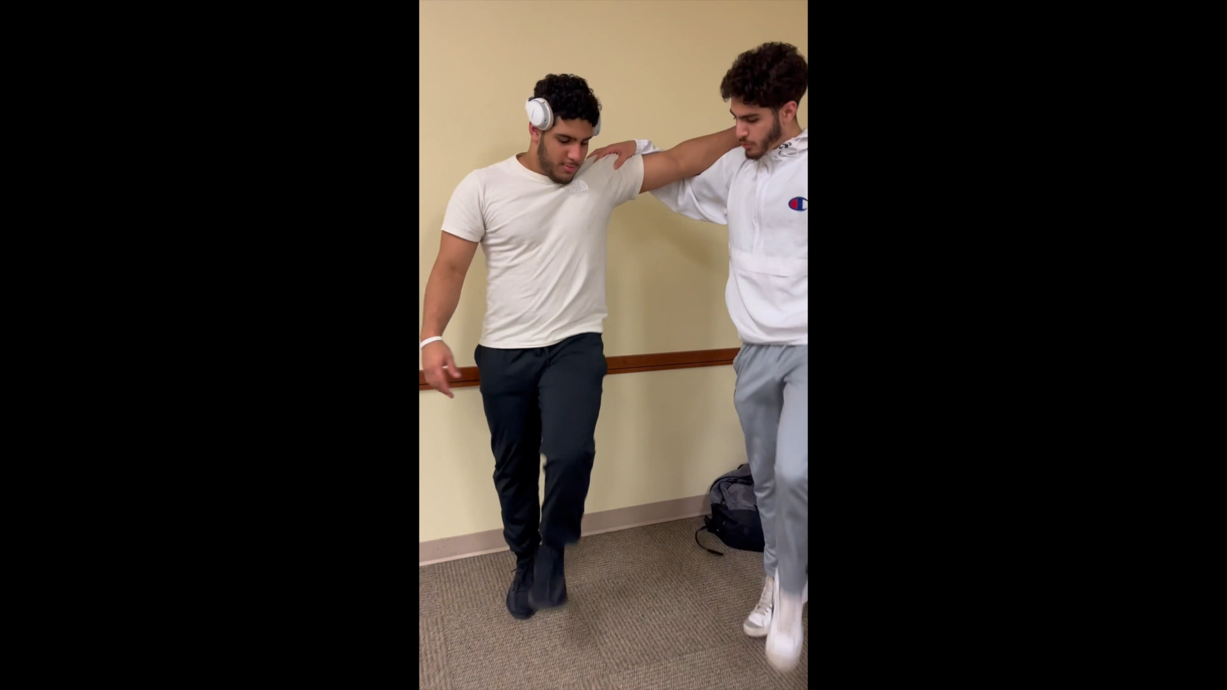

Slide 7
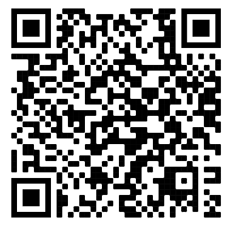
Thank You!
Notes:
Lojain - We would like to thank campus minstrity for giving us the room to talk about our experiences.
Dana - QR for petition

