Slide 1
Information for Prospective Psychology Majors

Slide 2
Question: Should you become a psychology major?
Answer: Of course you should!

Slide 3
Careers Related to Psychology
Bachelor’s degree
  human services, health care
  research
  sales and marketing
  state or local rehabilitation and social service agencies
  civil service
  human resources

Slide 4
Careers Related to Psychology
Master’s degree required
  social work
  mental health counseling
  marriage and family therapy
  academic counseling
  art or music therapy
  vocational rehabilitation counseling
  college counseling, college guidance

Slide 5
Careers Related to Psychology
Doctoral degree
  clinical or counseling (Ph.D., Psy.D., Ed.D.)
  neuropsychology
  forensic psychology
  research and academic careers in experimental psychology (e.g., statistics, research methods, developmental psychology, cognitive psychology, social psychology, developmental psychology, neuroscience, comparative psychology)

Slide 6
The Psychology Major Curriculum
38 credit hours
  3 required courses taken by all majors (11 credit hours)
  6 Courses from each of the 5 psychology content areas (18 credit hours)
  3 elective psychology courses
Students interested in independent research should consider Honors in Psychology their Senior year
Students should be thinking about courses and experiences that enrich their major
  Research with a Professor (can get course credit)
  Internship/Field Experience (can get course credit)
  Volunteering
  Service Learning in your courses
  Engagement with the Education Preparedness Program or On Your Marq Neurodiversity Support programs (as peer mentors, volunteers)

Slide 7
The Psychology Major Curriculum
Courses Taken by All Majors (11 credits)
PSYC 1001. General Psychology (or AP equivalent) (3)
Math 1700/Psyc 1700. Psychological Measurements and Statistics and Lab (4)
  Or Math/Psyc 1700H Honors Psychological Measurements and Statistics (4)
PSYC 2050. Research Methods and Designs in Psychology (4)
  Or PSYC 2050H Honors Research Methods and Designs in Psychology (4)
  2050H required to graduate with honors in psychology

Slide 8
The Psychology Major Curriculum
6 courses in each of the five content areas, with at least one in each (18 credits)
Development (1 course)
  PSYC 3101. Developmental Psychology: Conception Through Adolescence
  PSYC 3120. Developmental Psychology: Adulthood and Aging
Social Processes (1 course)
  PSYC 3201. Introductory Social Psychology
  PSYC 3230. Business and Organizational Psychology
Neurocognitive Foundations (2 courses)
  PSYC 3320. Cognition
  PSYC 4330. Human Factors Engineering
  PSYC 3601. Biopsychology

Slide 9
The Psychology Major Curriculum
Personal Processes (1 course)
  PSYC 3401. Abnormal Psychology
  PSYC 3501. Theories of Personality
Diversity and Inclusion (1 course): examples:
  PSYC 3210. Psychology of Prejudice
  PSYC 3220. Human Sexuality
  PSYC 3240. Psychology of Racism
  PSYC 3430. Psychology of Gender and Health
  PSYC 3440. Health Disparities
  PSYC 3550. Psychology of Gender Roles

Slide 10
The Psychology Major Curriculum
Elective Courses Examples (3 courses/9 credits; can include Content Area additional courses)
  PSYC 3410. Childhood Psychopathology
  PSYC 3420. Health Psychology
  PSYC 3560. Psychology of Religion
  PSYC 3701. Principles of Psychological Testing
  PSYC 3840. Psychology of Happiness
  PSYC 4701. Introduction to Clinical Psychology
  PSYC 4720. Psychology of Marriage and Family

Slide 11
Career Goals and Coursework
Psychology and the Health Professions
Popular major among premed students (as likely to be admitted to medical school as biology or chemistry majors)
PSYC 3420 (Health Psychology)
PSYC 3601(Biopsychology)
PSYC 3650 (Affective Neuroscience)
PSYC 3101 or 3120 (Development)

Slide 12
Career Goals and Coursework
Psychology and Law
One of many undergraduate majors chosen by pre-law students
Cognition (PSYC 3320)
Development (PSYC 3101)
Social Psychology (PSYC 3201)
Prejudice (PSYC 3210)

Slide 13
Career Goals and Coursework
Psychology and Business/Management
Students interested in business typically enter the work force after BA (may later get MBA)
Cognition (PSYC 3320)
Social Psychology (PSYC 3201)
Data analysis (Math/PSYC 1700)
Research methods (PSYC 2050).
Business and Organizational Psychology (PSYC 3230)
Human Factors in Engineering (PSYC 4330)

Slide 14
Career Goals and Coursework
Social Services and Clinical/Counseling
Clinical psychology, counseling, social work
Psychopathology (PSYC 3401 and 3410)
Clinical Psychology (PSYC 4701)
Psychology of Marriage and Family (PSYC 4720)
Biopsychology or Neuroscience (PSYC 3601 and PSYC 3650)

Slide 15
Declaring a Psychology Major
Declaration of Major form on Checkmarq
Students will meet with Arts and Sciences College advisor for freshman and sophomore years; with psychology faculty member junior and senior years
Advising Center (AC) and Department work together closely

Slide 16
The Importance of Practical Experience in Research or in Professional Placements

Slide 17
Research Opportunities for Psychology Majors
Especially important for applying to a Ph.D. program
  Research is heavily emphasized in these programs
Majors can satisfy up to 6 credits (of the 38 required) through research experiences in a faculty member’s lab
If interested in research, review faculty members’ web pages
  Send an email of introduction expressing interest

Slide 18
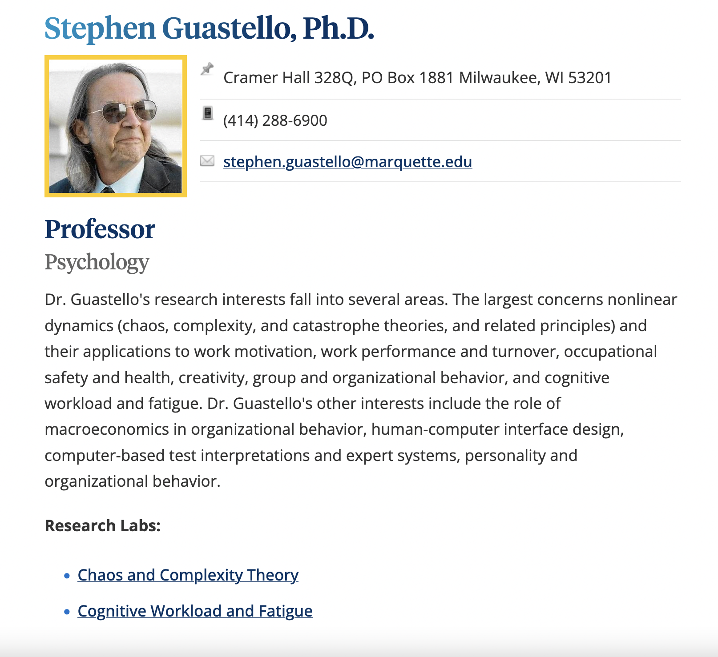

Slide 19
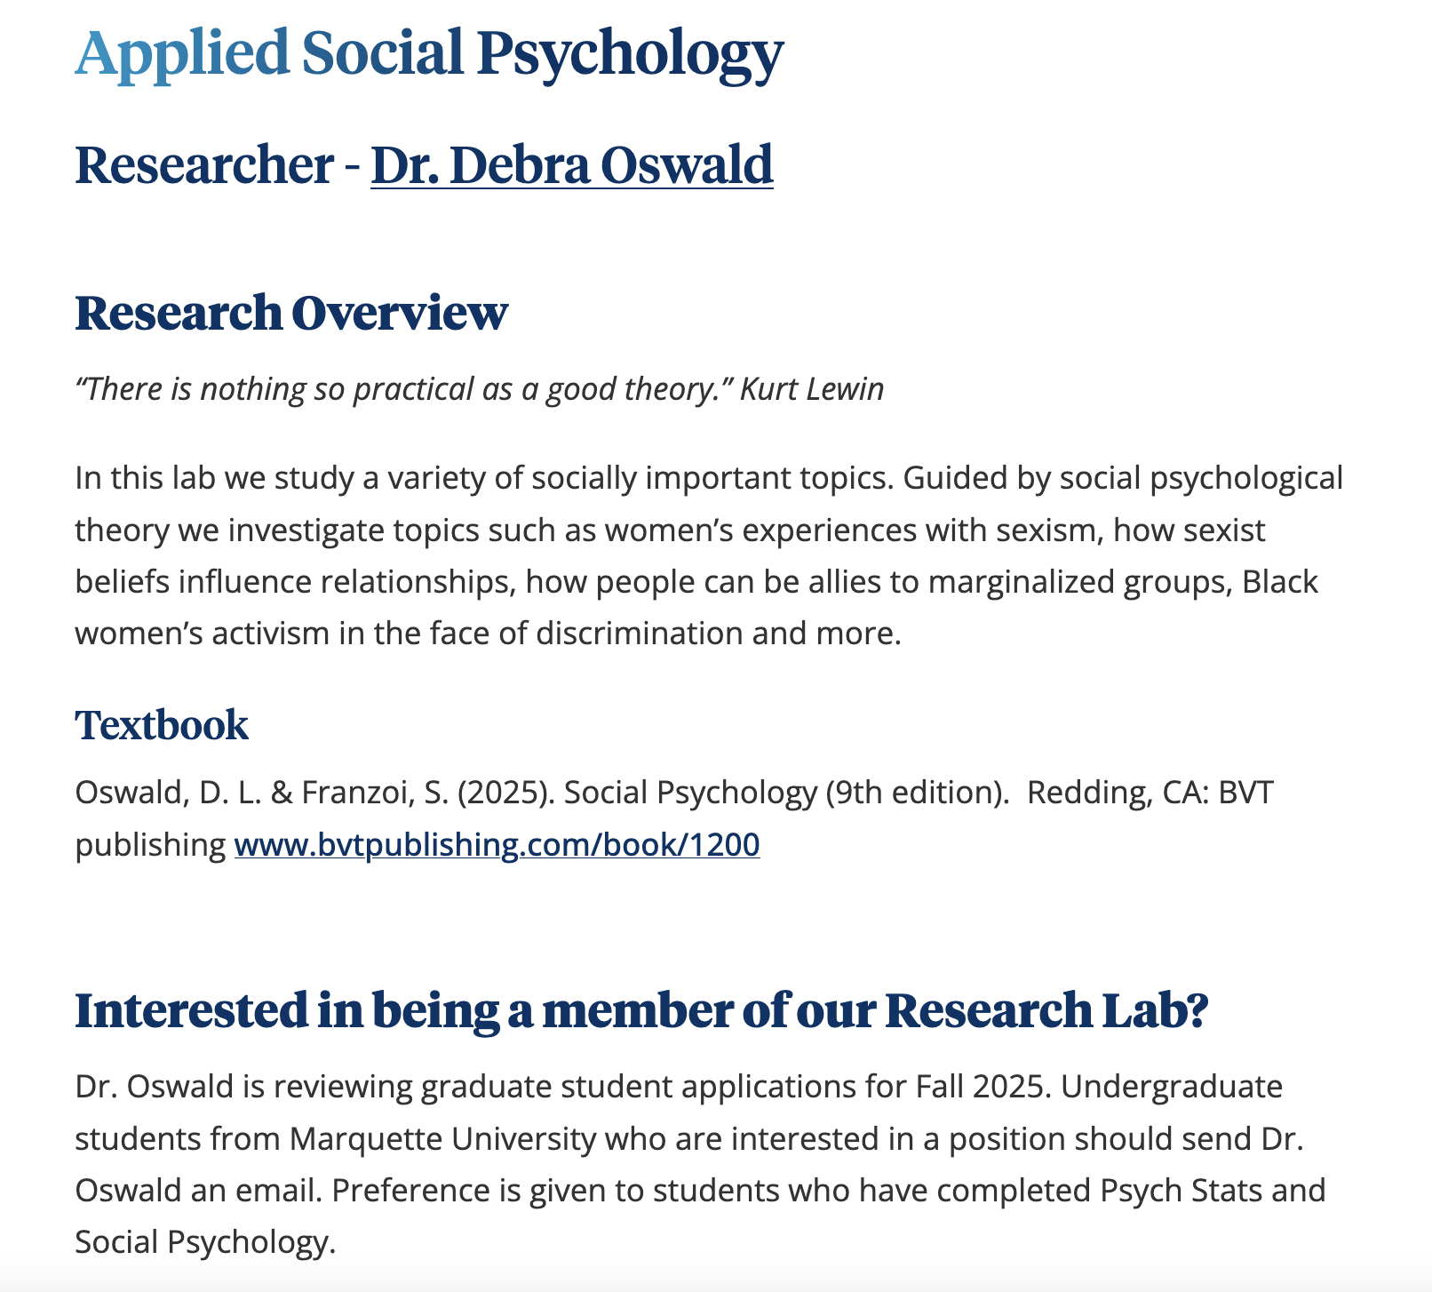

Slide 20
Field Experience (a.k.a. “internships”) in Psychology
Practical, real-life experience, organized experiences with various agencies in the Milwaukee area
  PSYC 4964. Field Experience in Psychology
  Can take it for up to 6 credits
  College has an internship office (http://www.marquette.edu/arts-sciences/internship/index.php)

Slide 21
Honors in Psychology
Opportunity to plan, carry out, and report results of an independent, collaborative research project (completed over the student’s last year).
Requirements
Cumulative GPA of 3.0 or better
Take PSYC 2050H Honors Research Methods (not 2050)
Reach out to faculty member
Students do not need to be in the Core Honors Program to apply
Research Experience (once enrolled)
PSYC 4954H: Honors Psychology Research Seminar (2 credits; 2 semesters = 4 credits)
PSYC 4956H: Honors Advanced Undergraduate Research (1 credit; 2 semesters = 2 credits)

