Slide 1

How To Log Impacts on MUEngage
Notes:
This powerpoint will walk you through how to log your impacts on MU Engage.

Slide 2
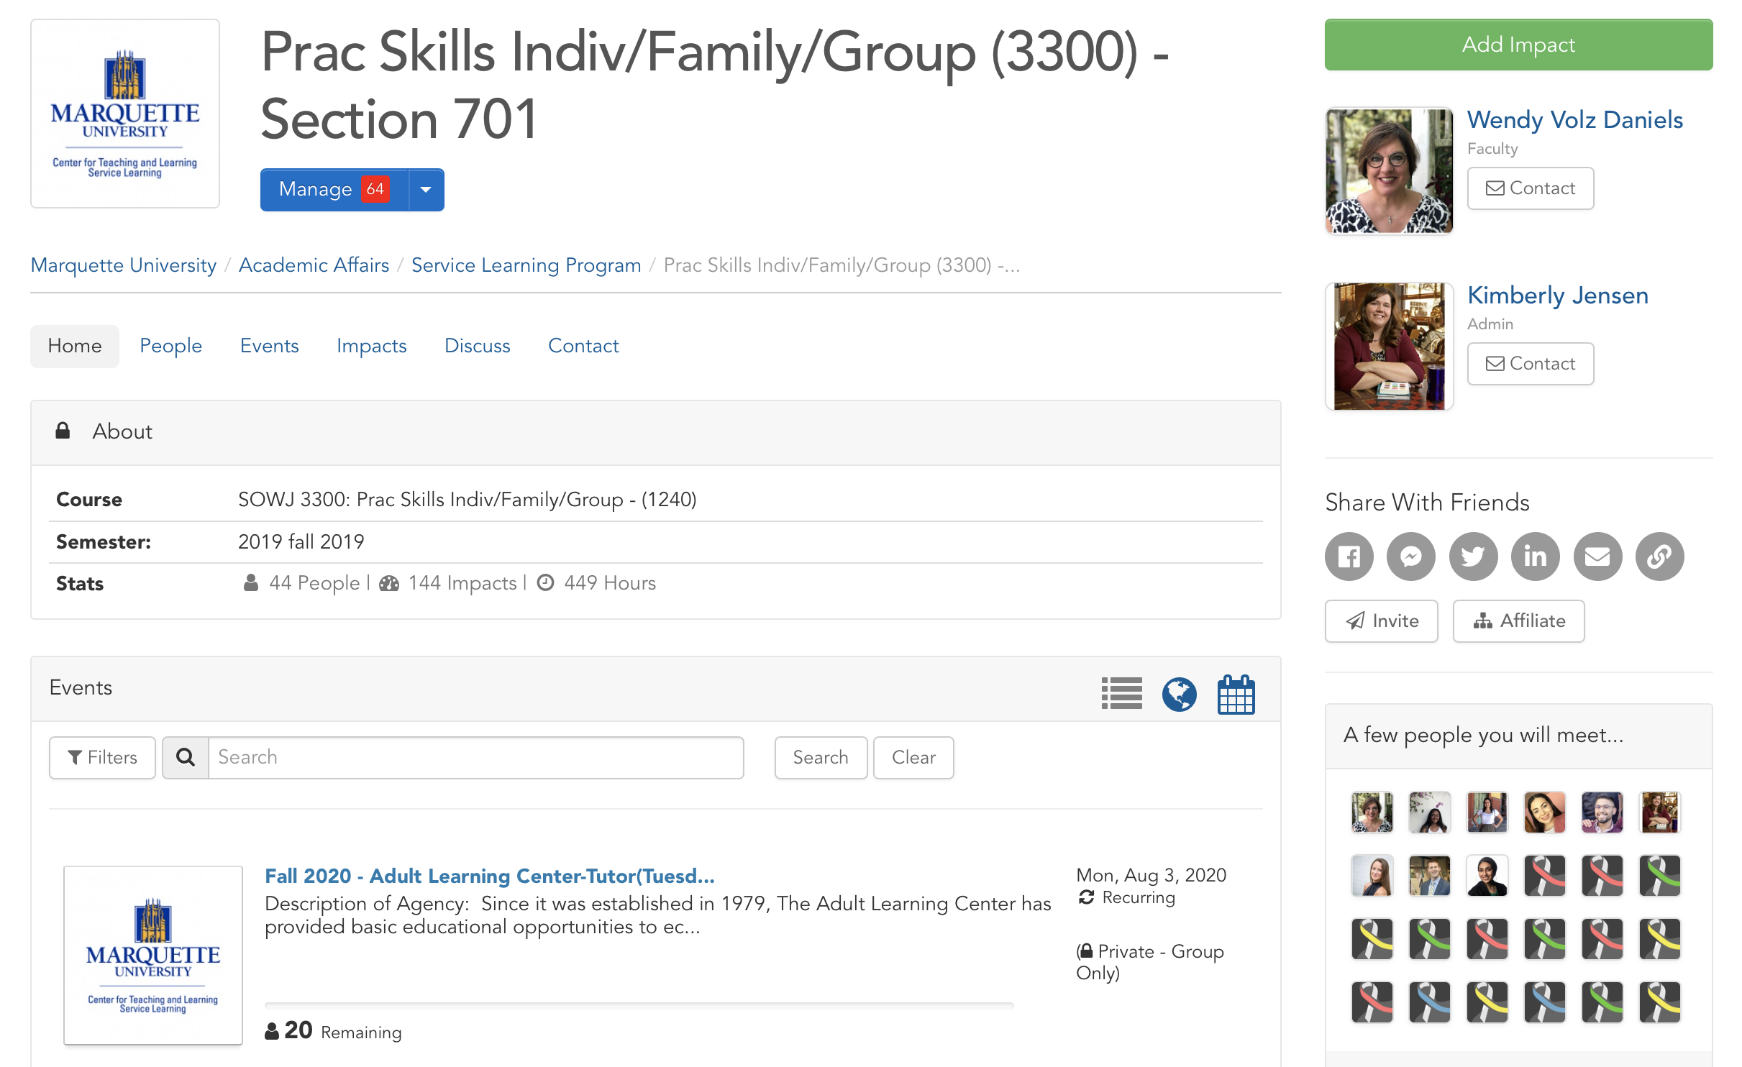
How to Add Impacts:
Option 1
Notes:
To have your service hours count, you must record them on MU Engage. On MUEngage, we call these service hours “Impacts.” To record your impacts, start by logging into your MUEngage account. There are two ways you can add your impact:
The first option is to go to your service learning course group. You should see a green ADD IMPACT on the right side of the screen.

Slide 3
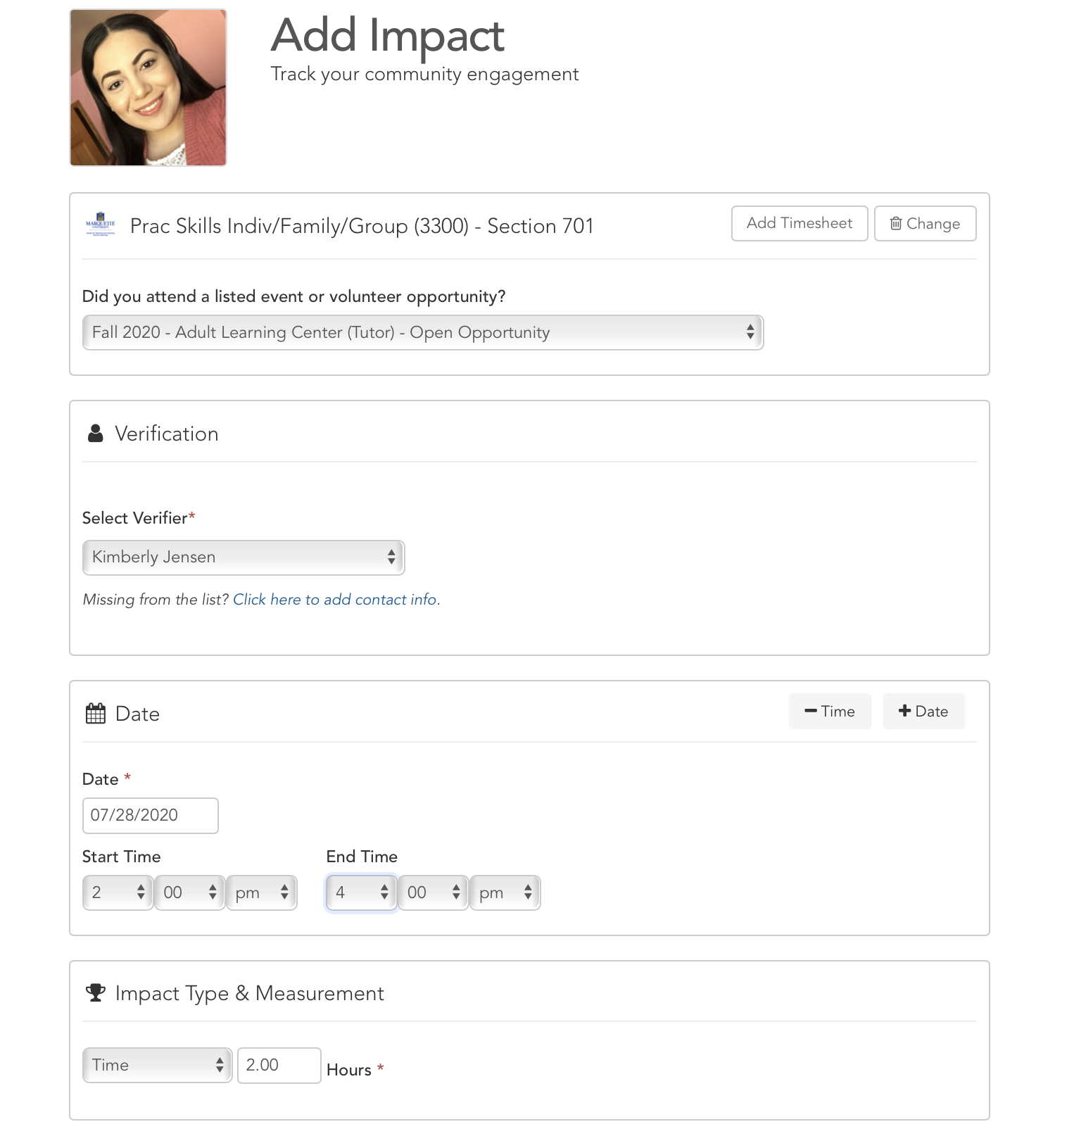
How to Add Impacts:
Option 1
Notes:
After you click ADD IMPACT, you must fill out the correct information. One of the most important parts of entering your hours is ensuring that you have listed the correct verifier. The verifier is the person who will verify with the organization that you completed your service. In the Select Verifier section, choose your Student Coordinator as the verifier. The Service Learning Program can only verify hours for event templates created by a staff person from the Service Learning Program. If you don’t know who your Student Coordinator is, contact the Service Learning Program office at servicelearning@marquette.edu

Slide 4
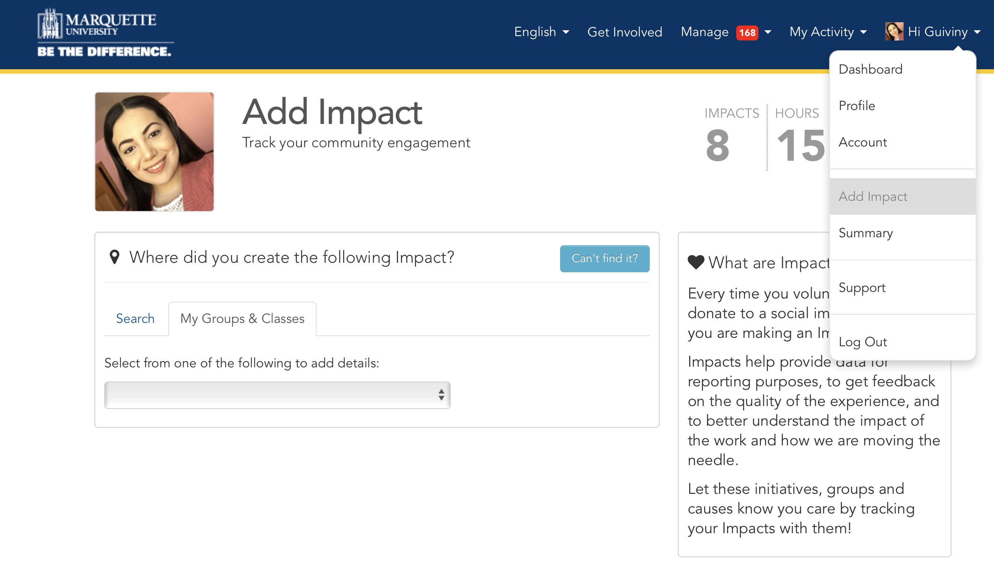
How to Add Impacts: Option 2
Notes:
Another way that you can add impacts is to scroll over to your name and click the tab that says “Add Impact.”

Slide 5
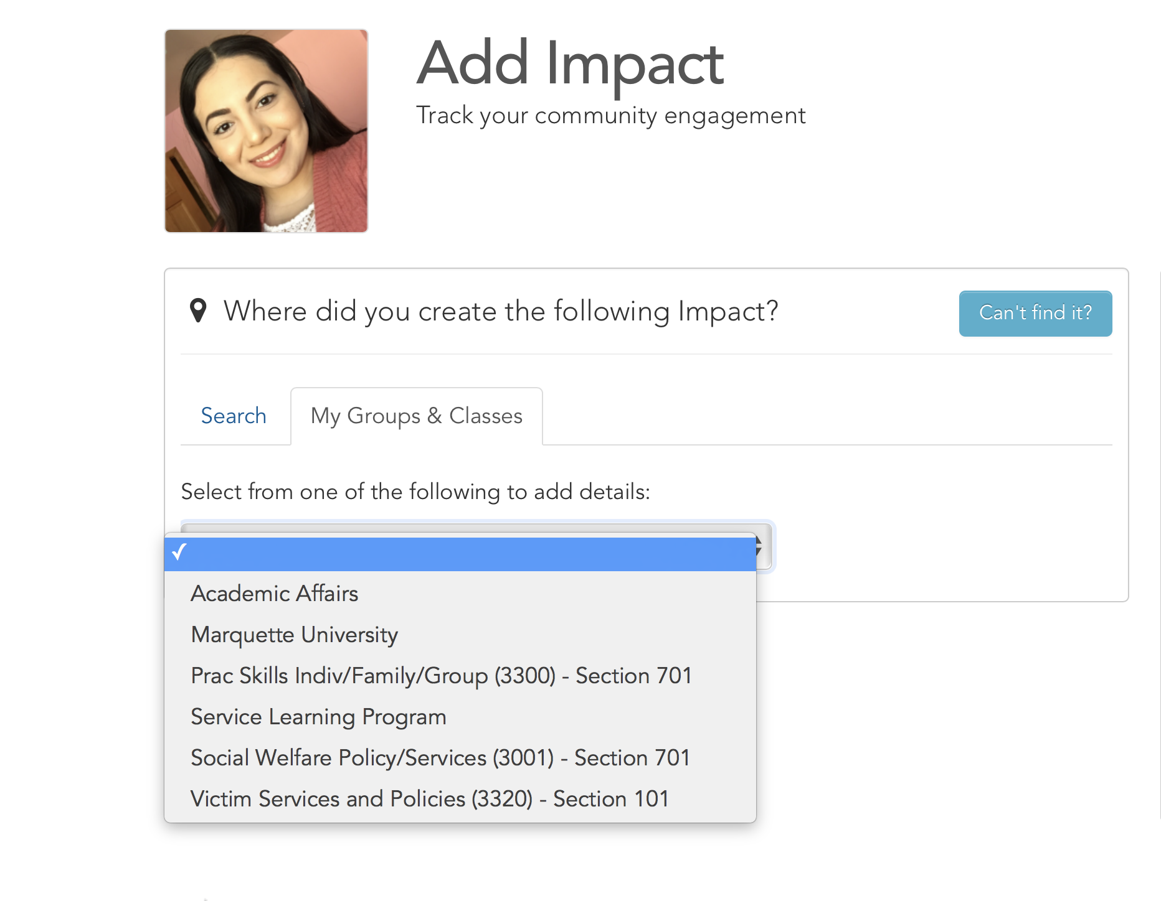
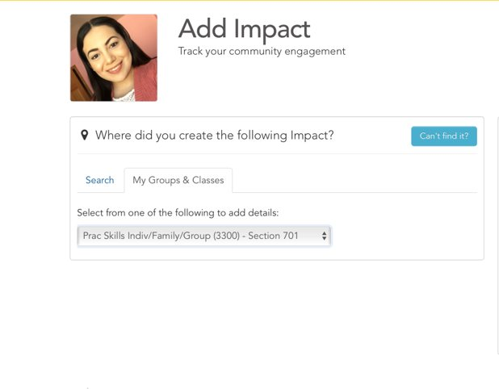
How to Add Impacts:
Option 2
Notes:
In the dropdown menu, select the course that you are completing your service learning hours for.

Slide 6
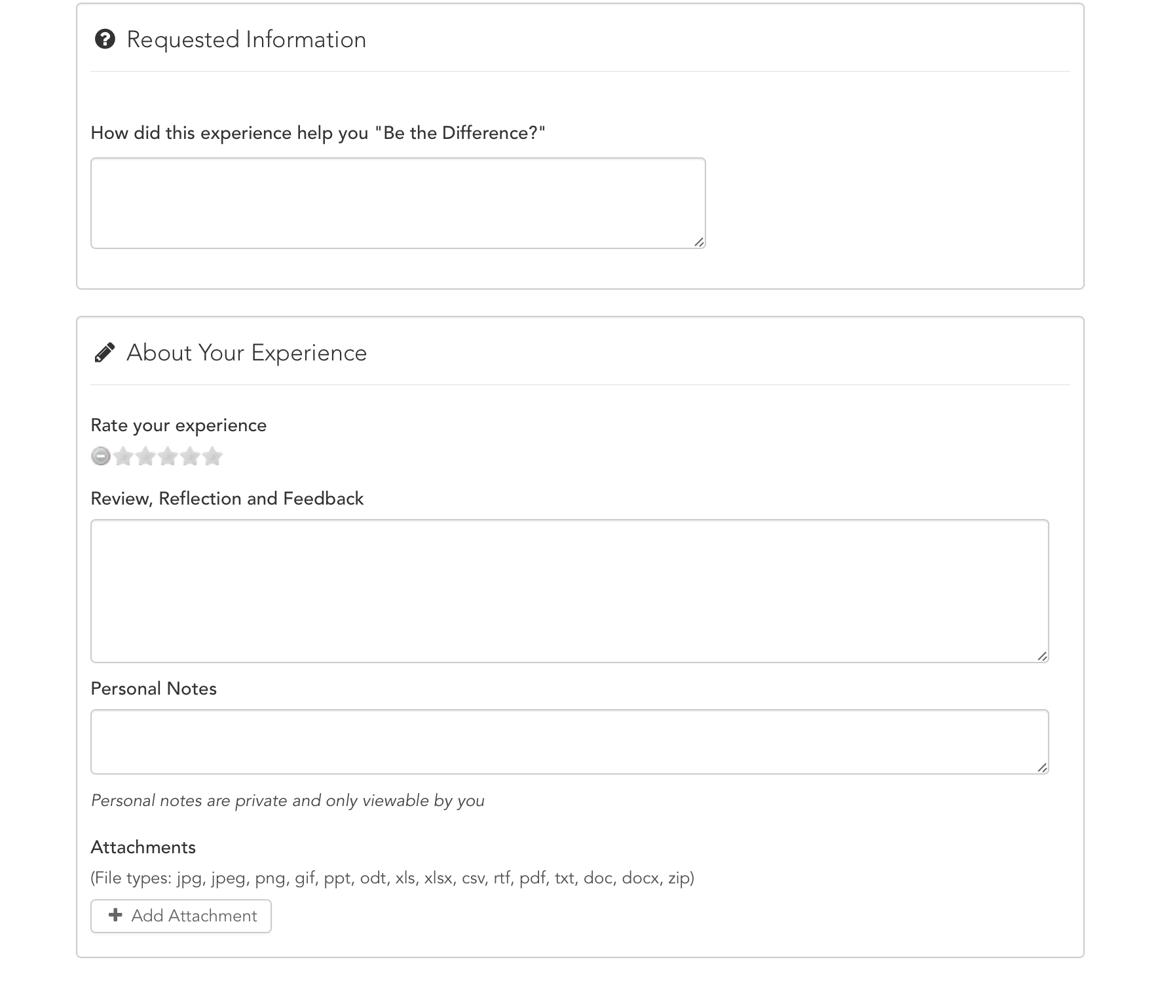
How to Add Impacts: ​
Option 2​
Notes:
You are then asked where you created the impact, meaning where you completed your service learning hours. You can use the search bar to find the site where you completed service, or you can select from a list of groups you’re already a part of.
Like I said before, one of the most important parts of entering your hours is ensuring that you have listed the correct verifier. Be sure to choose your Student Coordinator as the verifier.
Once you’ve selected your service learning organization, enter the number of hours and day you completed service.
You can also choose to type out a reflection on your experience, which may help you to process your experiences and could help in class projects; however, the additional information is not necessary to complete.

Slide 7
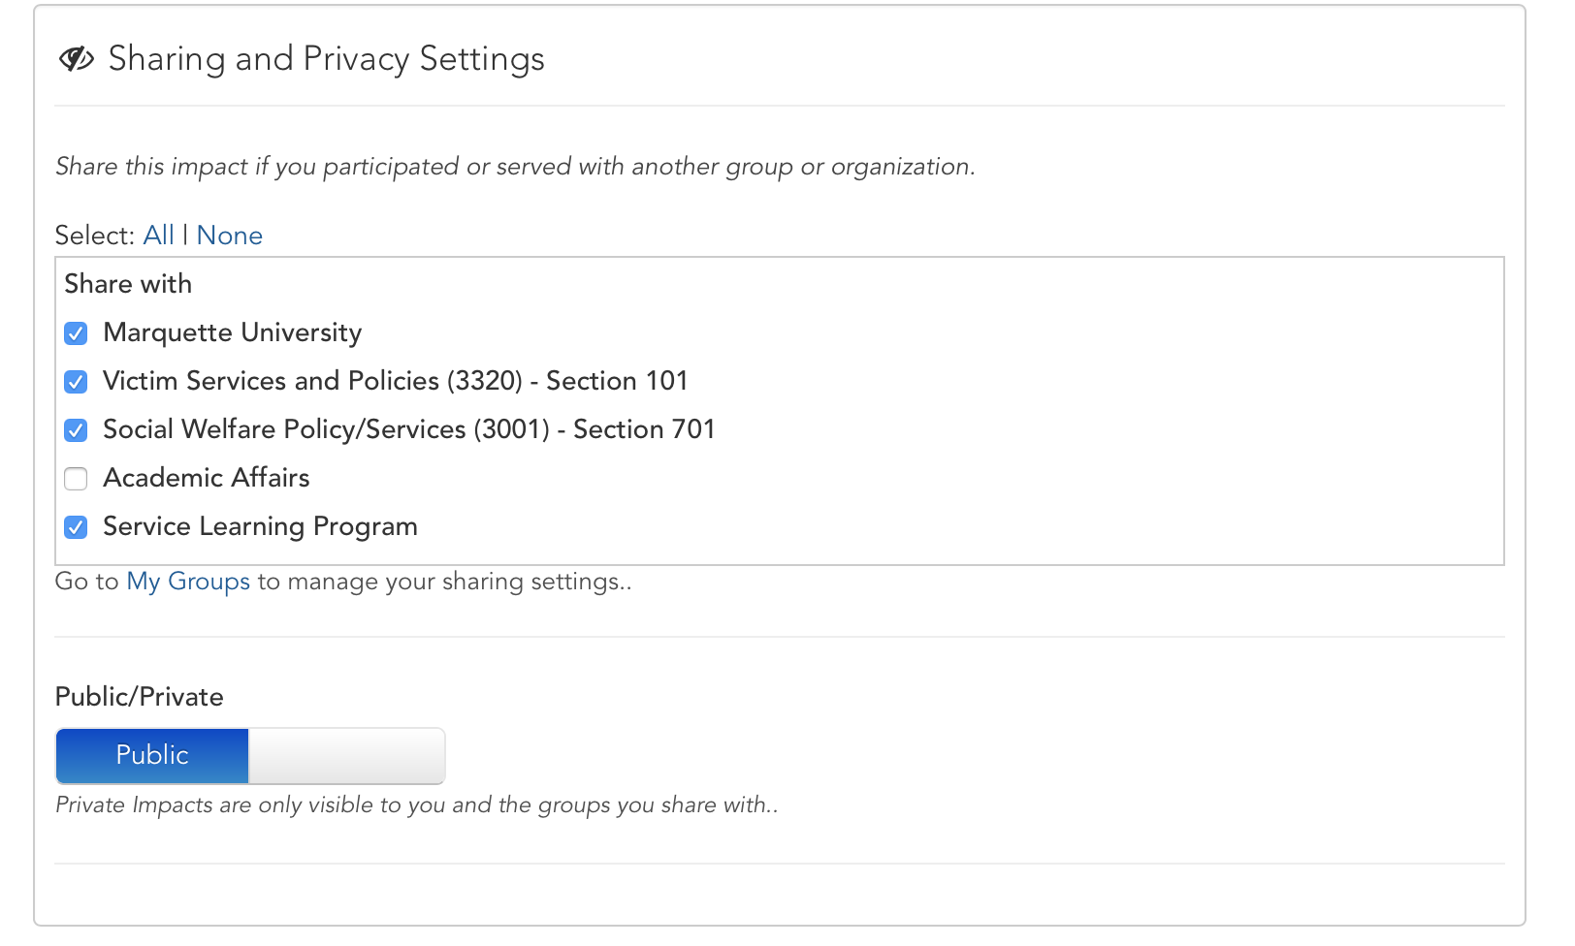
Multiple Service Learning Courses
Notes:
If you are taking more than one service learning course, in the SHARING AND PRIVACY SETTINGS section, make sure you share the impact with your other service learning course. If you do not share the hours with your service learning course, your professor will not see your service learning hours.

Slide 8
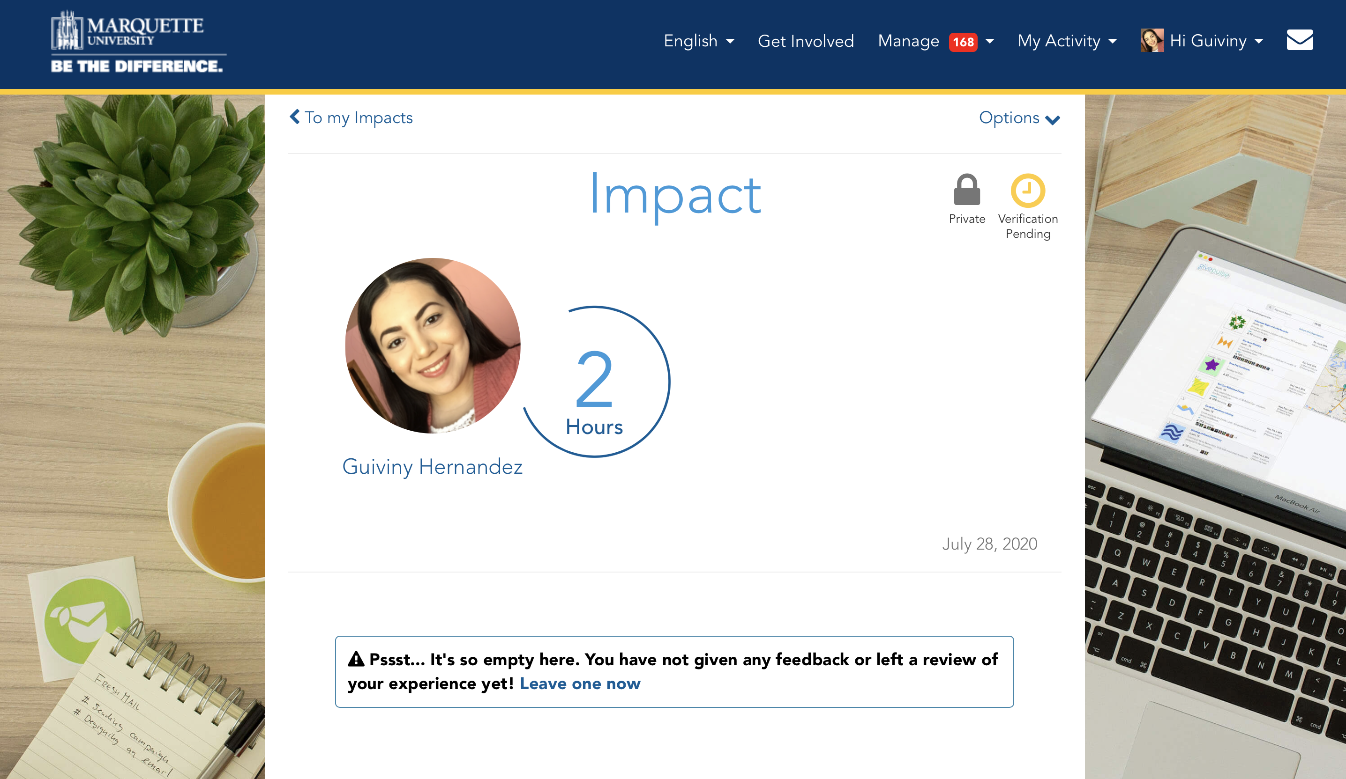
Confirmation
Notes:
Once you are finished filling out the correct information, click Add Impact. The Student Coordinator will confirm your attendance with your site, then verify the Impact.

Slide 9
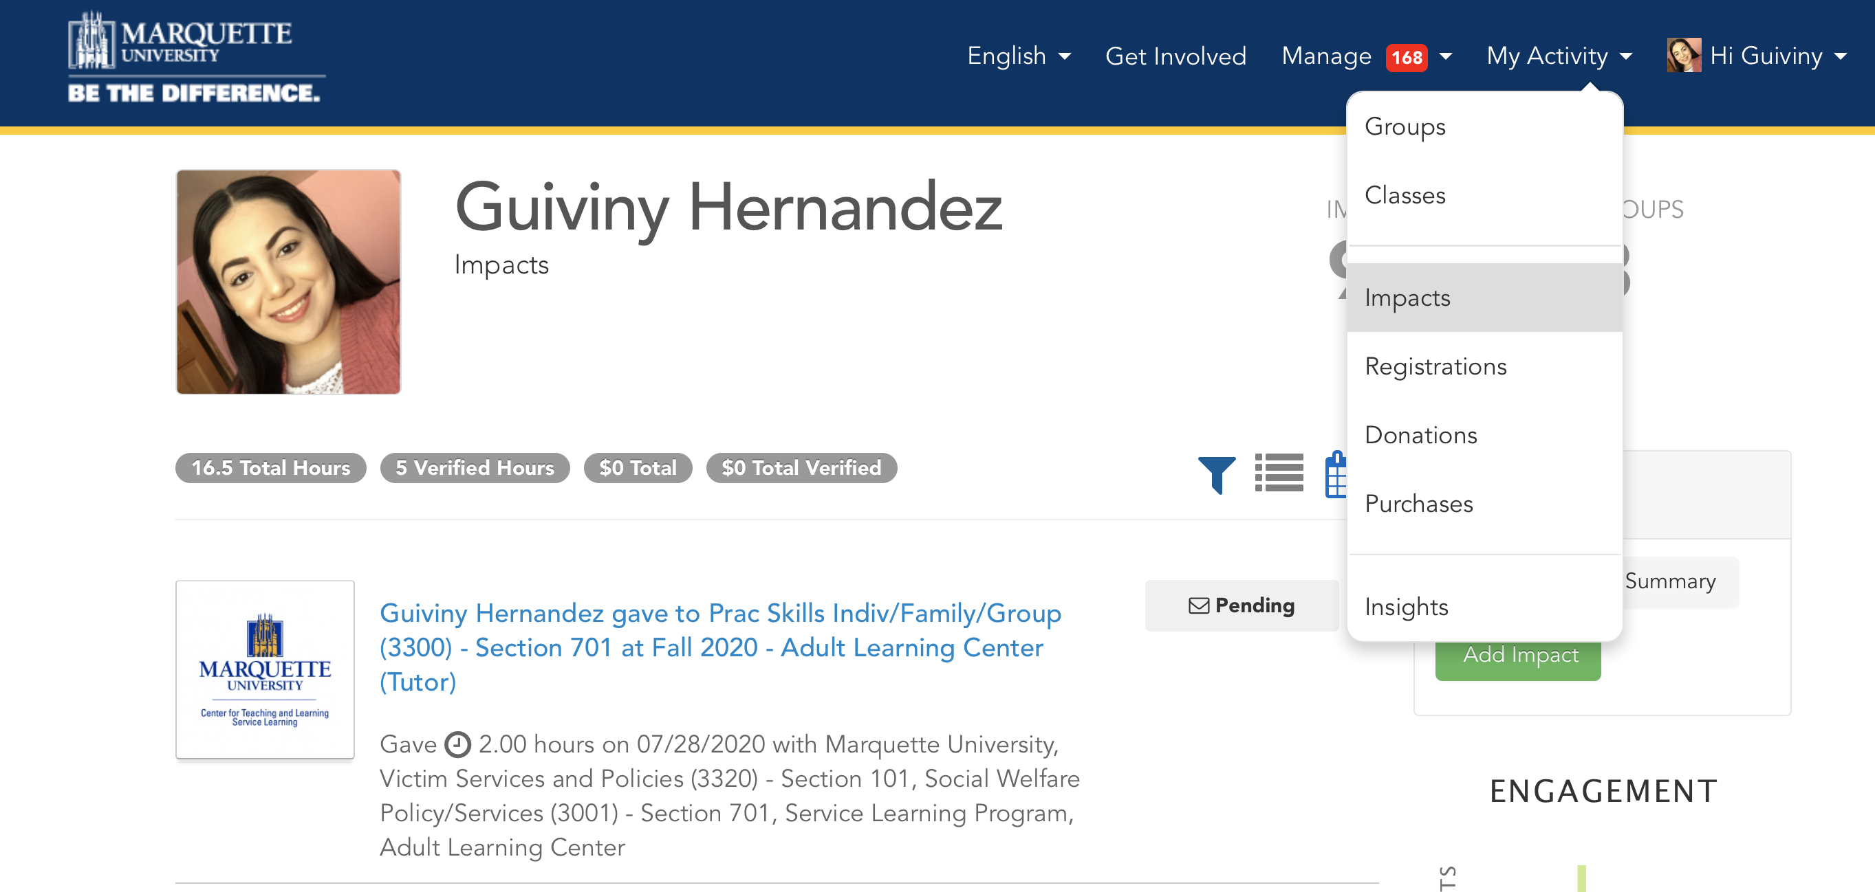
Editing Impacts
Notes:
If you mistakenly entered the wrong amount of impact hours or need to update your impacts, you can edit this change yourself. Go to the impacts on the dropdown under your name.

Slide 10
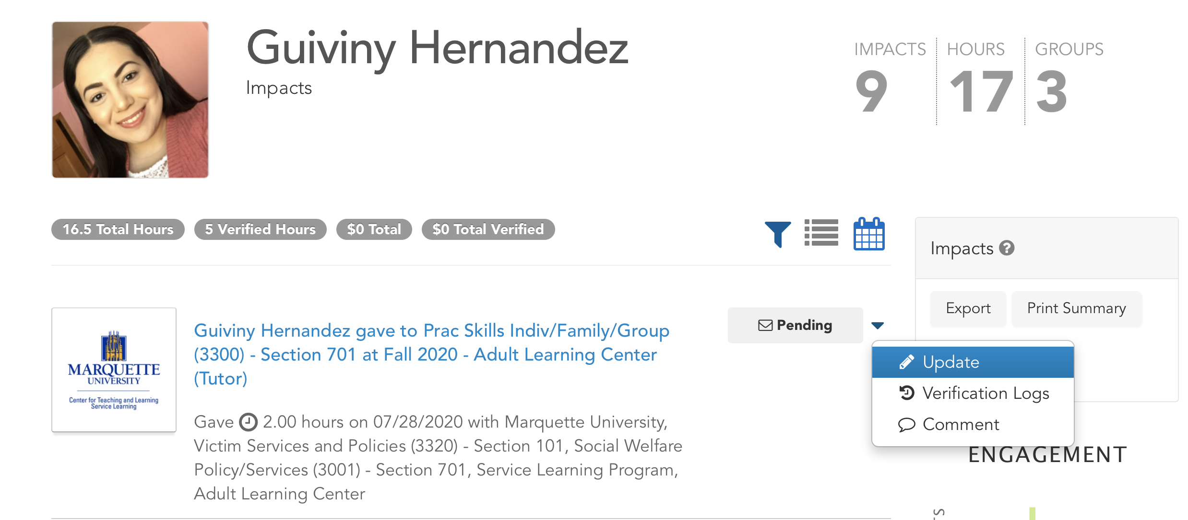
Editing Impacts
Notes:
Find the impact that you need to change, and on the right side, there will be a dropdown arrow. Go to the tab that says “Update.” From there, you can make any changes you need, or you can scroll to the bottom of the page to delete the impact, using the red “delete” button.

Slide 11
Reminders/Additional Info
Log/Record Impact Hours in MUEngage after each visit to your site. Don’t wait until the end of the semester
Submit Hours Timesheet to get hours verified in MUEngage
We will not log impacts for you!
2+ Service Learning Courses? Make sure you share your impacts​
Other Volunteer Management System
Notes:
Log Impact Hours (i.e. Service Learning hours)
You must record all your impacts (service learning hours) on MUEngage. Instructions on how to do this are on the service learning website. I encourage you to record impacts every week. If you don’t record impacts, your professor will not see the hours you completed.
Verification of Impacts (Hours)
All hours are verified. Don’t wait until to last minute to record impacts because you will need to wait until they are verified before you professor sees you completed the hours.
You must now log/record impacts in MUEngage AND submit an Hours Timesheet to get your hours verified on MUEngage. Your Student Coordinator will send you an Hours Timesheet via email when you register for service learning.
Manually Enter Your Hours
Do not wait until the last week to enter your hours. You must enter your hours every week. MUEngage will send you reminder to do this. You can even download the Give Pulse App and log impact hours on the mobile app.
Two or More Service Learning Courses?
For registration, pick a site from one of your courses and just get verbal approval from your other professor
If you have two or more service learning courses, log your hours in one course and make sure you share those impacts with your other course (instructions on how to do this is in the Instructional Guide).
Other Volunteer Management Systems
Keep in mind that community partners also have their own volunteer management systems. So you may find yourself recording impacts in MUEngage and still logging in volunteer hours with your site placement (for example, if you volunteer at an MPS school). At the end of the semester, you can email a printout of your logged hours to your Student Coordinator and that can serve as verification of your service learning hours in MUEngage.

Slide 12
Need more help? Check out more resources on our website!
https://www.marquette.edu/service-learning/muengage.php
Email us: servicelearning@marquette.edu
Notes:
You can also find all this information in the student MUEngage guide that is on our website. It is linked below in the description, and if you find yourself struggling with anything, please consult the guide before reaching out to our office. If you still do have questions, however, after watching this video and reading through the guide, please feel free to reach out to us at servicelearning@marquette.edu.

