Slide 1



MARQUETTE UNIVERSITY
SERVICE LEARNING PROGRAM

Slide 2
What is service learning? | Service learning allows students to engage with community-based organizations that directly relate to their academic coursework, creating a space for students to integrate classroom knowledge with practical experience to grow both their understanding and application of their course
Where do you participate in service learning? | Service learning can take place in various settings, including local communities, nonprofit organizations, schools, and other community-based agencies. We partner with a range of community organizations to provide students with diverse and impactful service opportunities in Milwaukee.
What is the purpose of service learning? | The primary focus of Marquette's Service Learning Program is the learning aspect. While the service provided should benefit the community agencies, the program prioritizes placing students in roles where they can directly experience, observe, and practice the concepts they are learning in the classroom. This approach ensures that students gain significant educational value from their service experiences to engage in activities that enrich their academic, professional, and personal growth.
What do you gain from service learning? | Academic Enhancement: Deepens understanding of course material by applying it in real-world contexts. Skill Development: Builds critical skills such as leadership, teamwork, problem-solving, and communication. Personal Growth: Encourages self-discovery and personal development. Civic Engagement: Fosters a sense of social responsibility and commitment to community service. Career Preparation: Provides practical experience and networking opportunities that are valuable for future career paths.

Slide 3
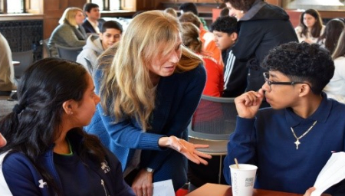
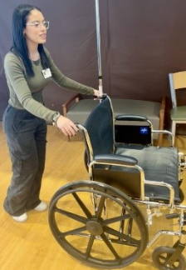
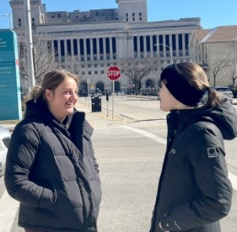
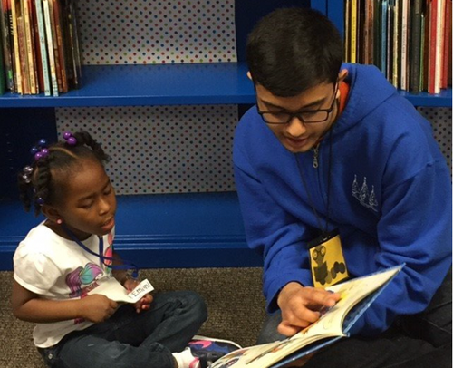
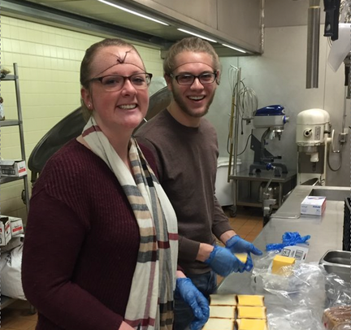
OUR EXPECTATIONS
  Commit to 18-20 hours of service over the semester (approximately 2-3 hours per week).
  Ensure your participation spans the entire semester, even if you fulfill your hours early.
  Align your actions with course objectives; seek guidance from your professor or site contact if you’re struggling to make connections.
  Uphold site expectations, ensuring appropriate dress and completion of mandatory training or checks.

Slide 4

TRANSPORTATION
Marquette’s Resources
Personal Resources
Safety Resources
  Make use of the Umo Mobility app to help schedule your bus routes.
  Reach out to the Student Coordinators if you need help arranging carpools, setting up a bus buddy group, or walking group to your site.​
  You may use the EagleExpress but remember it does not travel outside the normal routes or times for service learning.​
  Students may use rideshare apps like Lyft or Uber if they are willing to spend their own money.
  Students may use various GPS systems to guide them to their service sites including Google Maps, RIDE MCTS, Apple Maps, etc.
  Always be aware of your surroundings.
  Watch the Service Learning Safety Video prior to your site orientation at: http://www.marquette.edu/servicelearning/safety.shtml
  MUPD Non-Emergency 414-288-6800​
  MUPD Emergency 414-288-1911​

Slide 5

REFLECTION SESSIONS
  Students may be required to attend one reflection session throughout the semester.
    Reflection sessions allow students to make sense of their interactions with others, understand the broader context of service. These sessions provide a space to connect our thoughts, feelings, and practical experiences, fostering a deeper understanding of ourselves and our community.

Slide 6
REFLECTION SESSION INFORMATION
Special Offering: Living Stories
  In celebration of Mission Week, join us for this interactive event that helps us think about our own stereotypes and implicit bias about people with different social identities than our own.
    Wednesday, February 3, 3:30-5:30pm AMU Monaghan Ballrooms
MKE 1001
  Learn about Milwaukee’s rich history and discover your role within the community through a documentary and discussion. This session aims to deepen your understanding of the city's strengths and challenges.
    Friday, February 6, 2:00-3:30pm, AMU Henke Lounge
    Thursday, February 12, 5:00-6:30pm AMU Lunda Room
Caring for Our Neighbors: Empathy versus pity
  Empathy is a powerful attribute and resource in community-engaged work. But empathy is something much different than sympathy or pity. Together we will unpack the difference and think about how we can demonstrate compassion to people who are struggling, without being paternalistic or saviors.
    Tuesday, February 24, 2:30-4:00pm AMU Lunda Room
    Thursday, October 9, 9-10:30am, AMU Henke Room
Food for Today: Hunger, Food Access, and Poverty
Join us for this interactive session, conducted with support from our partners at the Hunger Task Force, as we learn what it takes to obtain “Food for Today” in this simulation activity about food insecurity.
    Wednesday, March 25, 9:00-10:30pm AMU 157
    Thursday, March 26, 3:00-4:30pm AMU 157
Is the Glass Half Full or Half Empty? Asset-Based Community Development
  Often when thinking about our communities we find ourselves in a deficit mode, thinking about what our communities and our community members don’t have or what is wrong. Join us as we reflect on engaging with Milwaukee through a strength-based approach.
    Wednesday, April 8, 12:00-1:30pm (VIRTUAL)
    Sunday, April 12, 3:00-4:30pm (VIRTUAL)
Impact of My Service Learning
  Service is full of power dynamics, and how we approach our work tends to dictate what we both give and take from the relationships we create in our service learning. What is our impact? How has this experience impacted us? What could you have done to make this experience more powerful? How has this experience changed your thinking, broadened your understandings, or inspired your future involvement in community?
    Thursday, April 16, 11:00-12:30pm, AMU 157
    Monday, April 10, 5:30-7:00pm, AMU Lunda Room
    Friday, April 24, 2:30-4:00pm, AMU Lunda Room

Slide 7

IMPORTANT DATES
  Registration opens January 21st at 12pm and ends January 28th at 5pm.
  Safe Environment Trainings are only required if serving at a Catholic institution or school. Check MUEngage for more information.
  Late registrations will need to meet with the Director or Assistant Director for placement. After February 20th, we will no longer be placing students.

Slide 8


LOGGING HOURS
  Log your impacts after each visit to your site.
  Make sure you log your impacts to ALL the correct places.
Ex: You logged at your site & logged under your t template on MUEngage.
​
  Hours will be verified twice during the semester- during midterms and finals. Ensure your hours are updated regularly, so your professors get an accurate report​.
  If you have multiple classes, share your impacts with all of your classes that require service learning. ​

Slide 9
INDEPENDENT VOLUNTEER AND CURRENT VOLUNTEER FORMS
Independent Placement Form | Students wishing to complete service learning at a organization that does not partner with the Service Learning Program.
Key Points | Check the Current Community Partner list to see if your organization partners with the Service Learning Submit the form to our office in order to log your hours for credit and submit a signed timesheet for verification. Both logging hours in MUEngage and submitting a timesheet are mandatory to receive credit. Timesheets must be submitted by the last week of classes. Professor must sign off on the form before it can be processed by our office Email the form to servicelearning@marquette.edu or turn it in in person at the 707 Building, Suite 303.
Current Volunteer Form | Students choosing to volunteer/continue volunteering at an organization that is partnered with the Service Learning Program
Key Points | Professor must sign off on the form before it can be processed by our office. Email the form to servicelearning@marquette.edu or turn it in in person at the 707 Building, Suite 303.

Slide 10
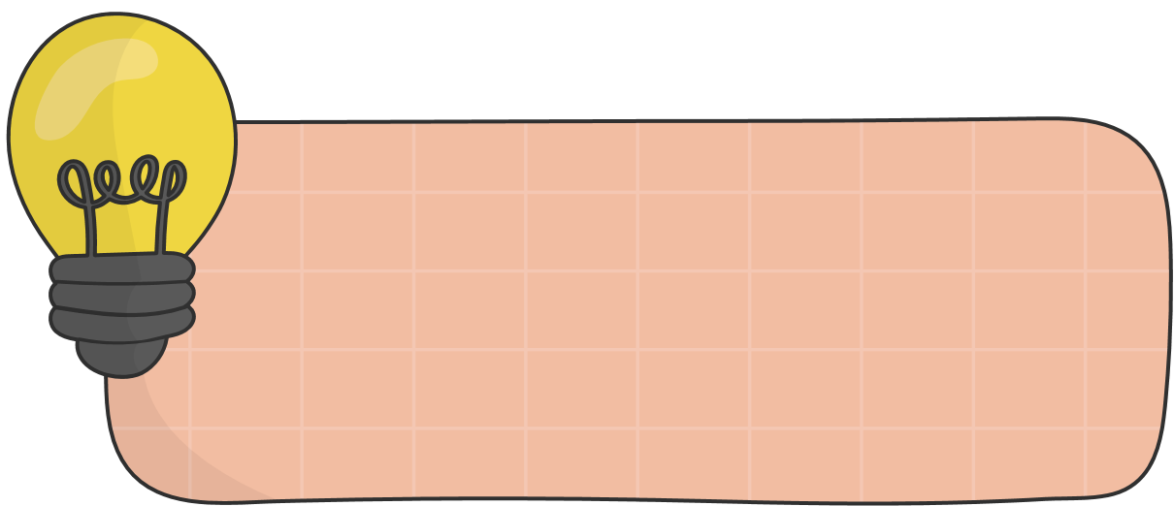







BEST PRACTICES FOR STUDENTS
CHECKING EMAILS DAILY
BUILDING RELATIONSHIPS
LIMITING PHONE USAGE
MAINTAINING A POSITIVE ATTITUDE
COMMUNICATING EFFECTIVELY
COLLABORATING WITH COMMUNITY PARTNERS
NOT ADOPTING A SAVIOR MENTALITY
DEMONSTRATING COMMITMENT AND ENGAGEMENT

Slide 11

STILL CONFUSED?
  Watch the instructional video on MUEngage on the Service Learning Website.​
  Reach out to the Service Learning staff with any questions as soon as possible​

Slide 12


NEED MORE INFO?
Instagram:
  @mu.servicelearning
General Email:
  servicelearning@marquette.edu
Phone Numbers:
  414-288-3262
  414-288-3264
Staff Contact Information:
  https://www.marquette.edu/service-learning/about-us.php

